Slide 1
Ensuring a thriving geoscience open education resource ecosystem: perspectives from 20 years at SERC
Sean Fox
Carleton College
December 14, 2022
Notes:
What do we mean by ecosystem
What characteristics of OER support the underlying ecosystem
And where is this ecosystem heading.
Could add ecosystem picture

Slide 2

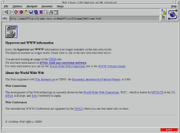

The term Open Education Resources (OER) was coined 20 years ago at the confluence of the early web and licensing ideas from the software and publishing worlds
+
=
*https://www.unesco.org/en/open-solutions/open-educational-resources
Notes:
OER: “learning, teaching and research materials in any format and medium that reside in the public domain or are under copyright that have been released under an open license, that permit no-cost access, re-use, re-purpose, adaptation and redistribution by others..”*
Low-cost, redistribution (i.e. the web) + licensing ideas from the software world (GPL, BSD et al.)
Parallel to other vectors in the Open Science realm, including Open Access (publications), and more recently Open Data (FAIR).
Earth Education community involved from the start.
E.g. DLESE (1999), SERC (2002)
UNESCO coined the term in 2002, MIT Open Courseware
Combined the free publishing made easy by the web with software licensing ideas, to address copyright concerns and especially to promote remixing
We see similar movement around open publishing (arXiv.org in 2001)

Slide 3
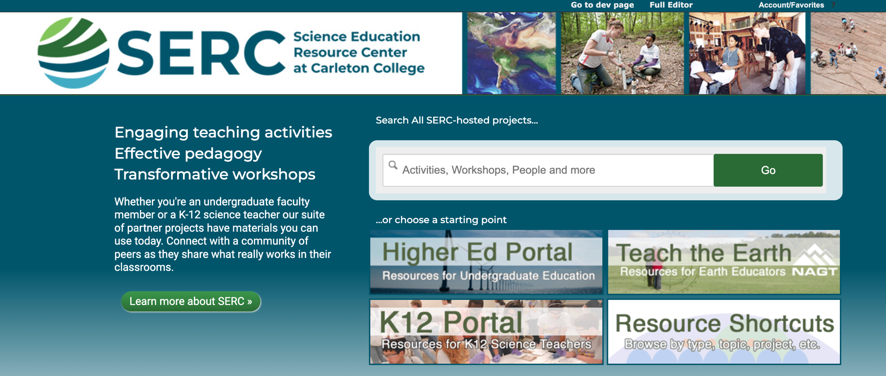
A Little Bit About SERC
We work collaboratively on national-scale projects to improve STEM education with a strong focus on Earth education
Grant funded projects (100+ NSF grants over 20 years)
Online resources are key in most of our projects:
  40,000+ pages of content. 4,000+ teaching activities (OER!)
  5 million annual visitors
  Participants/contributors from over 1100 institutions
https://serc.carleton.edu

Slide 4

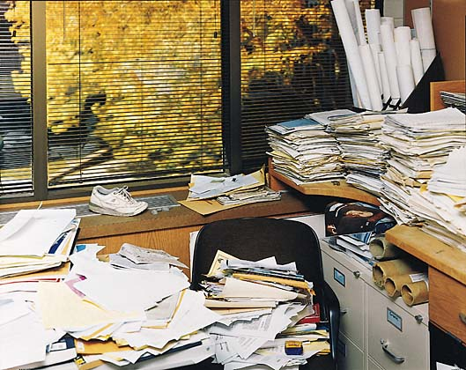
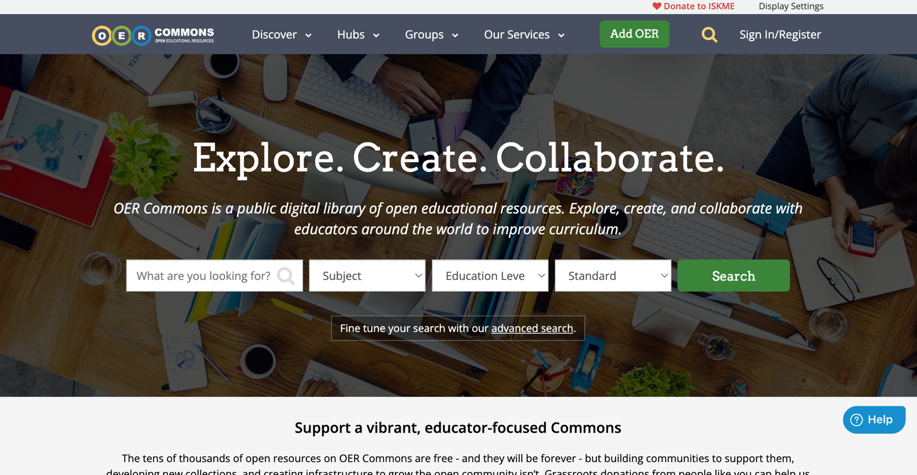
The OER label is often used in the context of free textbooks but applies to a much wider set of resources
https://openstax.org/ https://www.oercommons.org/
Notes:
Literature focuses on Open Textbooks – with emphasis on ‘free’
Actual use includes elements traditionally built/assembled by instructors: activities, videos, figures, data etc…
Sharing continuum runs from big ‘providers’ like OpenStax, OERCommons to individuals sharing within disciplinary communities and institutions.
Talk about what factors make a strong OER and OER ecosystems
Talk about what factors driving we see for OER today

Slide 5
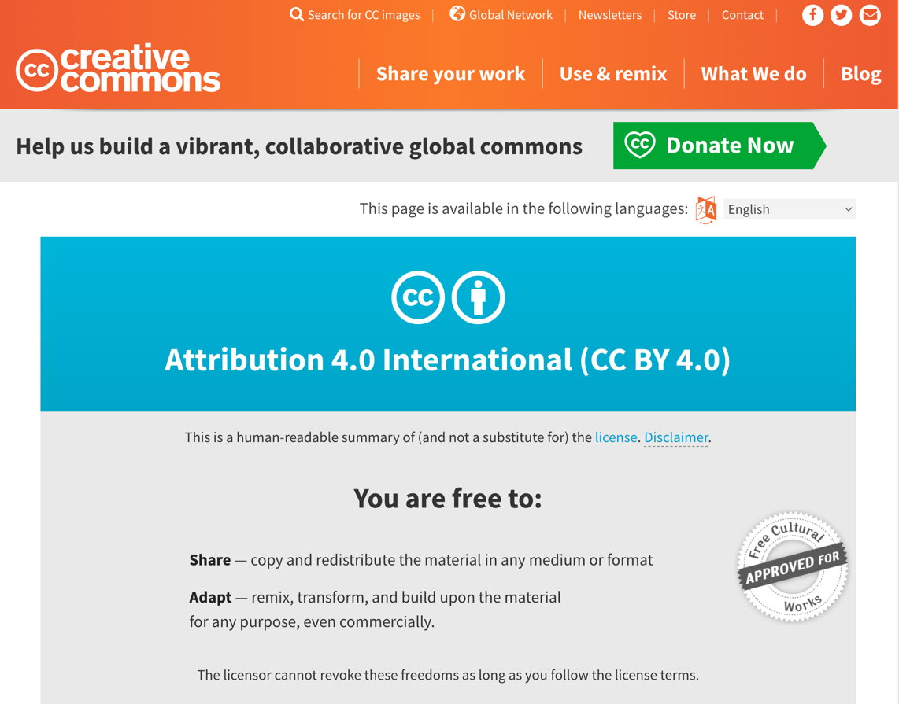
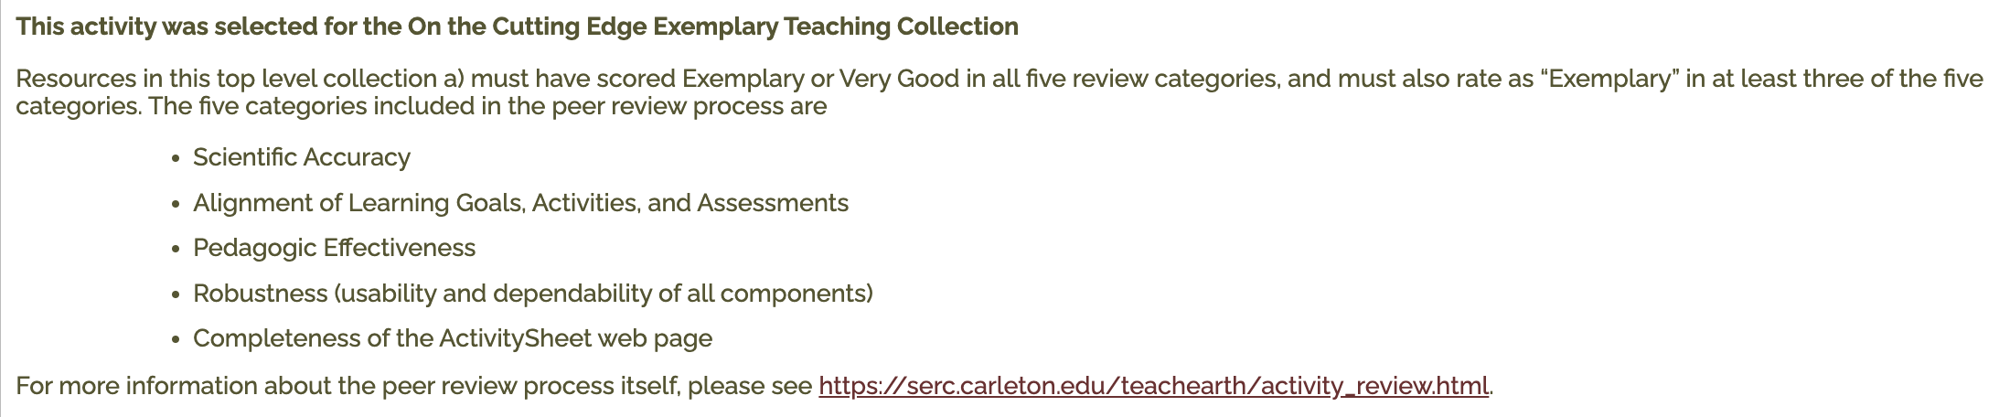
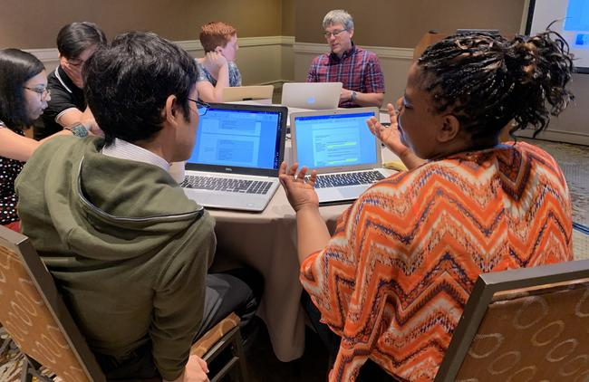
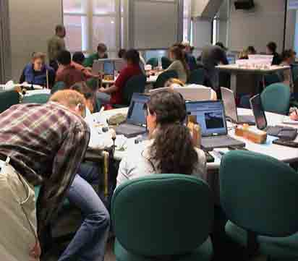
The community has tested solutions for both licensing (CreativeCommons) and ensuring/signaling quality.
Peer Review
https://creativecommons.org/
https://serc.carleton.edu/61244
https://serc.carleton.edu/234436
Classroom Testing
Notes:
Licensing that solves the copyright problem and allows frictionless remixing and redistribution. Creative Commons is a solution.
Quality
Design to rubrics reflecting evidence-based teaching, correct science, designed for reuse adaptation
Create in diverse teams
Test in (multiple) classrooms
Peer review
Labeling

Slide 6
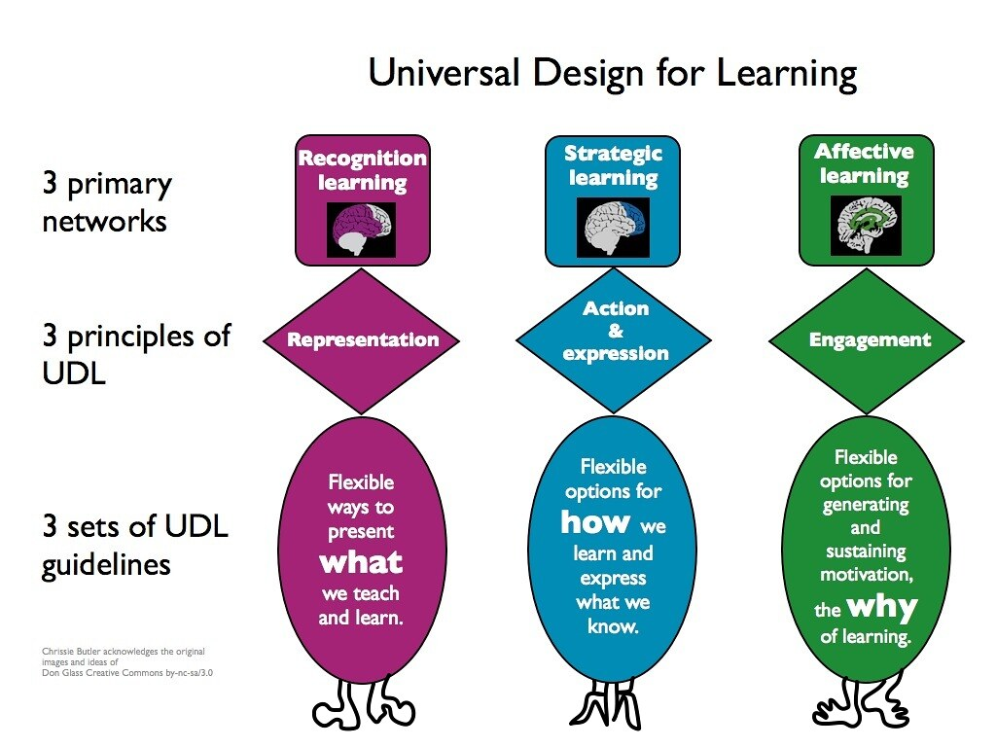
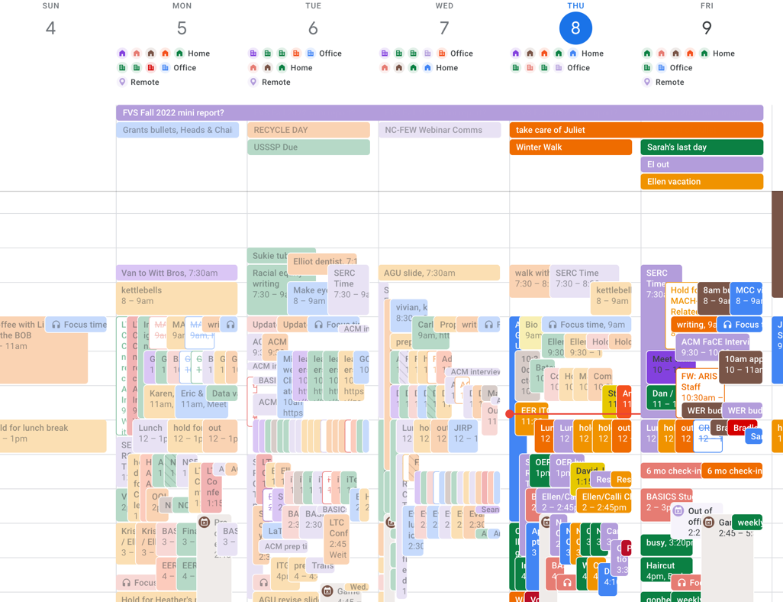
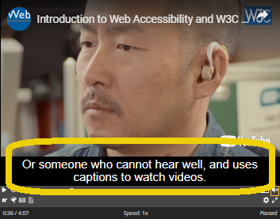
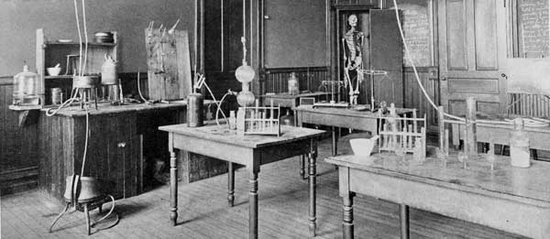
Effective OER aligns with instructor realities (e.g. prep time) and student needs (e.g. accessibility)
https://serc.carleton.edu/249733
Notes:
Know your audience: e.g. K12 (standards alignment, resource availability, minimal prep time) versus Higher Ed needs (adaptable to different course/instructor priorities)
Accessibility
Equity and Legal requirements
Universal Design for Learning (e.g. captions help learners who aren’t hearing impaired)
Improved Adaptability

Slide 7
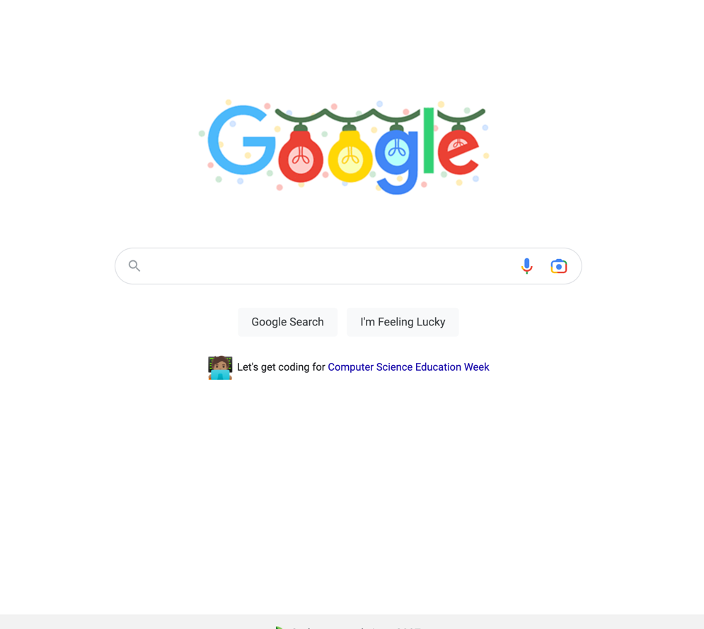
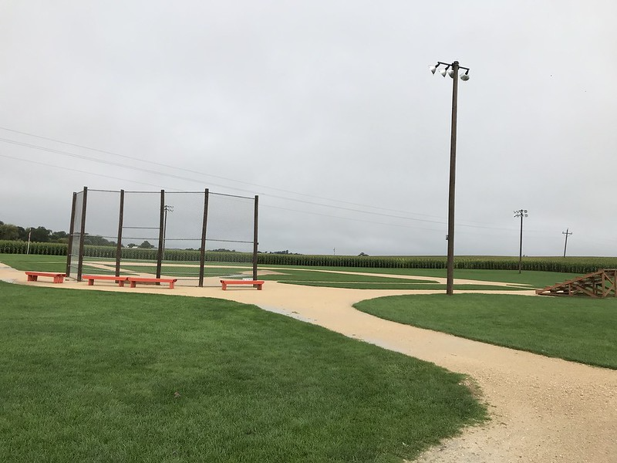
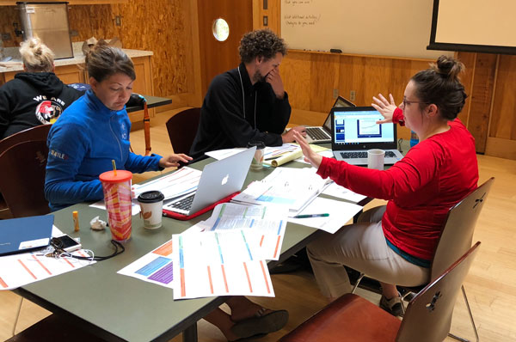
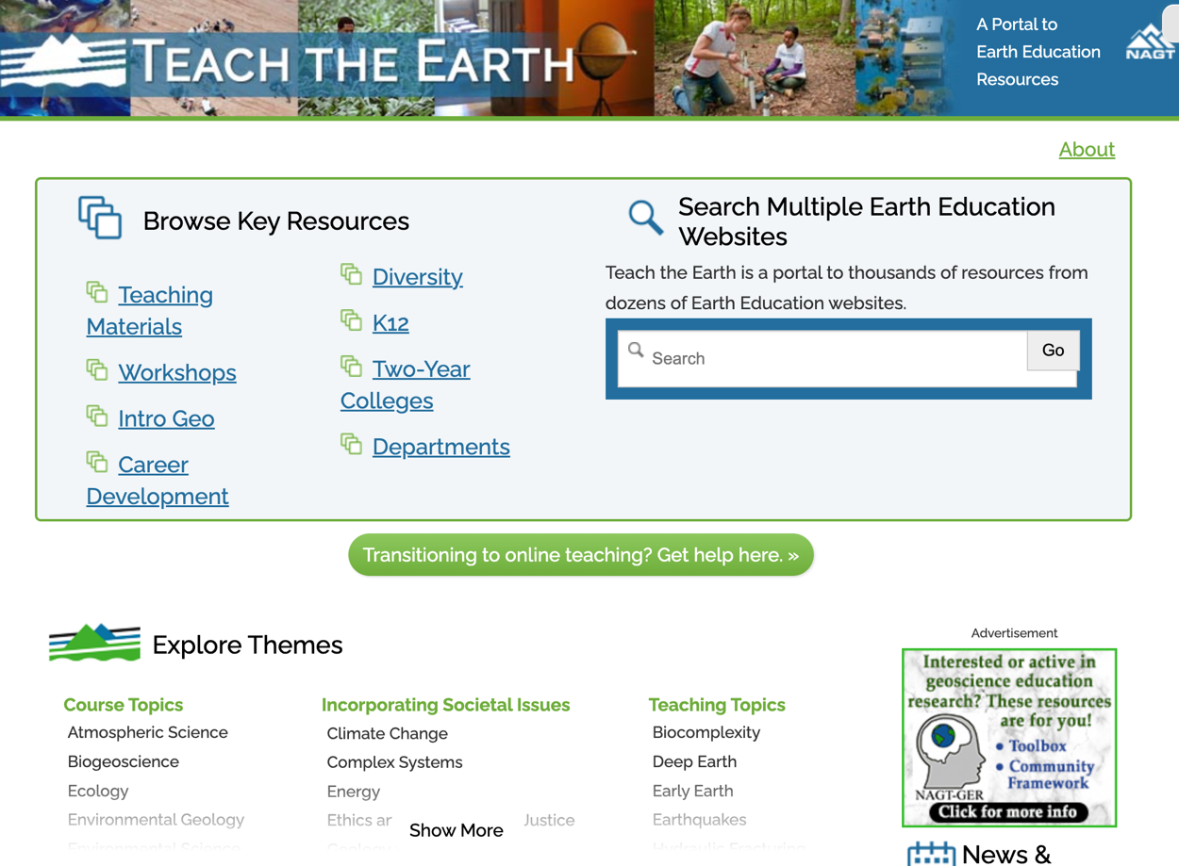
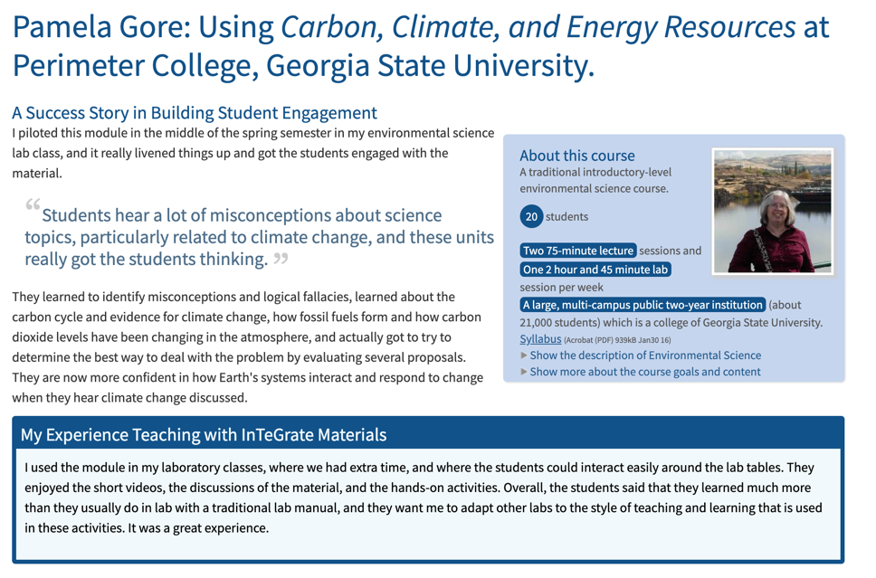
“If you build it they will not come”. The ecosystem needs drivers to encourage engagement, discovery, adoption and sharing
Notes:
Drivers for creation: events (workshops), connect sharing to discussion/event attendance, make results visible, get good ideas of out filing cabinets
Make visible. Drive adoption with webinars, events, having people be testers/authors -> evangelists.
Google still rules (SEO), put where people are (Compass), share quality signals, put up in formats that adapting easy.
Free is good
Adaptable is better
Shared and remixed and then shared and remixed again even better
It’s both the OER artifacts and the dialog around their use

Slide 8
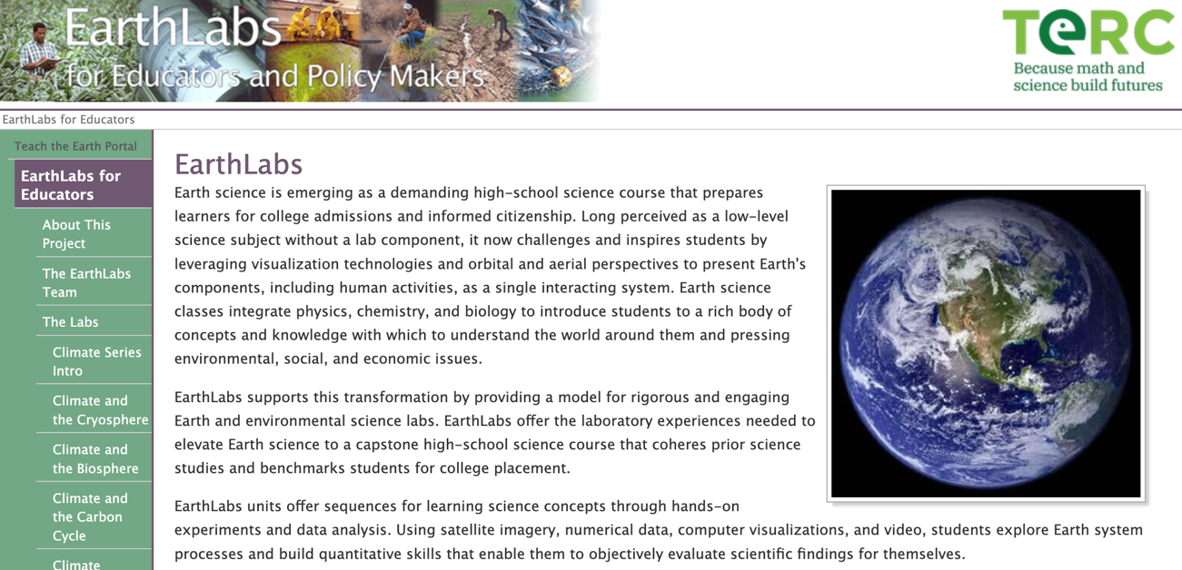

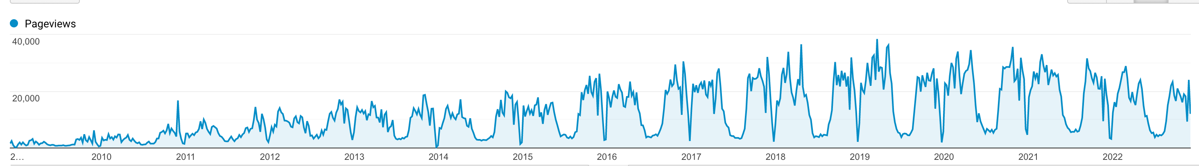
The wide adoption of the Next Generation Science Standards (NGSS) in the U.S. is an opportunity for the OER ecosystem to support a teacher population that has limited Earth Science expertise and who are now charged with elevating Earth and Space science in K12 classrooms.
https://www.nextgenscience.org/
https://serc.carleton.edu/earthlabs/
Notes:
NGSS - putting ESS front and center; teachers don’t have formal background. NGSS emphasizes science practices, working with real data
Earthlabs example of hands on data rich high school curricula. Funding ended in early 2010’s and traffic 2008-present is still higher than when funded (mid-point is 20k page views/month)

Slide 9
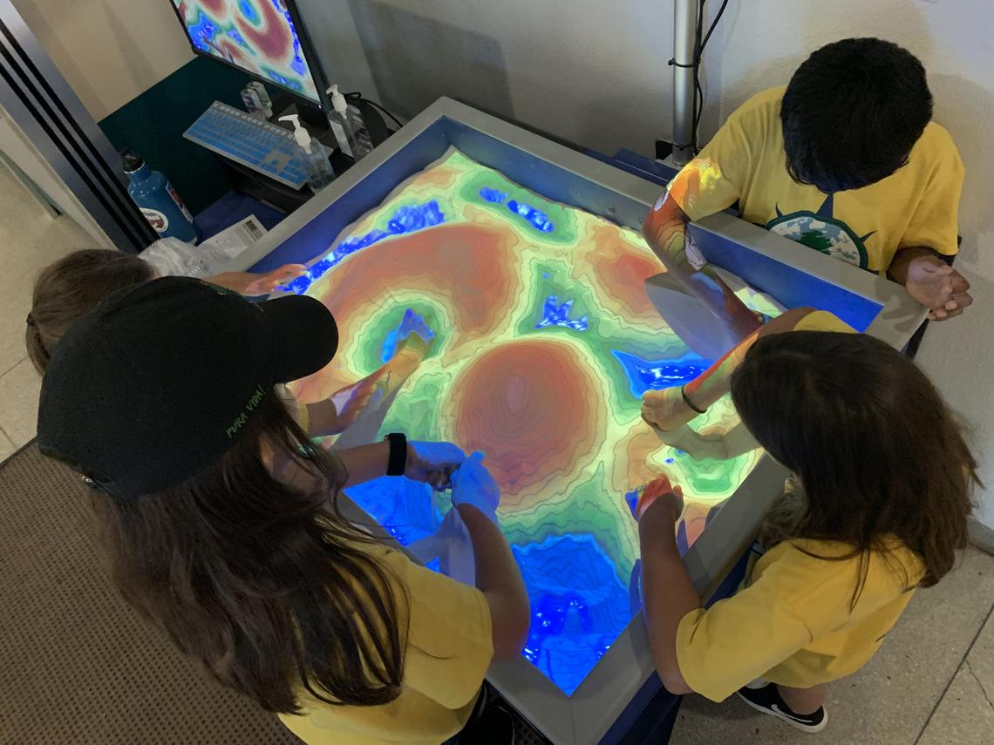
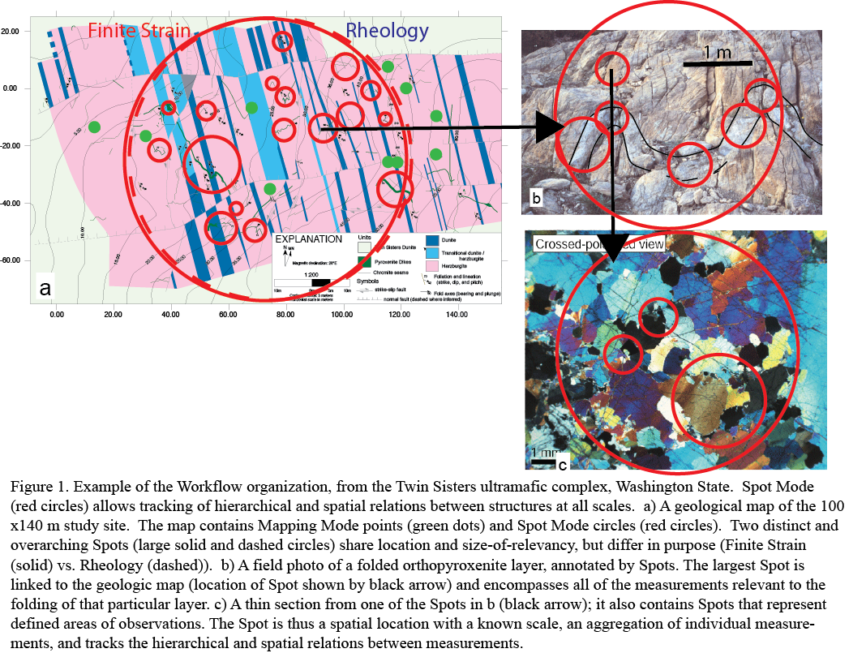
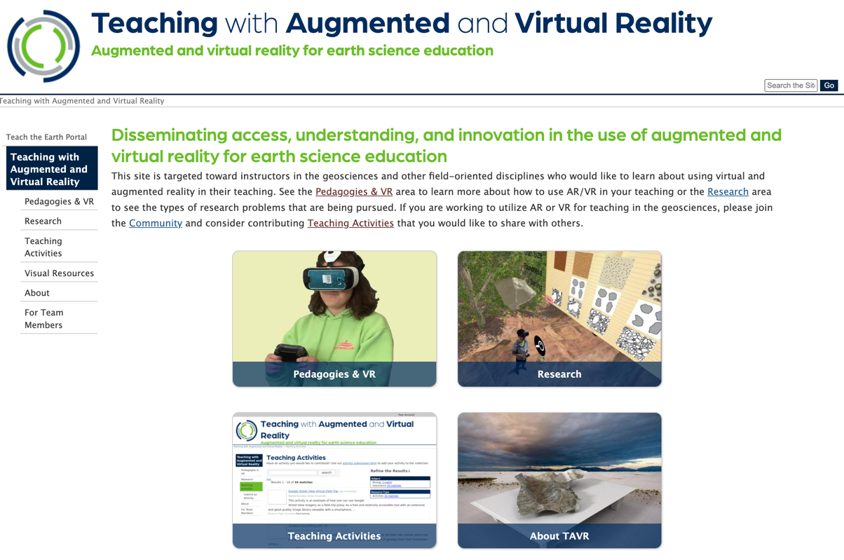
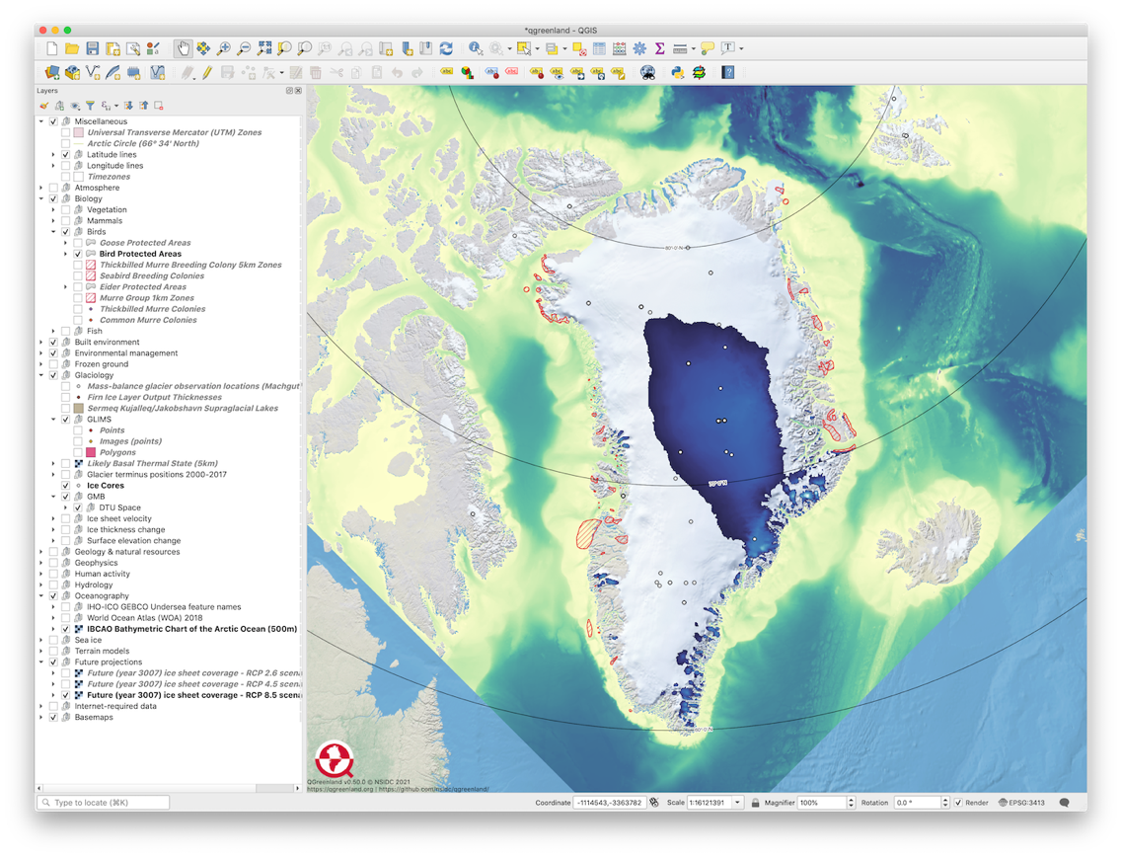
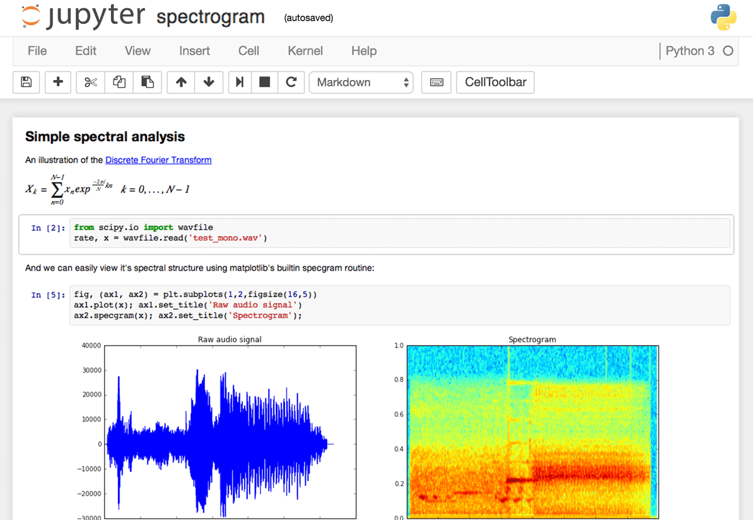
New technologies and increasing availability of data creates a big growth opportunity for new OER
https://serc.carleton.edu/TAVR/
Notes:
New tech (like AR/VR) and the every growing pool of data and tools the manipulate them open new opportunities for OER that gets students hand-ons in a way that textbooks never could.

Slide 10
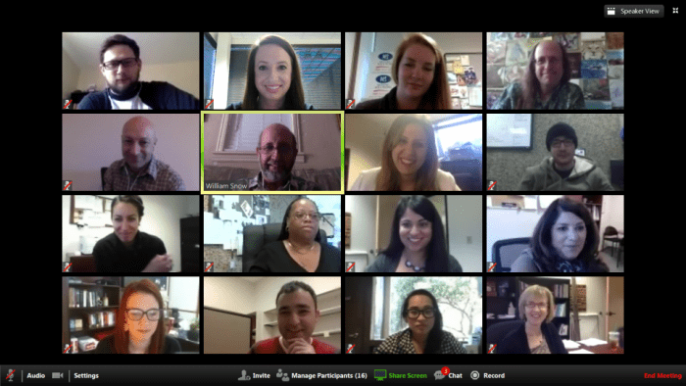
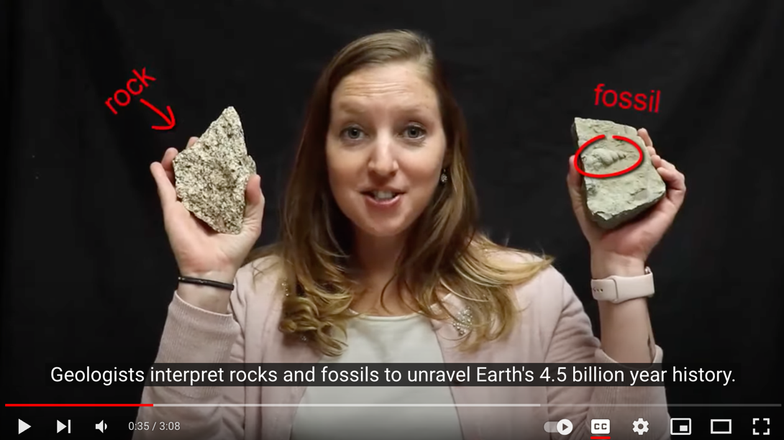
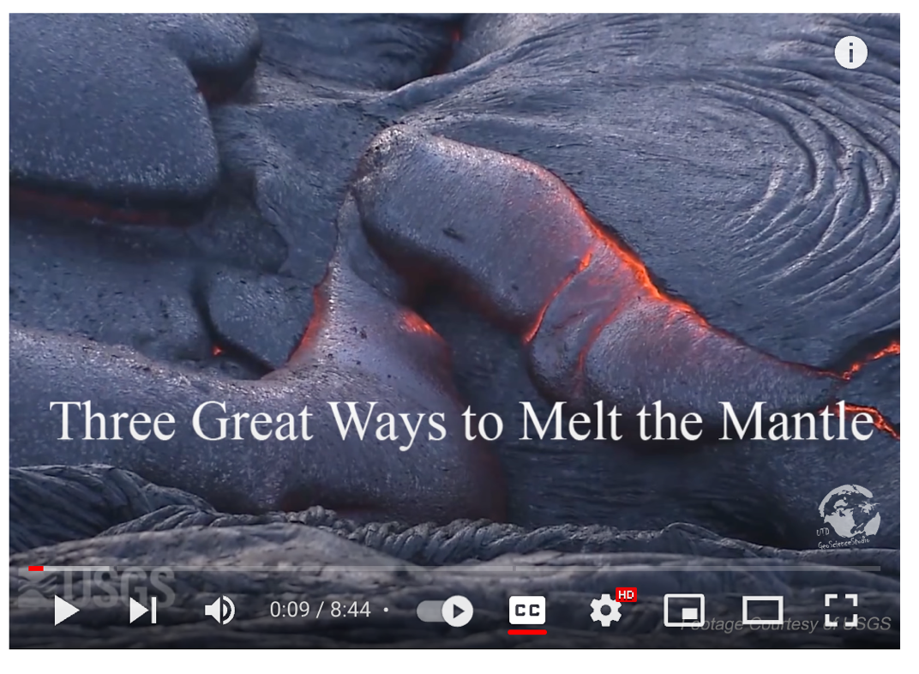
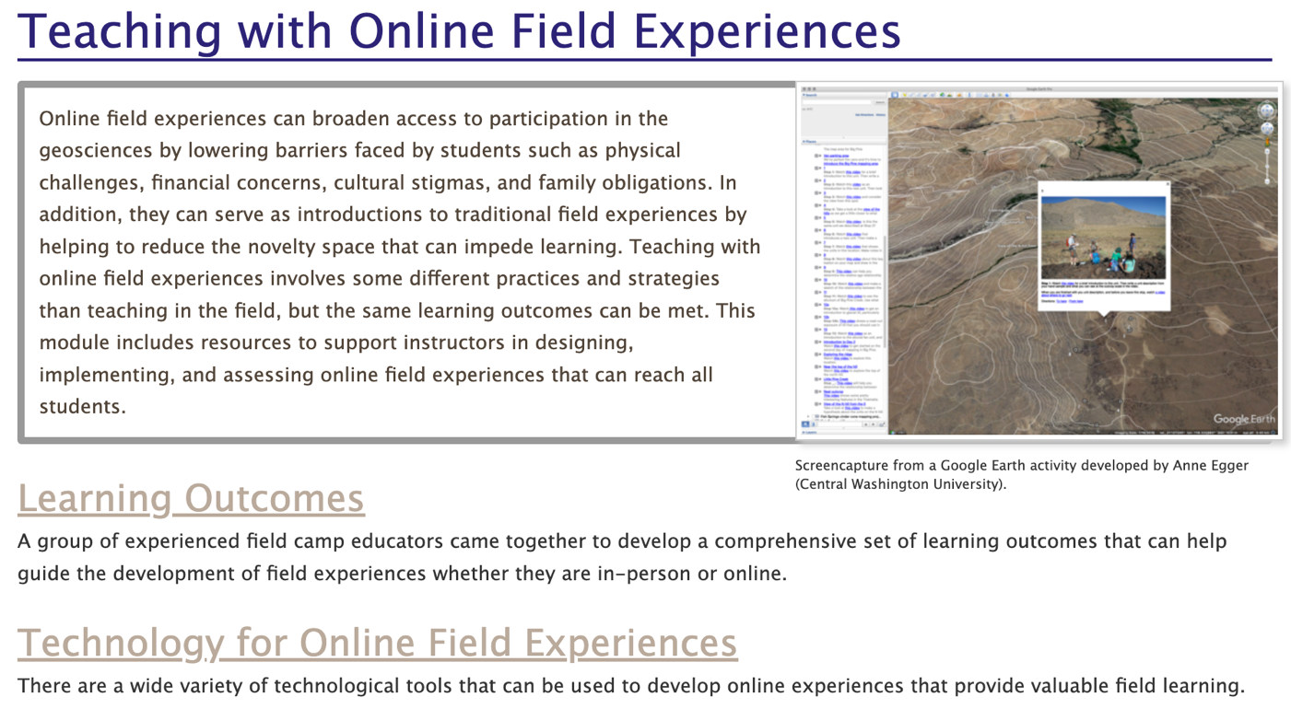
The pandemic forced a giant pedagogic experiment in hybrid/remote education that has changed what we think is possible. OER can help us meet these new expectations.
https://serc.carleton.edu/teachearth/teach_geo_online/
Notes:
Flipped classrooms need new supporting resources (everyone doesn’t need to make identical pre-class mini-lectures)
Experiments in virtual field trips – won’t replace the real thing but opens a bunch of doors to options better than just reading about the natural world

Slide 11
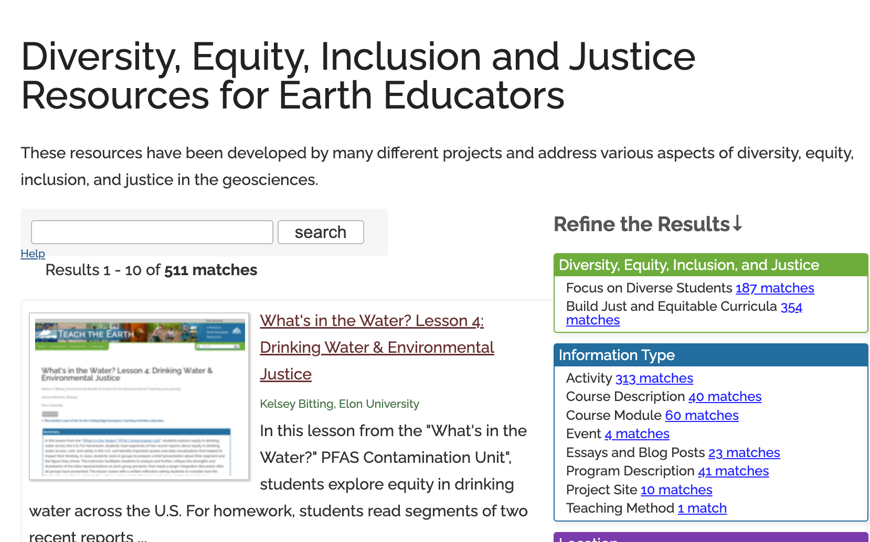
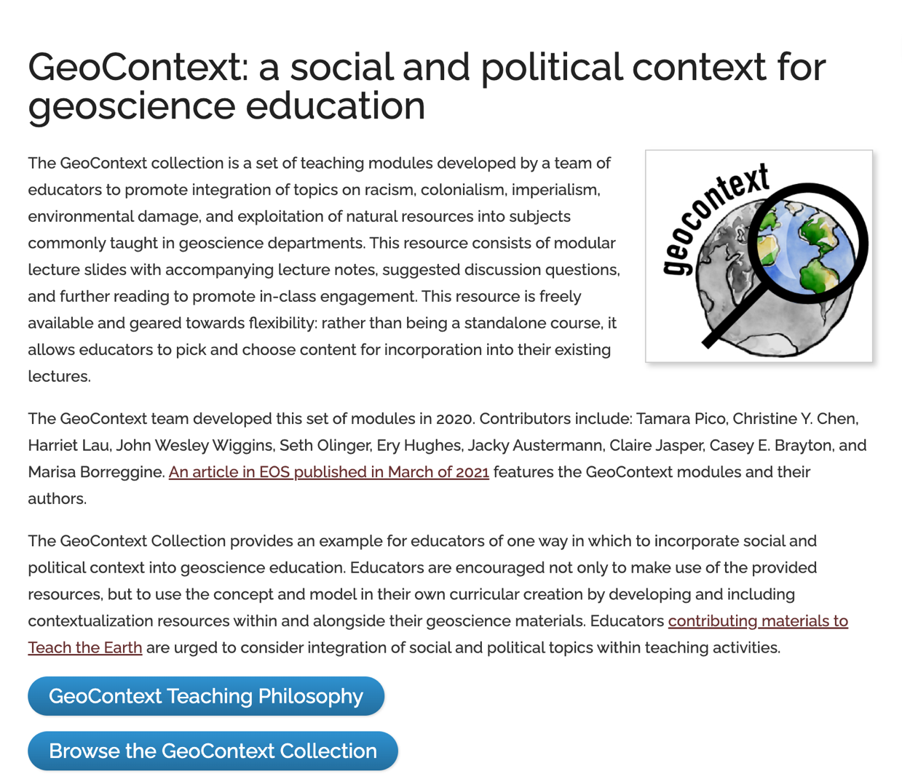
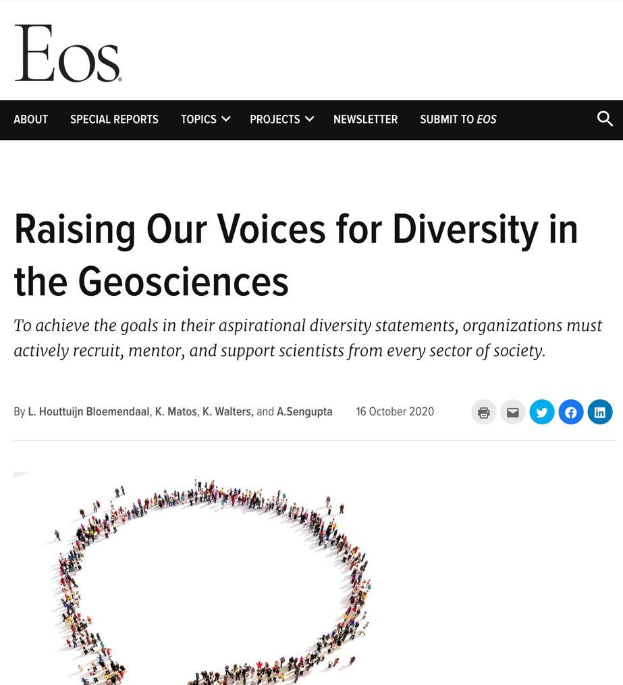
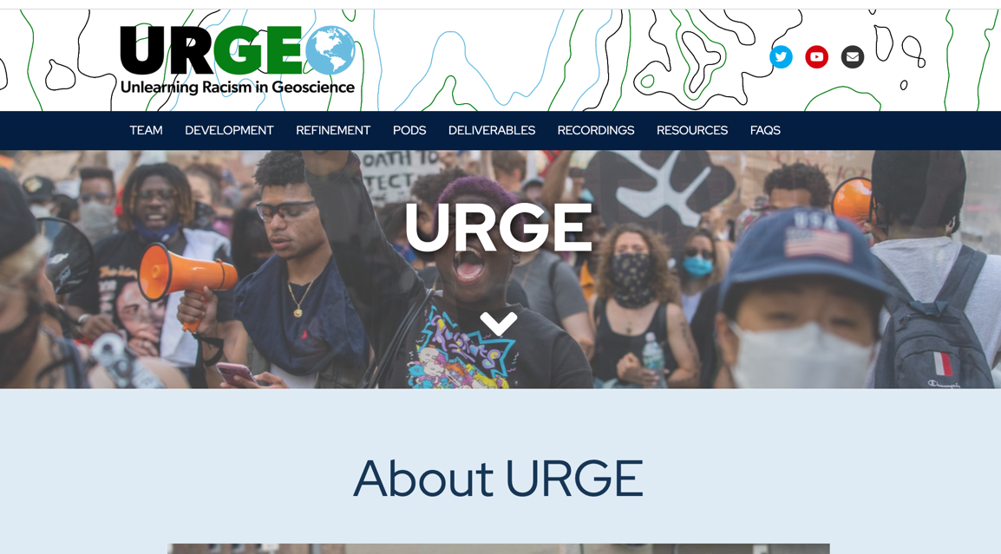
There is a huge supply/demand gap for teaching resources that support diversity, equity and inclusion in geoscience education.
https://urgeoscience.org/
https://serc.carleton.edu/teachearth/broad_partic/
Notes:
Lots of energy and interest
Resources that contextualize our our science
Classroom practices that support success for all our students

Slide 12
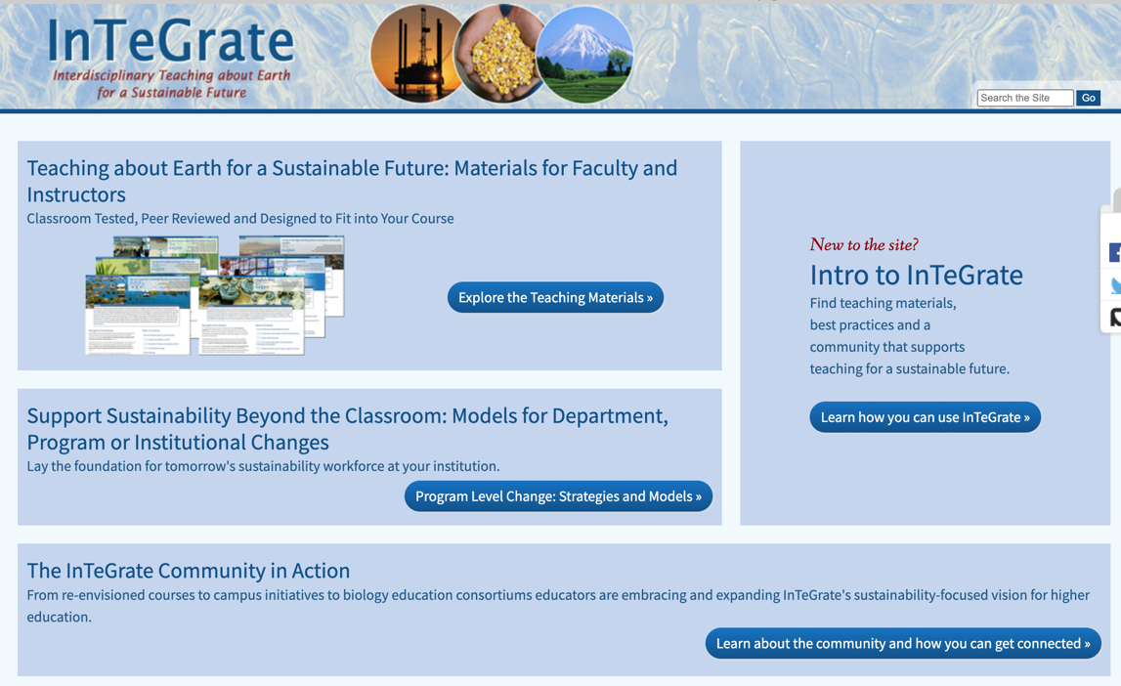
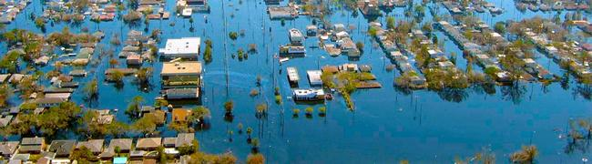
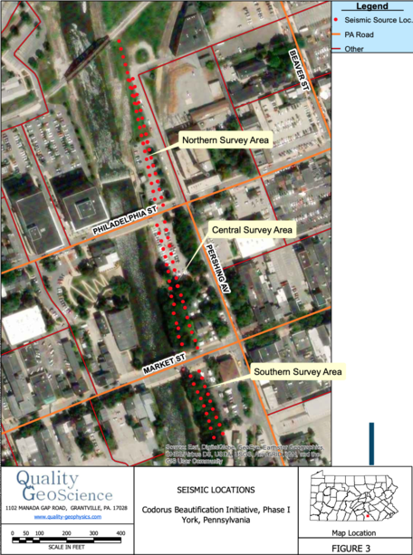
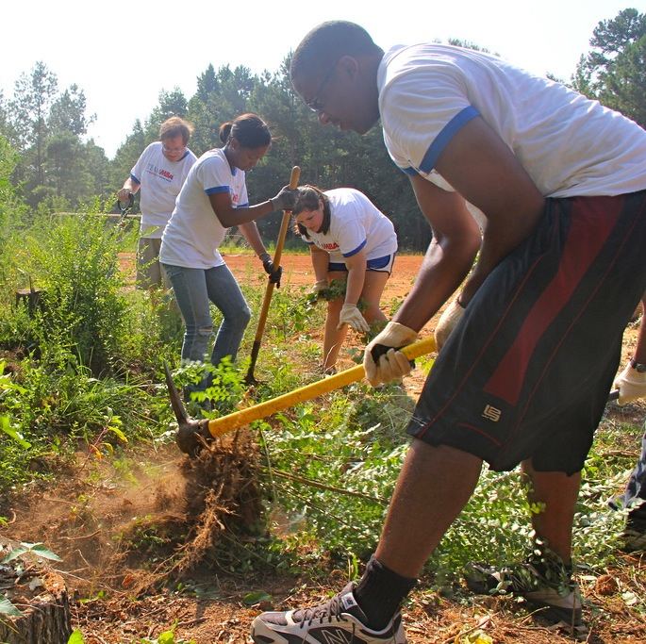
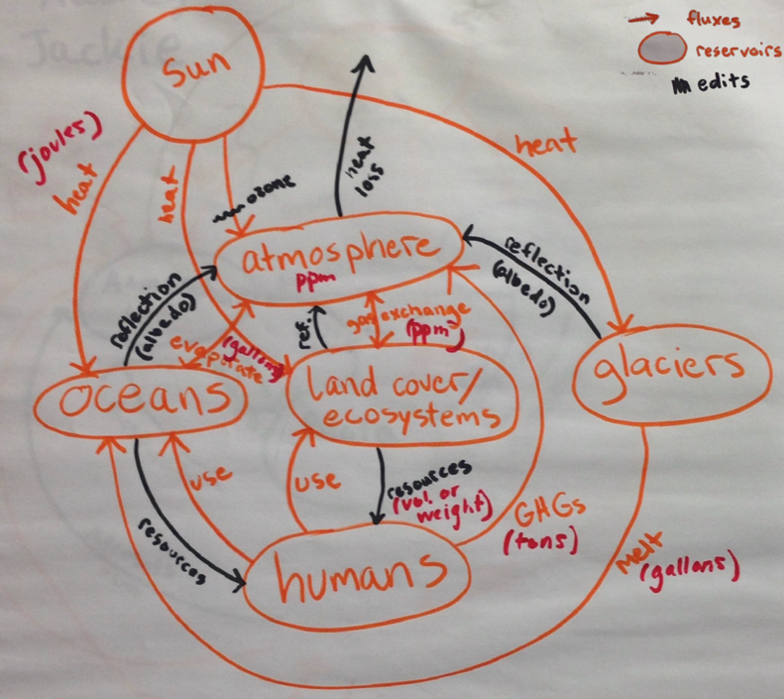
We need OER that helps students develop the skills to tackle real-world problems they care about. They need practice in data-intensive, transdisciplinary, place-based problem solving that engages with local communities and global challenges.
https://serc.carleton.edu/integrate/

Slide 13
Thank You
Sean Fox
sfox@carleton.edu
https://serc.carleton.edu

Slide 14
Photo Credits:
Creators and reuse information available the the listed urls.
The Geologist’s Office https://www.carleton.edu/campus/gallery/exhibitions/2002/vantagePoints/soth.html
Scale-up classroom https://serc.carleton.edu/details/images/13287.html
Faculty Professional Development https://serc.carleton.edu/details/images/234692.html
Captioning video
https://www.w3.org/WAI/media/av/captions/
UDL Diagram
https://wordpress.org/openverse/image/4a2a4df5-debc-46c1-9e24-5c961a50398a/
Field of Dreams photo Natalie Maynor https://www.flickr.com/photos/nataliemaynor/48726179762
Early Science Lab in Old Main
https://www.augustana.edu/about-us/sesquicentennial/quest-for-scholarship
NGSS Workshop participants
https://serc.carleton.edu/details/images/194461.html
AR Sandbox
https://www.usgs.gov/media/galleries/augmented-reality-ar-sandbox-photos
All other imagery either created by the presentation author, openly licensed and available from the websites listed on the respective slide, or thumbnails of publicly available websites used under fair use.

