Slide 1
Speak Up!
How to include student presentations in an online course
Dr. Alycia Ehlert
Associate Vice President, College of Arts and Sciences Daytona State College

Slide 2
What we will discuss today
Different types of delivery methods for online presentations
Strengths and weaknesses of these methods
Tips for helping students with their online presentations

Slide 3
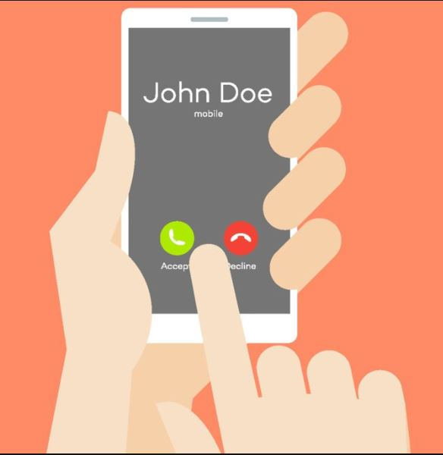
Delivery Methods for Online Presentations
Telephone/FaceTime/Skype conversations
Ideal for impromptu speeches
Works for oral exams
Strengths:
Helps students demonstrate their knowledge on a topic “off the cuff”
Weaknesses:
Students’ nervousness may interfere with the message
Tips:
Can use a voice over IP account so students won’t know your number

Slide 4
Delivery Methods (continued)
Videos
Students record a video and upload to YouTube or to the Video Assignment link in FalconOnline
Strengths:
Technology is accessible to most students
Weaknesses:
May spend a lot of time helping students with how to upload presentations
Tips:
Provide FAQs for how to handle technology issues

Slide 5
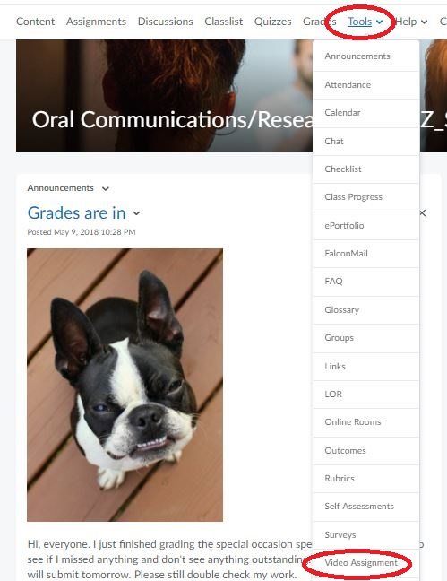
Videos

Slide 6
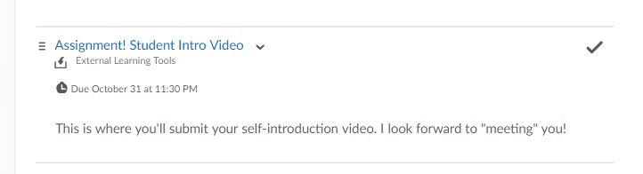
Videos

Slide 7
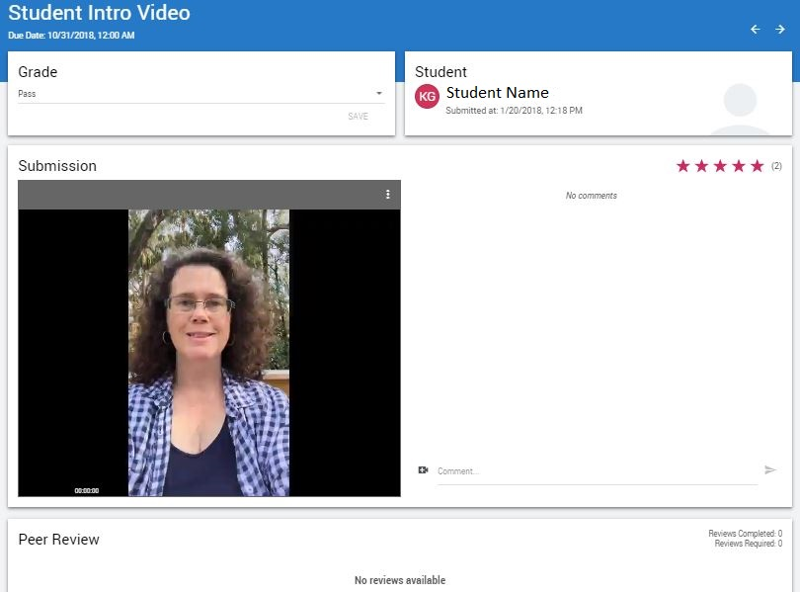
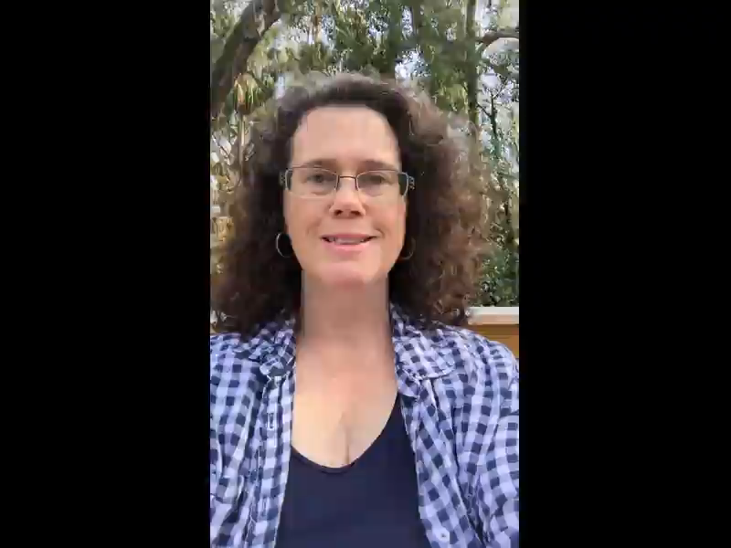
Videos

Slide 8

Videos
“How to Record a Great Speech for an Online Course,” Entire video available from https://www.youtube.com/watch?v=4qFTr6i5VeQ#action=share

Slide 9
Delivery Methods (continued)
Voice-over-PowerPoint
Helps students thoroughly explain information in a presentation
Strengths:
Great for use in group presentations
Good examples out there for students to strive towards
Weaknesses:
May spend a lot of time helping students with how to create presentations
Poor recordings or recordings that don’t work
Tips:
Provide FAQs for how to handle technology issues
Many resources available online

Slide 10
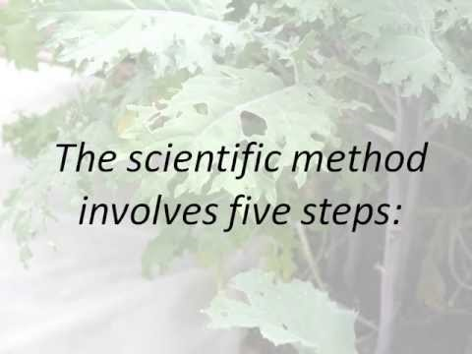
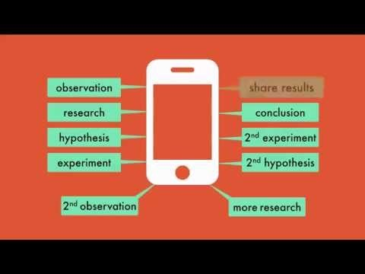
Voice-Over-PowerPoint
How to article available here
Retrieved from: https://www.youtube.com/watch?v=QkGOJYZQwLQ
Retrieved from: https://www.youtube.com/watch?v=SMGRe824kak

Slide 11
Delivery Methods (continued)
Virtual Classrooms
Presentations are given in real-time
Rooms can include two-way audio, interactive whiteboard, desktop sharing, and session recording

Slide 12
Delivery Methods (continued)
Virtual Classrooms
Strengths:
Professor and peers can provide immediate feedback and ask questions
Allows for more engagement with students
Weaknesses:
Weak internet connection can cause problems
Tips:
Only a couple people can share their video at a time
Works best with Google Chrome or Mozilla Firefox

Slide 13
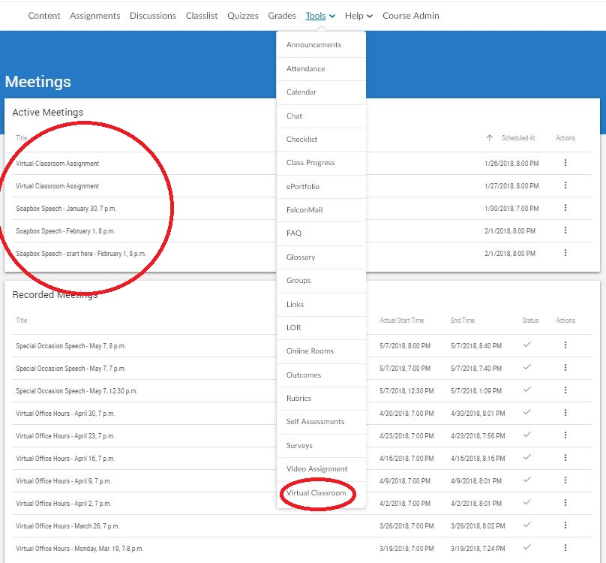
Virtual Classrooms

Slide 14
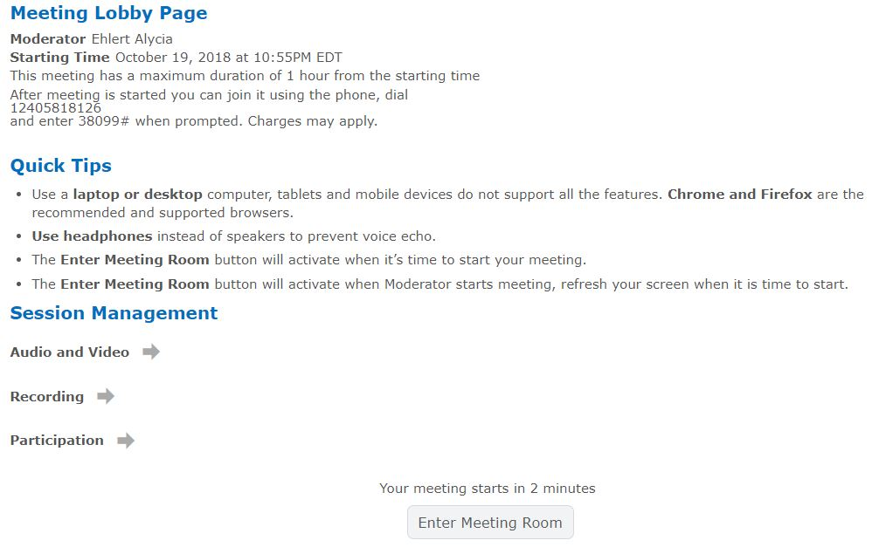

Slide 15
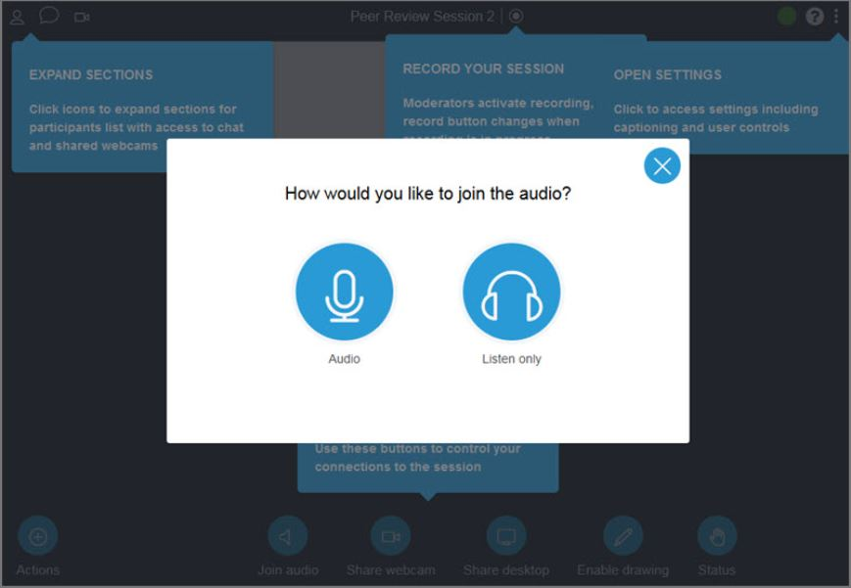
For a tutorial on how to use the YouSeeU Virtual Classroom, see this article.

Slide 16
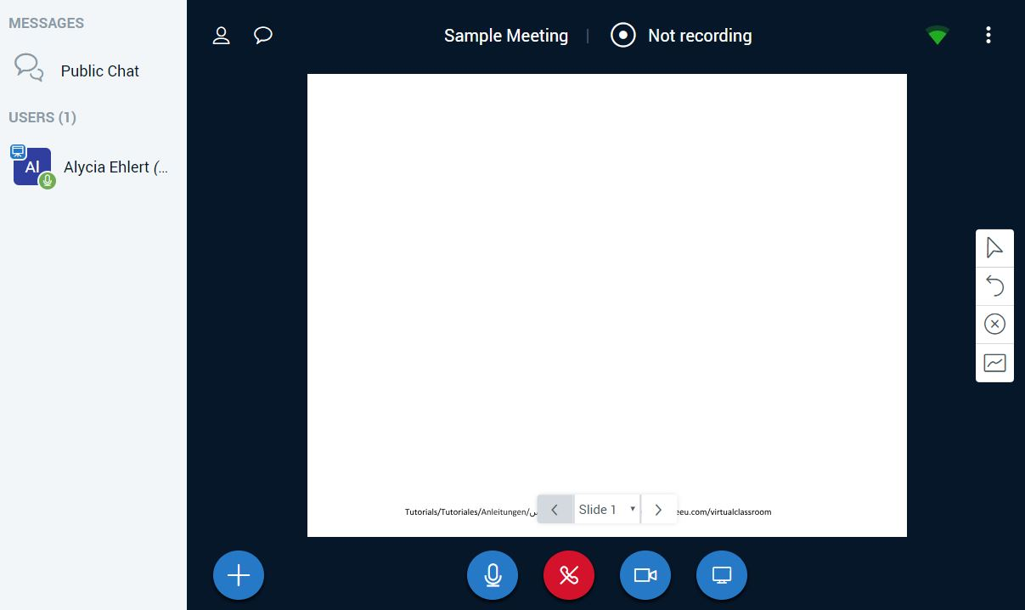

Slide 19
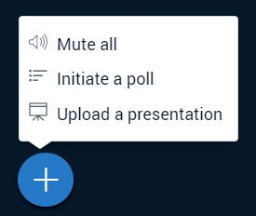

Slide 21
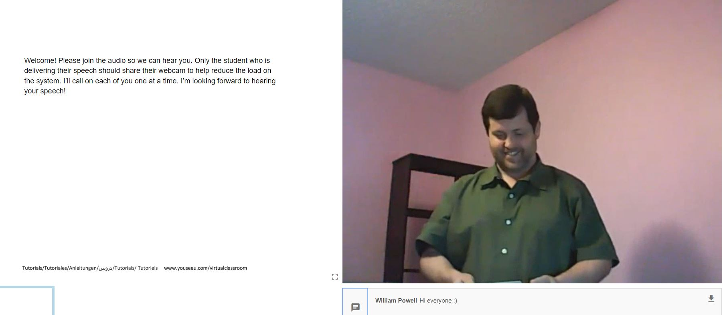
Virtual Classroom

Slide 22
Questions?
Alycia Ehlert
Alycia.Ehlert@daytonastate.edu
386-506-3769

