Slide 1
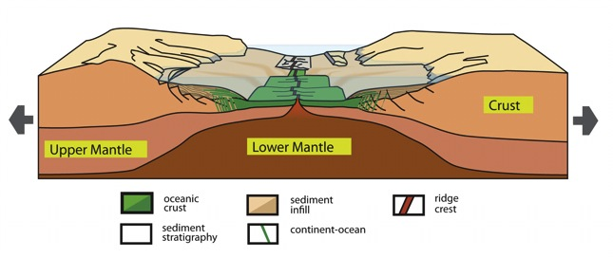
Science Highlights of the RCL Initiative
Rupturing Continental Lithosphere
Original Goals:
Modified from a summary by
Rebecca Dorsey, University of Oregon
Understand spatial and temporal evolution of rifts.
Focus on key processes, state parameters and physical properties that control them
- Link properties, processes, observations, and modeling
- Observations: one orogenic rift (Gulf of California) and one cratonic rift (Red Sea)
- Use experiments and data to address 4 thematic questions (below)

Slide 2
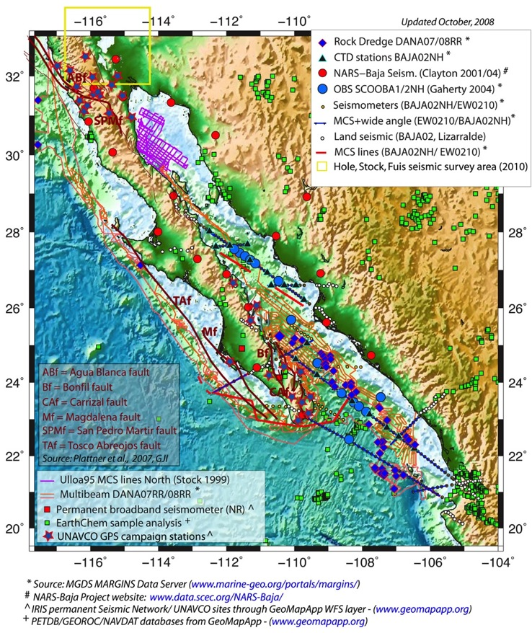
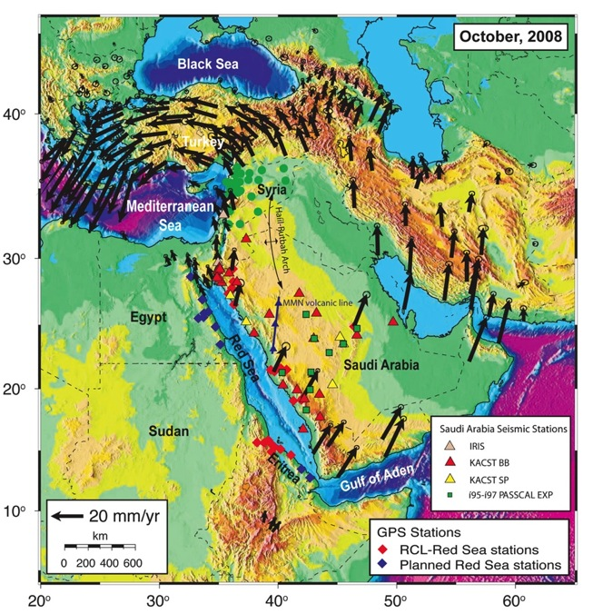
Two Focus Sites (and ancillary modeling studies)
Gulf of California / Salton Trough
Red Sea Region
Source: MARGINS 2009 Review - RCL Summary
www.nsf-margins.org/Review2009/
Notes:
Both of these ‘focus sites’ have detailed information and data overlays in the free, open-source GeoMapApp program (http://www.geomapapp.org/).
Click on the ‘Focus Sites’ menu in GeoMapApp.

Slide 3
Science Highlights of the RCL Initiative
Rupturing Continental Lithosphere
Original Scientific Questions
Summary by Rebecca Dorsey
University of Oregon
1. What forces drive rift initiation, localization, propagation and evolution ?
2. How does deformation vary in time and space, and why ?
3. How does crust evolve, physically and chemically, as rifting proceeds to spreading ?
4. What is the role of fluids and magmatism in continental extension ?

Slide 4
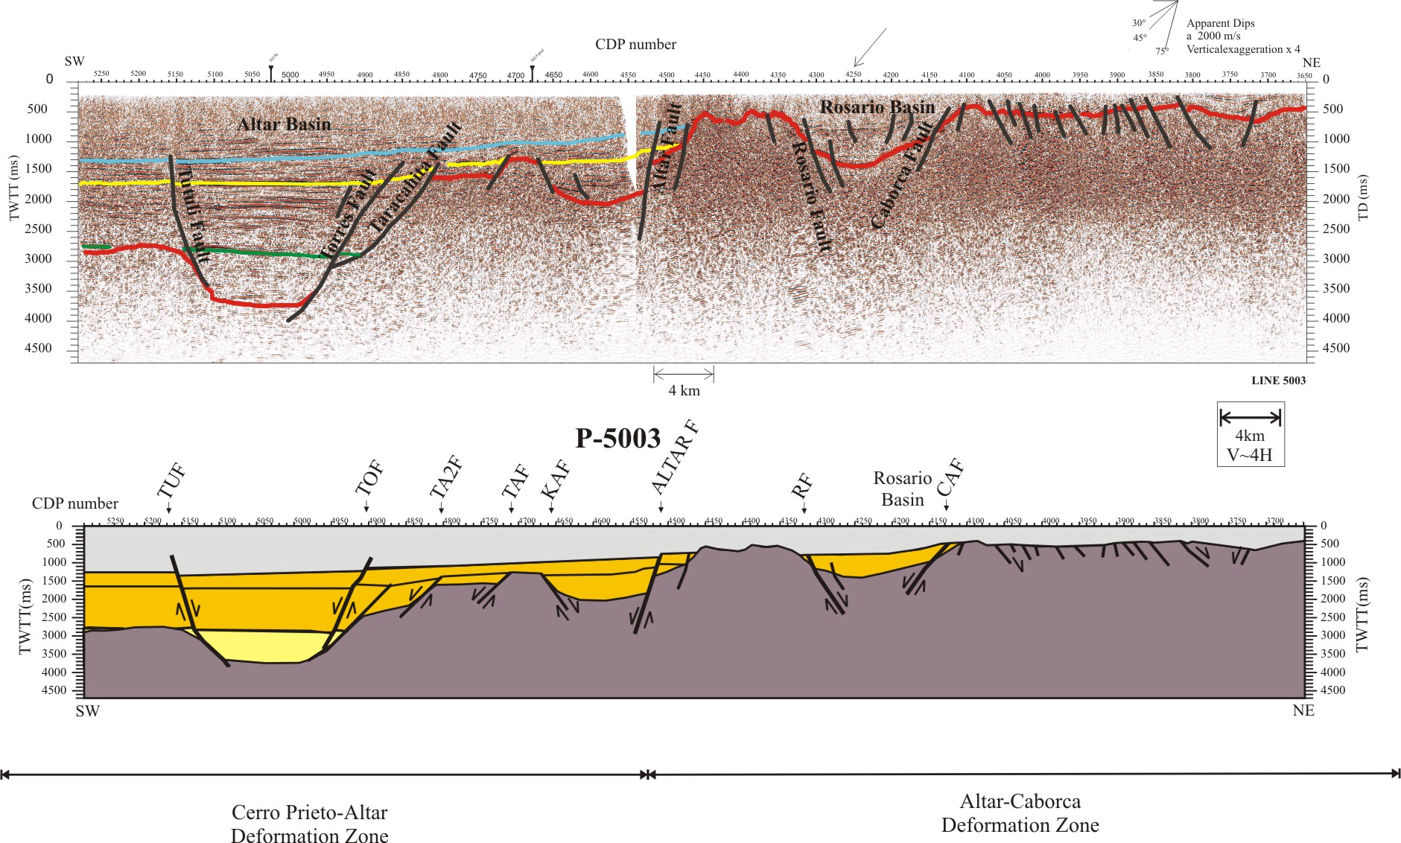
Science Highlights of the RCL Initiative
GAME CHANGERS: New results that change the way we think about continental rifting, rupture, and underlying controls
1. Styles of Extension Important factors:
(a) Different styles of extending the lithosphere
(b) Structural evolution of normal faults in rifts
(c) Pre-rift tectonic histories (subduction, collision)
(d) Faulting style controls shape of sedimentary basins
Modified from Gonzales-Escobar, 2013

Slide 5
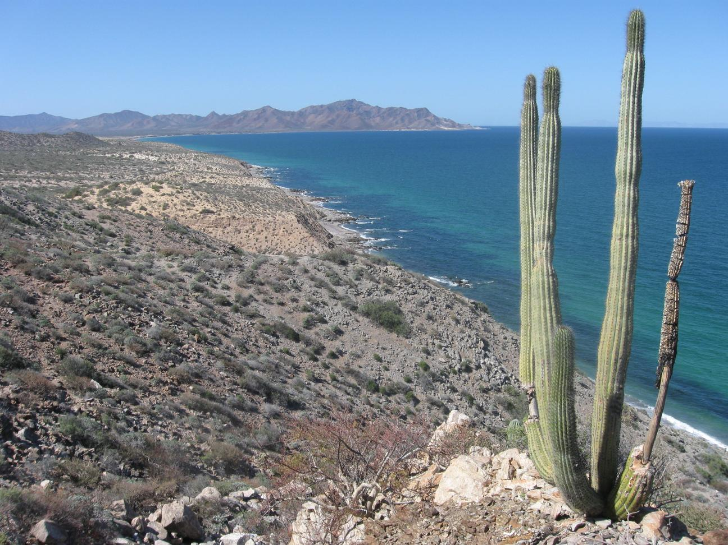
Science Highlights of the RCL Initiative
GAME CHANGERS: New results that change the way we think about continental rifting, rupture, and underlying controls
2. Role of Sedimentation
Sediments not just a passive record of earth history. Exert a direct control on rift process, magmatism, crustal composition, formation of ocean basins.
Includes critical link to interior fluvial system (Colorado River) – “source to sink”. Can create new type of hybrid crust at Ocean – Continent Transition.

Slide 6
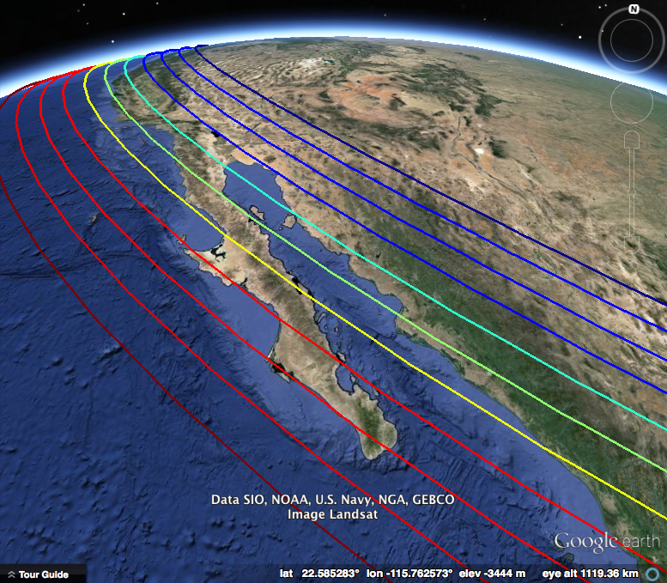
Science Highlights of the RCL Initiative
GAME CHANGERS: New results that change the way we think about continental rifting, rupture, and underlying controls
3. Role of Rift Obliquity Important factors:
(a) Oblique extension and strike-slip faults
(b) Relationship between the orientation of the rift and relative motion direction (° of obliquity)
(c) Rift obliquity affects resulting morphology of the rift zone (Gulf of CA vs. Red Sea)

Slide 7
Science Highlights of the RCL Initiative
GAME CHANGERS: New results that change the way we think about continental rifting, rupture, and underlying controls
4. Role of Magmatism
Pre-rift volcanism depletes the upper mantle
- leads to less syn-rift magmatism
Less magma makes lithosphere effectively stronger, so deformation migrates (not localized).
This produces a WIDE RIFT zone and longer time to rupture.

Slide 8
Science Highlights of the RCL Initiative
GAME CHANGERS: New results that change the way we think about continental rifting, rupture, and underlying controls
1. Styles of Extension Important factors: (a) Different styles of extending the lithosphere; (b) Structural evolution of normal faults in rifts; (c) Pre-rift tectonic histories (subduction, collision); (d) Faulting style controls shape of sedimentary basins.
2. Role of Sedimentation Sediments not just a passive record of earth history. Exert a direct control on rift process, magmatism, crustal composition, formation of ocean basins. Includes critical link to interior fluvial system (Colorado River) – “source to sink”. Can create new type of hybrid crust at Ocean – Continent Transition.
3. Role of Rift Obliquity Important factors: (a) Oblique extension and strike-slip faults; (b)Relationship between the orientation of the rift and relative motion direction (° of obliquity); (c) Rift obliquity affects resulting morphology of the rift zone (Gulf of CA vs. Red Sea).
4. Role of Magmatism
Pre-rift volcanism depletes the upper mantle → less syn-rift magmatism. Less magma makes lithosphere effectively stronger, so deformation migrates (not localized). This produces a WIDE RIFT zone and longer time to rupture.
Modified from Gonzales-Escobar, 2013

