Slide 1
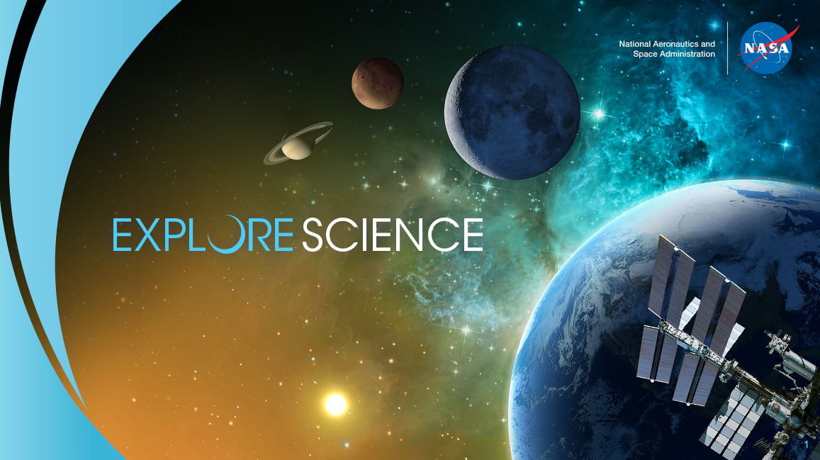
Courtney O’Connor
Emily Furfaro
Aliyah Craddock
Mamta Nagaraja
NASA Science Mission Directorate
June 2021

Slide 2


Intro to NASA Social + SMD Social
Our Digital Distribution Platforms:
Over 231+ million total followers
Across all accounts and platforms
NASA has the most followers of any agency/department in the federal government on:

Slide 3

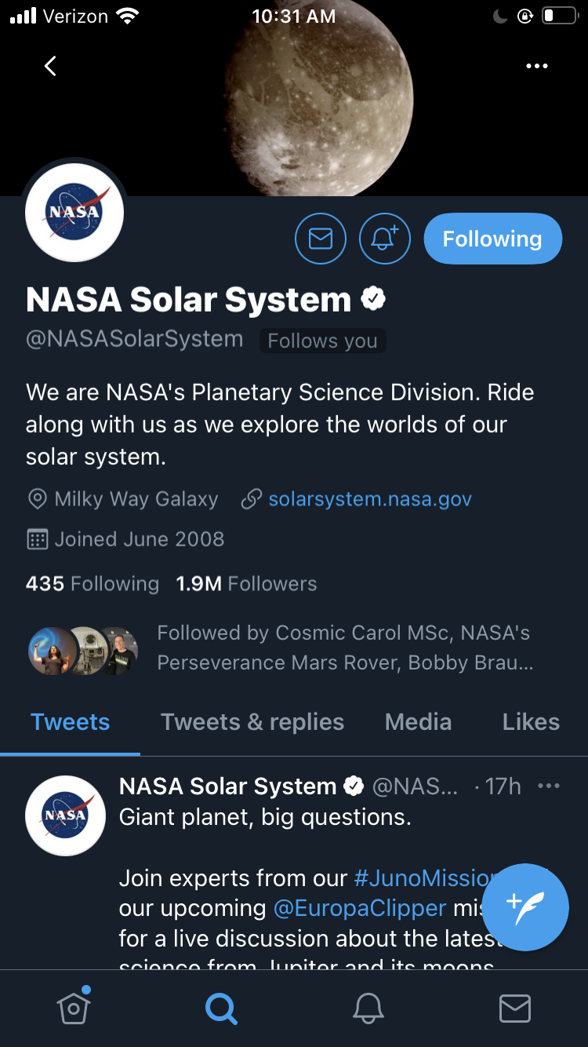
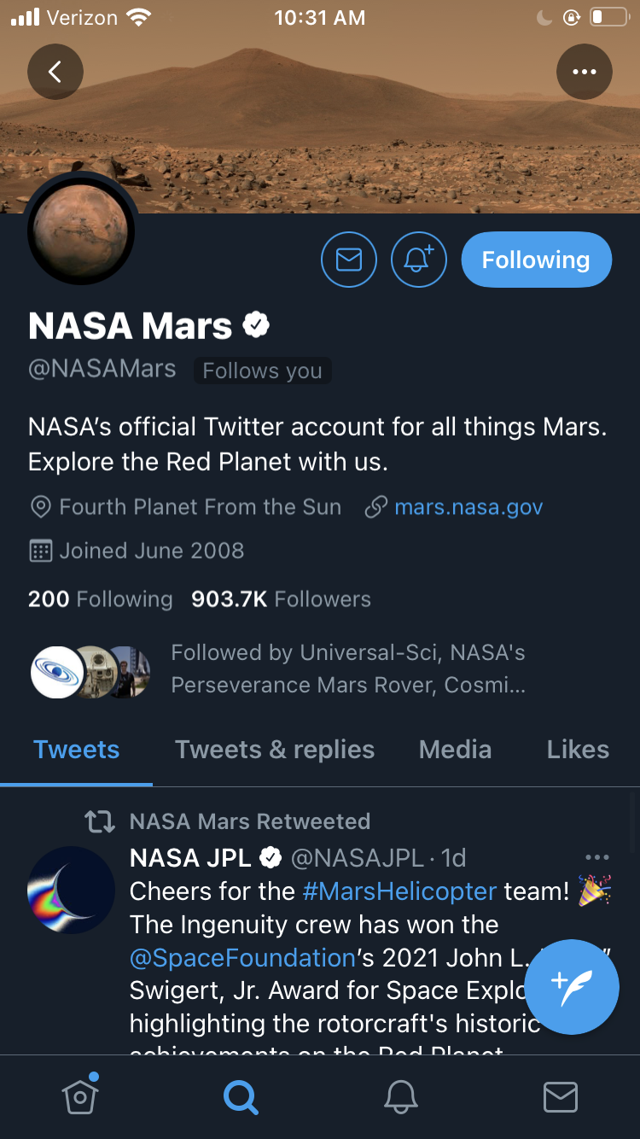
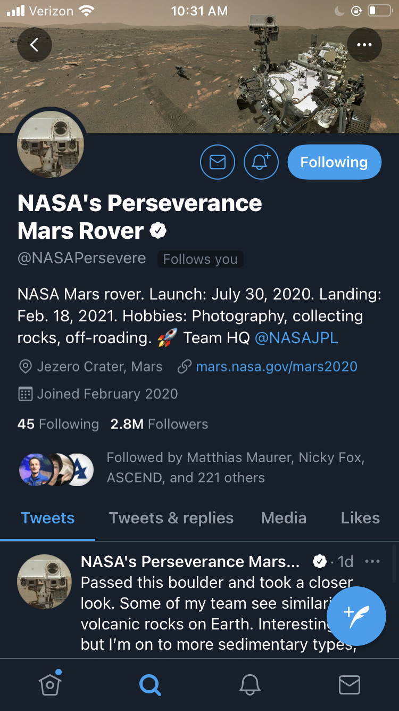
NASA Science Social Media

Slide 4
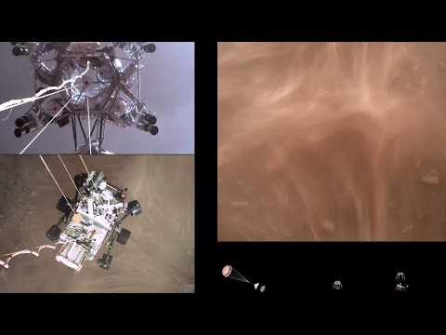
Notes:
Begin video at 2:40, please.

Slide 5
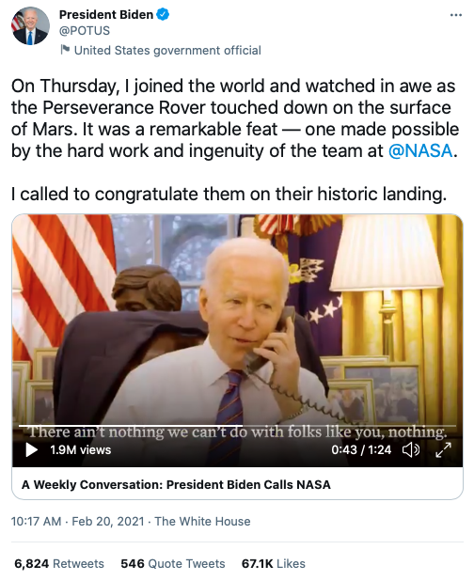
Perseverance Touchdown on Mars
Perseverance landed on Mars on Feb. 18, 2021
Landing broadcast in English and Spanish: 4.2 million live viewers with 21 million recorded views – NASA’s most popular YouTube video of all time
Web traffic: 26.9 million page views across all of NASA sites on landing date
Hashtag performance: Over 240k total social media mentions involving #CountdownToMars
Notable mentions: POTUS, VPOTUS, FLOTUS, Barack Obama, Ringo Starr

Slide 6

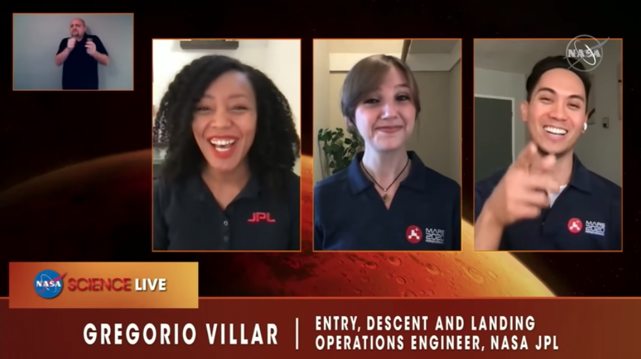
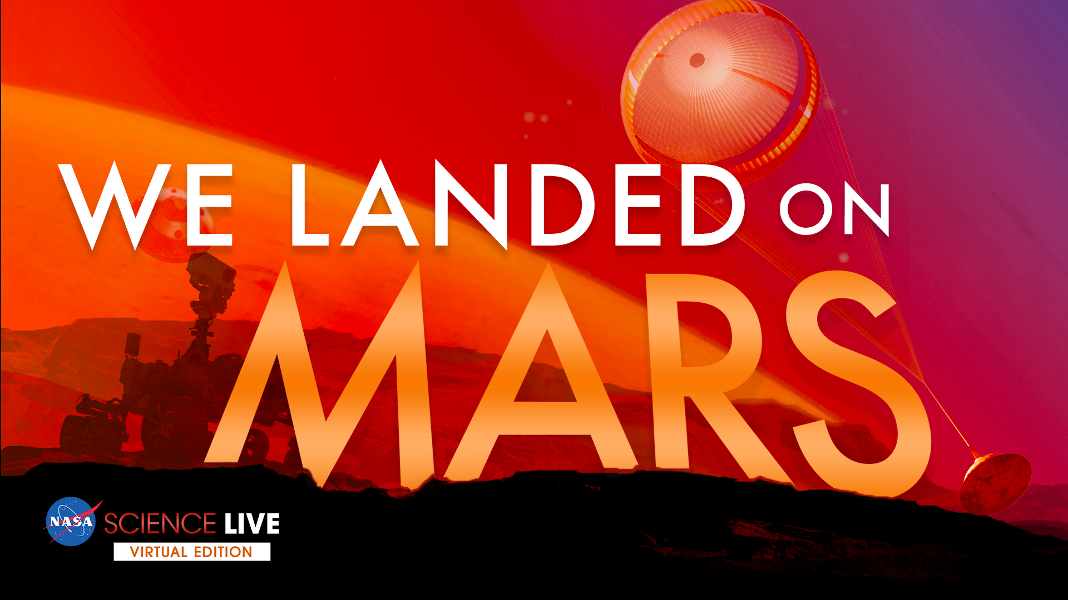
NASA Science Live
We Landed on Mars
Air Date: Friday, Feb. 19 - Day after landing
Total Episode Views: 2,408,540
Peak Live Viewers: 35,000+
The NASA Science Live show airs on NASA’s YouTube, Facebook and Twitter channels, as well as NASA TV, which have a combined audience of more than 79 million followers.
Episodes cover a range of topics from breaking news, mission updates to fascinating science topics.
We aim to reach the general public audience on social media and approach each episode as if we are explaining the topics to viewers who have little to no background knowledge about what is being discussed.
A large portion of every episode is dedicated to answering questions from the audience using #askNASA. This real-time engagement allows members of the public to interact with NASA experts on a range of scientific topics.

Slide 7
Influencer Bootcamp
What is an Influencer Bootcamp? This interactive VIP guest experience was an opportunity to engage digital influencers for the Perseverance landing.
This one-hour virtual event took place on Zoom in the days leading up to the Perseverance landing.
A curated list of digital influencers was invited to attend this private event – included education, science, and space influencers, with a focus on diversity and inclusion.
The moderator asked questions to help facilitate the conversation flow, but this conversational chat allowed for experts to share impactful personal stories and generate excitement for the mission and future Mars exploration.

Slide 8
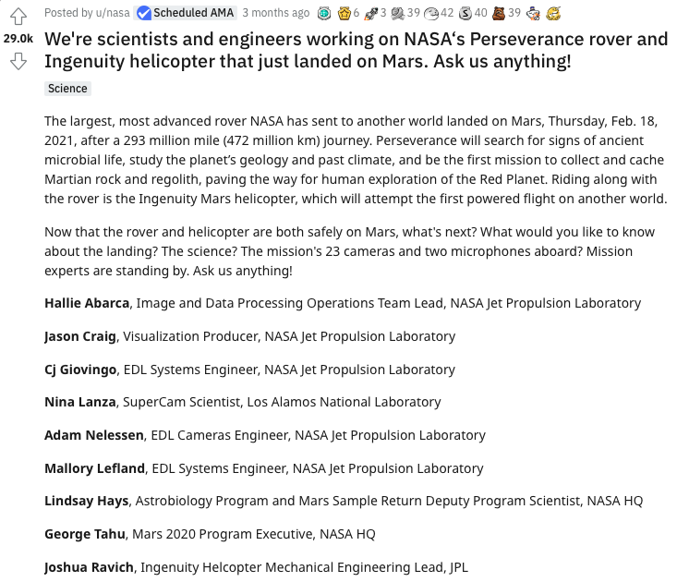
Reddit AMA
What is a Reddit AMA? Reddit AMAs (which stands for “Ask Me Anything”) are Q&As designed to bring an authority on a subject to a community of interested people.
For the Perseverance landing, NASA hosted a Reddit AMA on Feb. 22, just days after the successful landing on Mars.
The AMA was hosted in r/iAMA – a community with 21.1 million followers.
Perseverance scientists, engineers, and mission leadership participated in the event, answering questions in real-time for two hours.

Slide 9
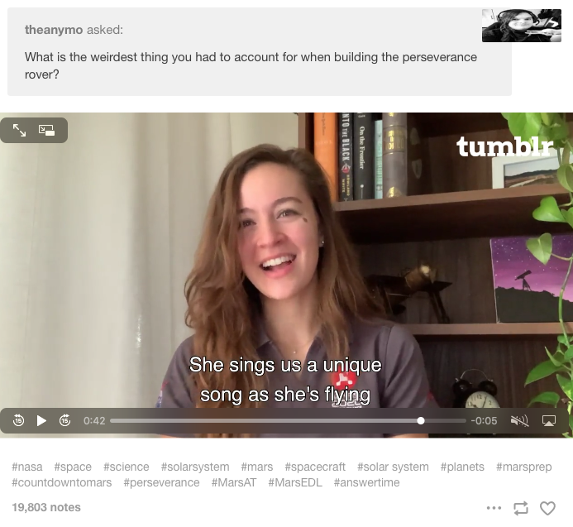
Tumblr Answer Time
What is a Tumblr Answer Time? Video and text Q&As with notable people. In the days leading up to an Answer Time session, Tumblr users are invited to submit questions for special guests.
For the Perseverance landing, NASA hosted a Tumblr AMA with engineer Chloe Sackier in the weeks leading up to landing.
Tumblr blog post with the call for public questions posted on January 26 to https://nasa.tumblr.com
Video responses recorded over the next several days and the Tumblr video posts with videos published on February 4
Top video post received 19,000+ interactions

Slide 10
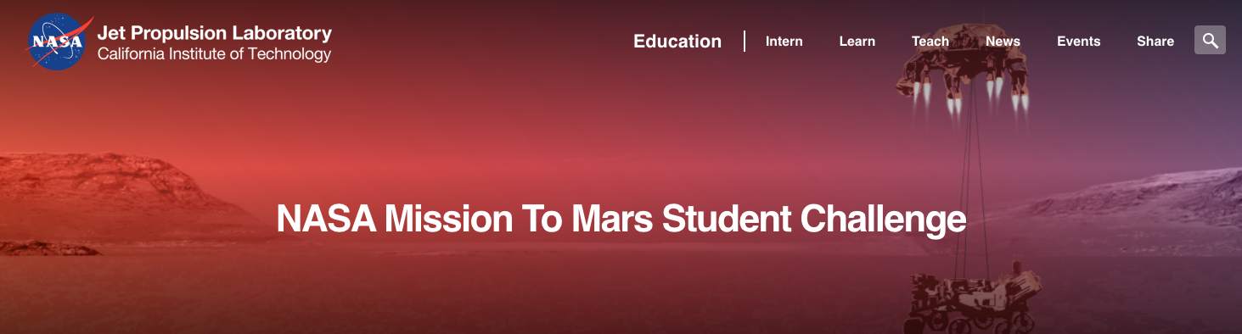
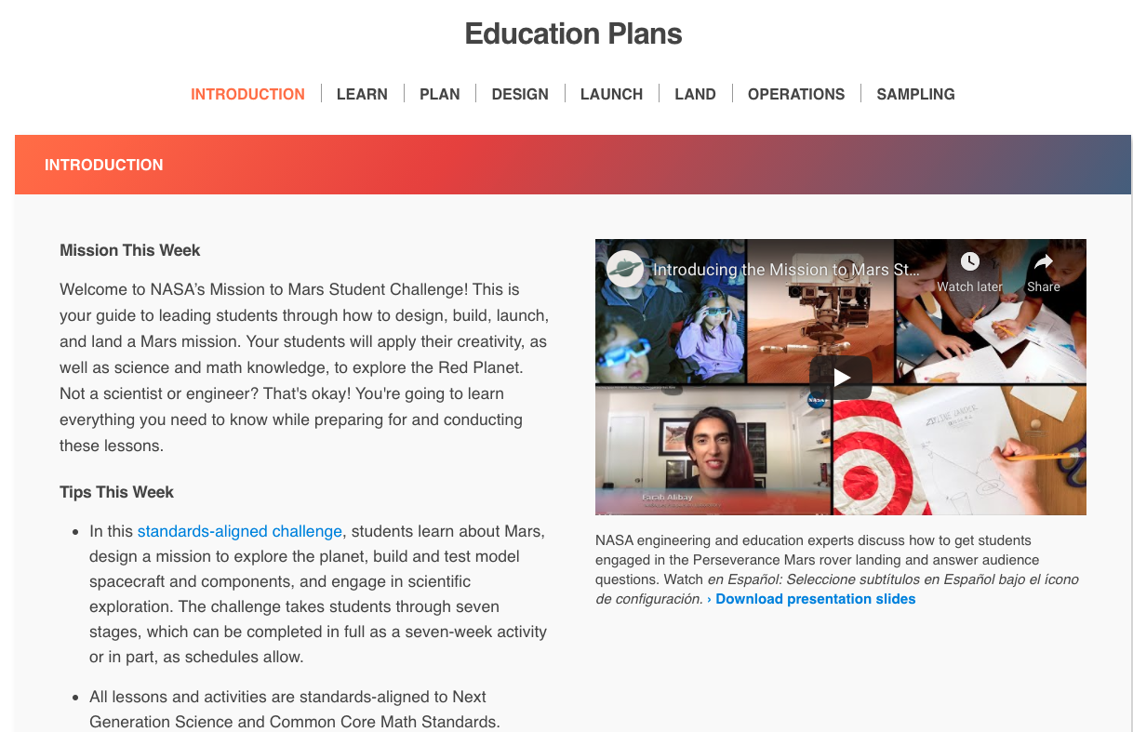
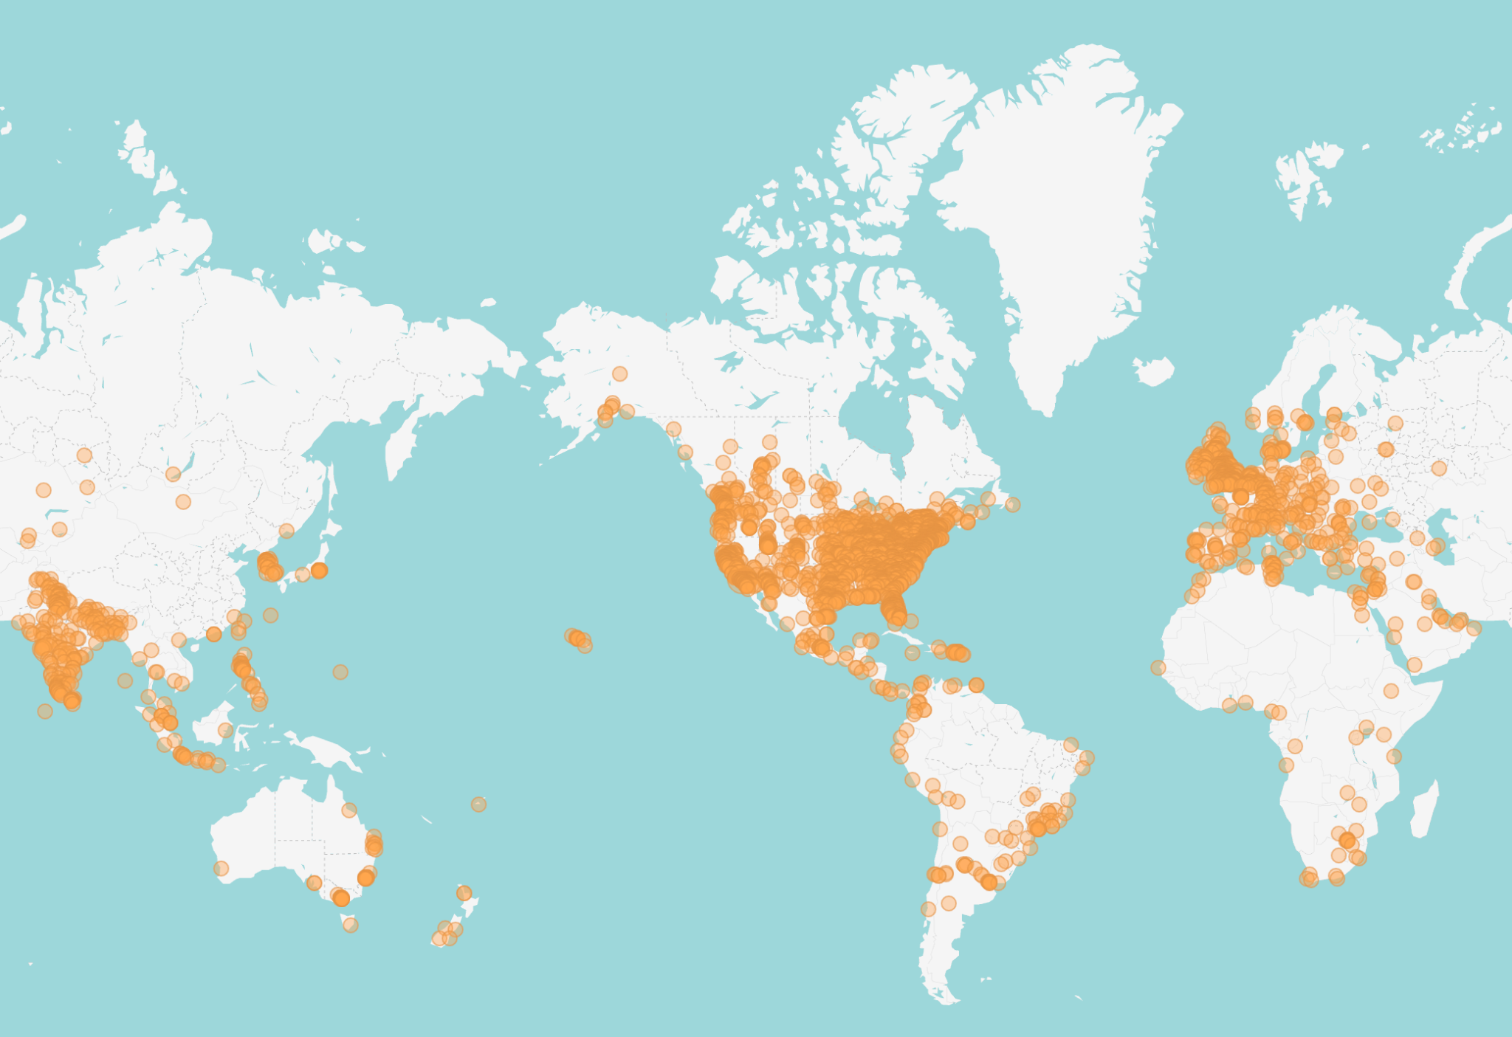
Engaging Students Virtually
Over 1 MILLION students worldwide registered for the NASA Mission to Mars Student Challenge.

Slide 11
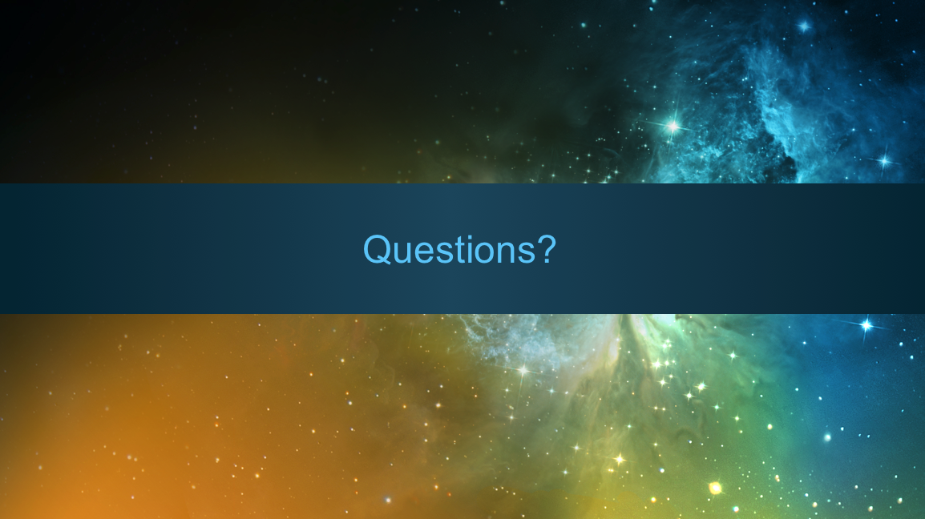

Slide 12
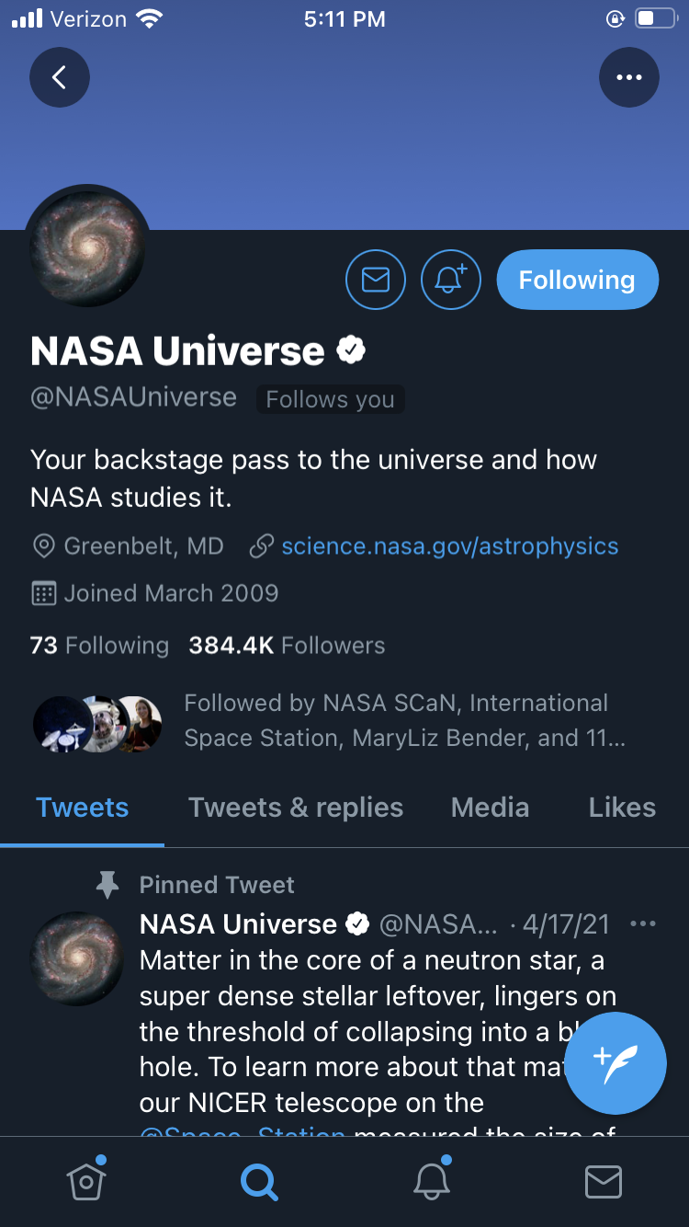
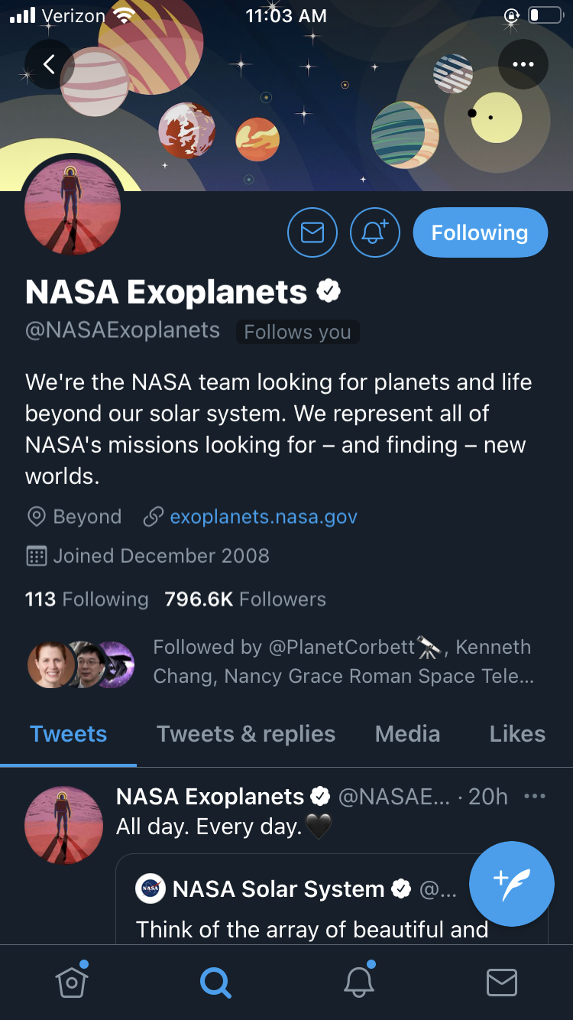
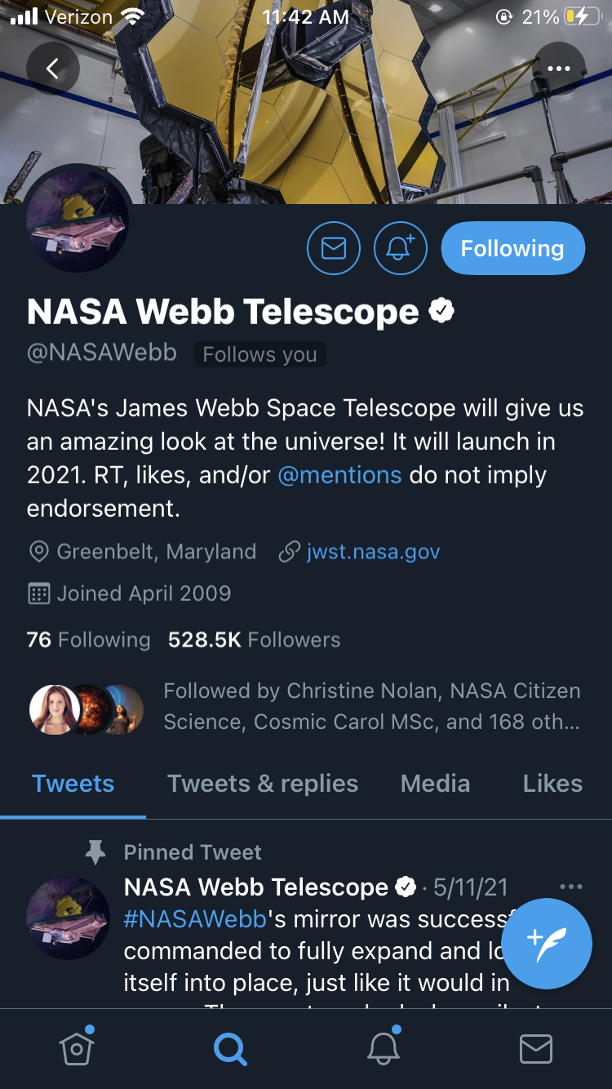
NASA Science Social Media

