Slide 1
Welcome to the
2016 InTeGrate Professional Development Webinar Series
Free and open to the public, this series aims to help faculty teach about the earth in the context of societal issues. The series incorporates InTeGrate principles into teaching practices, provides materials available for adoption, and creates a forum for participants to learn and share teaching strategies.
http://serc.carleton.edu/integrate/workshops/webinars/2015_2016/soils/index.html
Notes:
Alice will introduce the series and say a few words about InTeGrate

Slide 2




Teaching about Soils as a Critical Resource: Materials and Activities for your Classroom
Kathy Baldwin
Martha Murphy
Hannah Scherer
Alice Newman
Eastern Washington University
Santa Rosa Junior College
Virginia Tech
SERC (Moderator)
Notes:
Alice will introduce each speaker ––(name, affiliation, what modules she’s authored, and what she’ll talk about today)

Slide 3
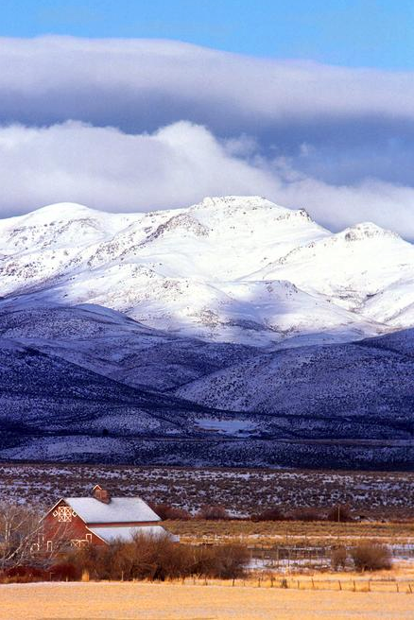
Overview of Webinar
An Introduction to Soils and Society
Soils teaching activities
Using soils to teach systems thinking
Participant reflection
Wrap-up and upcoming opportunities
Notes:
Alice can present this
Give people a heads up that something to take notes on will be helpful.

Slide 4
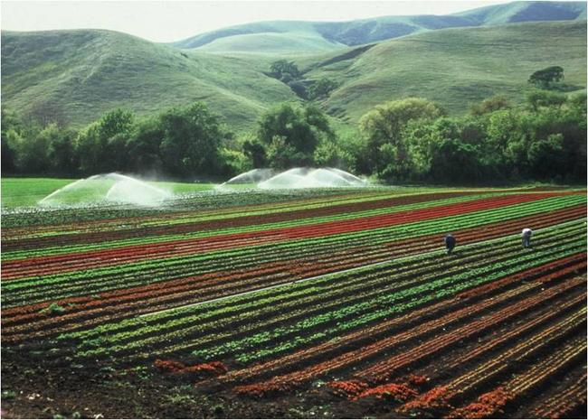
Soils and Society
Highly relevant to grand challenges facing society
Provides a frame for systems thinking
  Broadening knowledge of human impact on systems
Soil is everywhere!
  Easily accessible to every educator
Easy to include local context
Why Soils?
Notes:
Kathy

Slide 5
A Growing Concern Module
Notes:
Martha

Slide 6
Unit 3 – Natural and Agricultural Erosion Rates
Students consider the negative impact of agricultural erosion on soil sustainability
(visualization activity)

Slide 7
Visualize the average cropland erosion in
1 year = 0.6 mm
Visualize how much soil thickness will change in your lifetime
(from Unit 3)
Approximately equivalent to the thickness of
2 business cards
One credit card
Visualize the average soil formation in
1 year = 0.036 mm
Approximately equivalent to the thickness of
2 pieces of aluminum foil
Half the thickness of a piece of copier paper
Visualize the average cropland erosion in
1 decade = 6 mm
Approximately equivalent to the thickness of
3 quarters + 1 dime
A slim cell phone
Visualize the average soil formation in
1 decade = 0.36 mm
Approximately equivalent to the thickness of
Four $100 bills
One business card
Notes:
Students might be asked if they can demonstrate differences in the last century of erosion for natural & cropland settings. The instructor might then show a meter stick to give context to the above averages.

Slide 8
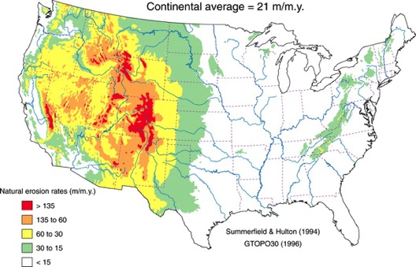
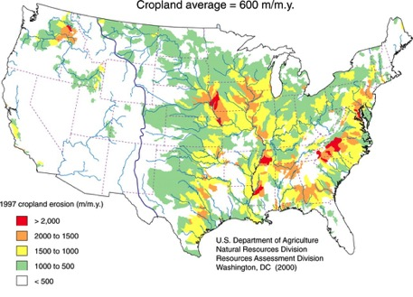
In figure A, areas in white and green have erosion rates that are less than soil production rates (30 m/my).
In figure B, all regions that are colored in have erosion rates that exceed soil production rates.
Figure A. Natural Erosion Rates
Figure B. Cropland Erosion Rates
Based on the two figures,
How much area could potentially generate new soil? (Estimate to the nearest 10%.)
Is the soil at your location threatened under present erosion rates?
Answers:
20%
If your location is not contained within the circled areas, topsoil is threatened.
(Wilkinson and McElroy, 2007, GSA Bulletin January/February, 2007 vol. 119 no. 1-2 140-156 )
Notes:
The answer to question 2 depends on your location. Only if you live within the boldly circled areas is erosion less than production. All other locations have threatened soil resources under current practices.

Slide 9
Unit 4 – Using SoilWeb™ to Investigate the Soil Beneath You http://casoilresource.lawr.ucdavis.edu/gmap/
Students do pre-work reading and reflection in which they learn about the importance of organic matter, a key factor in soil fertility

Slide 10
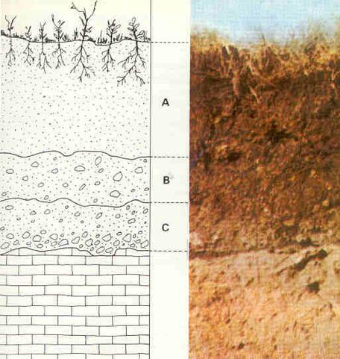
Soil Horizons
Notes:
CC Photographer Colette Kessler, USDA NRCS South Dakota
Location Dakota Lakes Research Farm, Hughes County, SD
Image URL: https://www.flickr.com/photos/87743206@N04/8053617736/
CC 2.0, No changes made to the image.

Slide 11
Using SoilWeb™ to Examine Local Soil Horizons & Percent Soil Organic Matter
Students draw soil horizons and percent soil organic matter to scale.
Comparing the two, students discuss which soil horizon controls fertility.
They then compare their site to another, provided in the powerpoint, and compare the erosion rate of each site in mm/year.

Slide 12
Click here
Santa Rosa Junior College

Slide 13
Santa Rosa Junior College

Slide 14
Click it
Santa Rosa Junior College

Slide 15
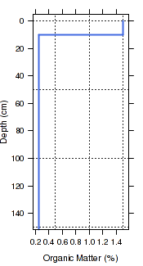
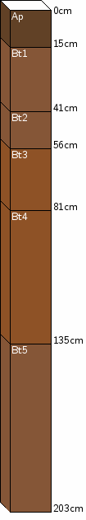
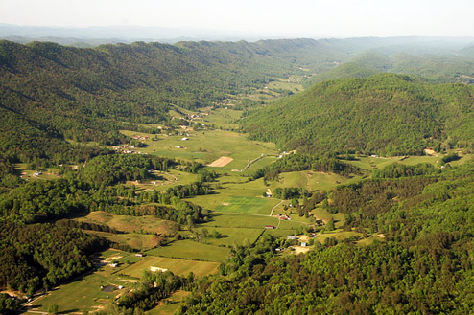
Bristol, Tennessee
Unit: Collegedale
Notes:
Image Created: May 13 2007Appalachian Mountains, Blue Ridge Mountains, CC-BY-SA-2.5,2.0,1.0
URL: http://en.wikipedia.org/wiki/Ridge-and-Valley_Appalachians#mediaviewer/File:Bristol_tenn_ridgelines2.jpg
SoilWeb http://casoilresource.lawr.ucdavis.edu/soilweb/

Slide 16
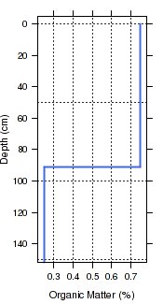
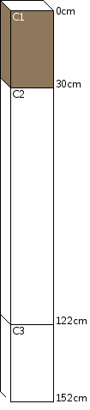
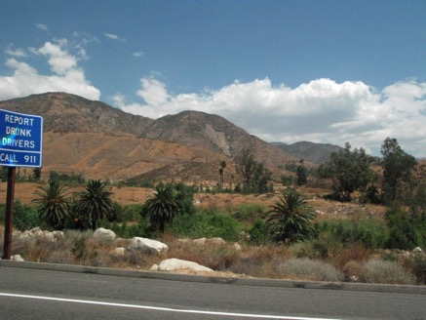
San Bernardino, California
Unit: Tujanga gravelly
Notes:
Image posted to Flickr.com, was uploaded to Commons using Flickr upload bot on 18:53, 28 September 2008 (UTC) by Amerique (talk). On that date it was licensed under the license below.
Creative Commons Attribution-Share Alike 2.0 Generic
URL: http://commons.wikimedia.org/wiki/File:Arrowhead,_San_Bernardino_Mountains.jpg
SoilWeb http://casoilresource.lawr.ucdavis.edu/soilweb/

Slide 17
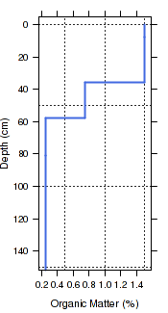
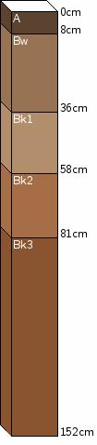
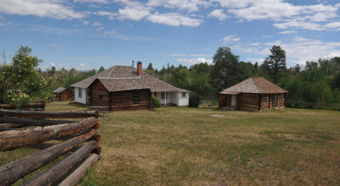
Daggett County, Utah
Unit: Wildmount
Notes:
SoilWeb http://casoilresource.lawr.ucdavis.edu/soilweb/
Photo source:
http://commons.wikimedia.org/wiki/File:SWETT_RANCH,_DAGGETT_COUNTY,_UTAH.jpg

Slide 18
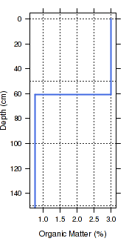
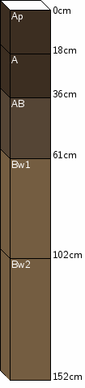
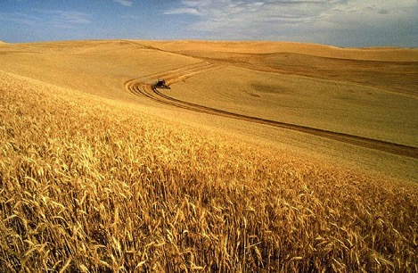
Palouse, Idaho
Unit: Palouse silt loam
Notes:
SoilWeb http://casoilresource.lawr.ucdavis.edu/soilweb/
Image URL: http://en.wikipedia.org/wiki/Wheat#mediaviewer/File:Wheat_harvest.jpg
Wheat harvest Public Domain Unknown - ars.usda.gov - Image Number K1441-5

Slide 19
In figure A, areas in white and green have erosion rates that are less than soil production rates (30 m/my).
In figure B, all regions that are colored in have erosion rates that exceed soil production rates.
Figure A. Natural Erosion Rates
Figure B. Cropland Erosion Rates
Based on the two figures,
How much area could potentially generate new soil? (Estimate to the nearest 10%.)
Is the soil at your location threatened under present erosion rates?
Answers:
20%
If your location is not contained within the circled areas, topsoil is threatened.
(Wilkinson and McElroy, 2007, GSA Bulletin January/February, 2007 vol. 119 no. 1-2 140-156 )
Notes:
The answer to question 2 depends on your location. Only if you live within the boldly circled areas is erosion less than production. All other locations have threatened soil resources under current practices.

Slide 20
Soils, Systems, and Society Module
http://serc.carleton.edu/dev/integrate/teaching_materials/soils/index.html
Notes:
Kathy’s section

Slide 21
Unit 2 Mapping Patterns
WA Mean Annual Precipitation
WA Elevation Map
WA Soil Map
WA Agriculture Map

Slide 22
Unit 2: Mapping Patterns
Washington Elevation Map

Slide 23
Unit 2: Mapping Patterns
Washington Mean Annual Precipitation

Slide 24
Unit 2: Mapping Patterns
Washington Soil Map

Slide 25
Unit 2: Mapping Patterns
Washington Agriculture Map

Slide 26
Soils, Systems and Society Module
Lessons Learned
Pilot module assessments indicated that students struggled most with interdisciplinary and systems thinking.
  Lesson alignment with the Next Generation Science Standards (NGSS).
Module revised to include:
  Reading and discussion about systems thinking
  Concept mapping activity to connect Earth systems
  One lesson plan from the Soils, Systems and Society Kit must teach K-8 students about systems.

Slide 27
Systems Thinking
http://serc.carleton.edu/integrate/teaching_materials/systems_what.html

Slide 28
Earth Systems Concept Mapping
http://serc.carleton.edu/integrate/teaching_materials/mineral_resources/conceptmaps.html
Notes:
Blurry

Slide 29
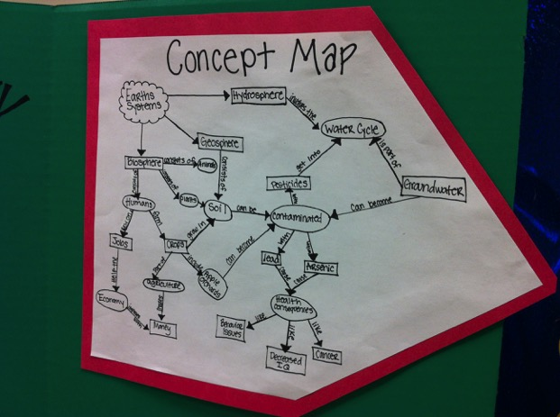
Example of Preservice Teacher Concept Map

Slide 30
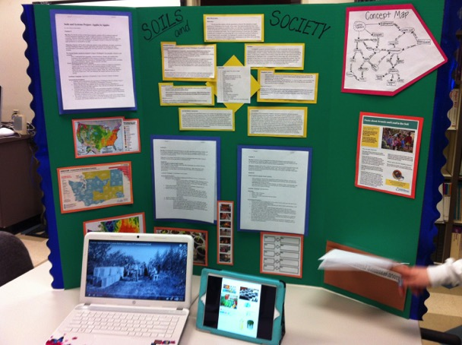
Soils, Systems and Society Kit

Slide 31
A Growing Concern Module
Systems thinking activity
Notes:
Hannah

Slide 32
Notes:
Make sure to emphasize scale of the questions and implications for pedagogy in the share out portion; point out specific examples that are “simple” and “complex” and those of different scales.

Slide 33
Unit 5: Predicting the effects of climate change on soil loss
http://serc.carleton.edu/integrate/teaching_materials/sustain_agriculture/activity5.html

Slide 34
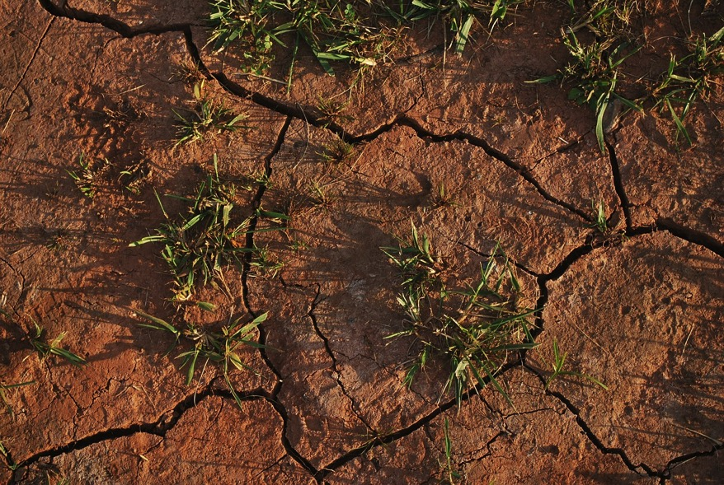
The relationship between precipitation and soil erosion is a complex system.
Estimated average soil loss = R*K*LS*C*P
Notes:
From the RUSLE, we know that these changes in precipitation will impact soil erosion (loss), but this equation doesn’t allow us to easily consider interactions between the factors to understand how this happens.
Image credit: PublicDomainPictures (http://pixabay.com/en/soil-land-dry-cracked-drought-15540/)
Public domain image, CC0 1.0 Universal

Slide 35
The relationship between precipitation and soil erosion is a complex system.
?
Precipitation
Erosion
Notes:
A systems diagram is another way to think about this and it allows us to consider changes in the system more conceptually.
Query the students if they can give examples of other (bigger) systems; make sure to discuss the earth system (introduced in Unit 1). Now we are going to focus in on a smaller scale system.
We know that precipitation influences erosion, but there are intermediate processes that impact exactly how this works.

Slide 36
This diagram illustrates relationships between factors that influence erosion in agricultural systems.
Runoff
+
+
Precipitation
Erosion
-
-
+
Crop Yield
Modified from: Pruski, F. F., and M. A. Nearing, 2002, Climate-induced changes in erosion during the 21st century for eight U.S. locations, Water Resour. Res., 38(12), 1298, doi:10.1029/2001WR000493.
Notes:
This systems diagram is based on modeling of the effects of climate change on erosion in various agricultural regions in the US. It allows for a more sophisticated examination of how precipitation influences erosion. The next few slides walk through how to read this diagram.
The student notes handout has a blank version of this diagram for them to fill in as you go along, including a space to write definitions for the various symbols. Let them know that they don’t need to copy it all down at once on this slide.

Slide 37
The direction of the arrows indicates cause and effect relationships.
Runoff
Precipitation
Erosion
Crop Yield
(diagram modified from Pruski and Nearing, 2002)
Notes:
Alice…this is too long.

Slide 38
For example, this arrow tells us that changes in precipitation cause changes in runoff.
Runoff
Precipitation
(diagram modified from Pruski and Nearing, 2002)

Slide 39
If it were pointing the other way, that would mean that changes in runoff cause changes in precipitation. This doesn’t make much sense!
Runoff
X
Precipitation
(diagram modified from Pruski and Nearing, 2002)

Slide 40
But, the direction of the arrows doesn’t tell us how a factor impacts other factors.
Runoff
Precipitation
Erosion
Crop Yield
(diagram modified from Pruski and Nearing, 2002)

Slide 41
The + and – signs indicate what type of relationship exists between the factors.
+ = positive relationship
- = negative relationship
Runoff
+
+
Precipitation
Erosion
-
-
+
Crop Yield
(diagram modified from Pruski and Nearing, 2002)

Slide 42
A positive relationship means that a change in one factor causes an effect on another factor in the same direction.
Runoff
+
+
Precipitation
Erosion
+
Crop Yield
(diagram modified from Pruski and Nearing, 2002)

Slide 43
For example, this arrow indicates that… an increase in precipitation causes an increase in runoff
AND a decrease in precipitation causes a decrease in runoff
Runoff
+
Precipitation
(diagram modified from Pruski and Nearing, 2002)

Slide 44
A negative relationship means that a change in one factor causes an effect on another factor in the opposite direction.
Runoff
Erosion
-
-
Crop Yield
(diagram modified from Pruski and Nearing, 2002)

Slide 45
For example, this arrow indicates that… an increase in crop yield causes a decrease in erosion
AND a decrease in crop yield causes an increase in erosion
Erosion
-
Crop Yield
(diagram modified from Pruski and Nearing, 2002)

Slide 46
So, we can use this diagram to describe relationships between factors that influence erosion in agricultural systems and predict how changes in one factor will influence other factors.
Runoff
+
+
Precipitation
Erosion
-
-
+
Crop Yield
(diagram modified from Pruski and Nearing, 2002)

Slide 47
Models for Syracuse, Nebraska, predict that precipitation will decrease overall for the region. Erosion is also expected to decrease for wheat.
Which pathway is most likely to be dominant for wheat?
Runoff
+
+
Precipitation
Erosion
-
-
+
Crop Yield
(diagram modified from Pruski and Nearing, 2002)
Notes:
Decrease in precipitation → decrease in runoff → decrease in erosion
Note that this pathway must be dominant to explain the predicted results. It can be expected that crop yield will also decrease (due to less available water), which would contribute an increase in erosion, but this must be smaller than the effects of decreasing runoff.
Follow-up question: Why would a decrease in runoff cause a decrease in erosion? Less water to carry sediment (soil) away.

Slide 48
The same models predict that, while precipitation decreases overall for the region, erosion is expected to increase for cornfields.
Which pathway is most likely to be dominant for corn?
Runoff
+
+
Precipitation
Erosion
-
-
+
Crop Yield
(diagram modified from Pruski and Nearing, 2002)
Notes:
Decrease in precipitation → decrease in crop yields (→ increase in runoff) → increase in erosion
Note that in this case, crop yield must be severely impacted so that even though there is less water around there is an increase in erosion.
Follow-up question: Why would a decrease in crop yield lead to increased runoff and/or erosion? decreased canopy protecting soil from impact of raindrops; fewer roots and lower organic matter in soil means less stability (more erosion) and decreased infiltration (more runoff).

Slide 49
Based on these pathways, which crop do you think is more severely impacted by the decrease in precipitation?
Wheat
Runoff
+
+
Precipitation
Erosion
-
-
+
Crop Yield
Corn
(diagram modified from Pruski and Nearing, 2002)
Notes:
The dominant pathway for wheat does not include an impact on crop yield, which indicates that this crop is not severely impacted by the modeled decrease in precipitation for this location.
On the other hand, the dominant pathway for corn does include an impact on crop yield, which indicates that this crop must be impacted by the modeled decrease in precipitation for this location.
This can be explained by the fact that corn requires more water to grow than wheat and takes longer to grow, meaning it needs sustained water throughout the summer. So, for corn, the decrease in precipitation decreases crop yields to a degree where erosion actually increases compared to current rates.

Slide 50
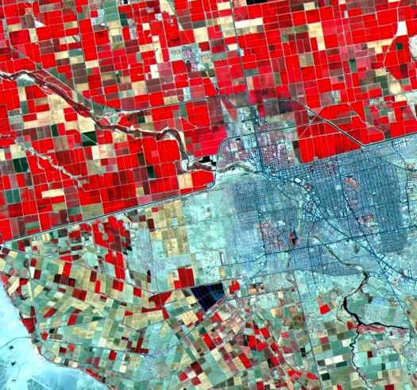
In agricultural systems, humans also make decisions that can have big impacts.
What are some ways in which humans influence agriculture?
Notes:
Wrap-up
In the corn/ wheat example, we saw that a change in the system can impact individual crops in different ways. What is planted and the management practices employed are ultimately human decisions that have a big impact on the agro-ecosystem. This image is provided as an example of how economics and politics also have an impact on the agricultural system. You can use this to guide a closing discussion about the idea that sustainable solutions to mitigating the impacts of climate change must address environmental, social, and economic factors.
Image description from NASA: Dramatic differences in land use patterns are highlighted in this image of the U.S.-Mexico border. Lush, regularly gridded agricultural fields on the U.S. side contrast with the more barren fields of Mexico. This June 12, 2000, sub-scene combines visible and near infrared bands, displaying vegetation in red. The town of Mexicali-Calexico spans the border in the middle of the image. Watered by canals fed from the Colorado River, California's Imperial Valley is one of the country's major fruit and vegetable producers. This image covers an area 24 kilometers (15 miles) wide and ~24 kilometers (15 miles) long in three bands of the reflected visible and infrared wavelength region.
Public Domain Image Credit:
NASA/GSFC/METI/ERSDAC/JAROS, and U.S./Japan ASTER Science Team
http://photojournal.jpl.nasa.gov/catalog/PIA02659

Slide 51
Both soils modules:
Focus on the value of soils
Promote systems thinking
Examine patterns as a way to understand Earth systems
Interpret map data
Are inquiry based. Students are allowed to investigate their interests
Have performance based summative assessments
Notes:
Who’s presenting this?

Slide 52
Resources
http://serc.carleton.edu/integrate/info_team_members/currdev/effective_materials/systems_think.html
Notes:
Hopefully you have more questions than you did at the beginning! Here are some great places to go for more information on specific concepts and approaches
Still need to compile these and add here and to the website. Will just highlight a few key ones on this slide then refer them to the webinar site

Slide 53

Resources
http://serc.carleton.edu/integrate/participate/systems_thinking/index.html
Notes:
Hopefully you have more questions than you did at the beginning! Here are some great places to go for more information on specific concepts and approaches
Still need to compile these and add here and to the website. Will just highlight a few key ones on this slide then refer them to the webinar site

Slide 54
After reflecting on this prompt for a moment, please use the ‘chat’ feature to write a few sentences.
How do you envision applying what you learned today to your situation, whether it’s your class, department, or college/university?
You are also welcome to ask other questions for discussion at this time.

Slide 55
Upcoming opportunities
Next InTeGrate webinar:
Working with Diverse Students on Societally Relevant Geoscience Issues
Wednesday, May 11
11:00 am Pacific | 12:00 pm Mountain | 1:00 pm Central | 2:00 pm Eastern
Registration deadline: Monday, May 9
Join us at the next Earth Educators’ Rendezvous (July, in Madison, WI)
Consider your department or course for NAGT’s Traveling Workshops Program
Help us…help you…
Webinar evaluation

