Slide 1
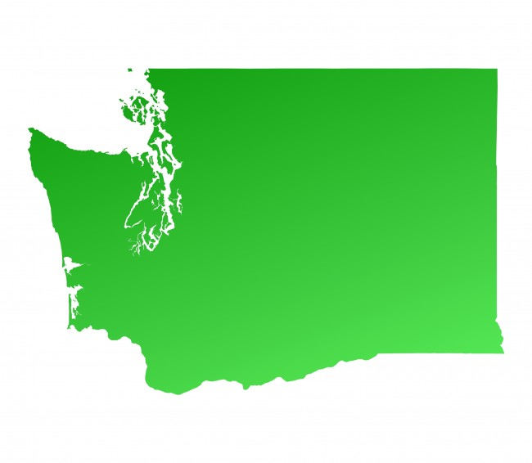
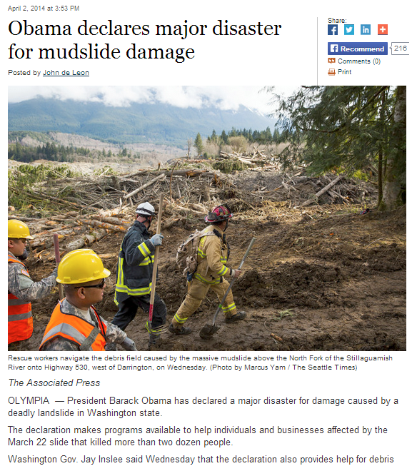
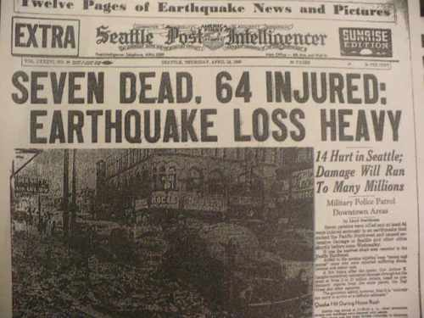
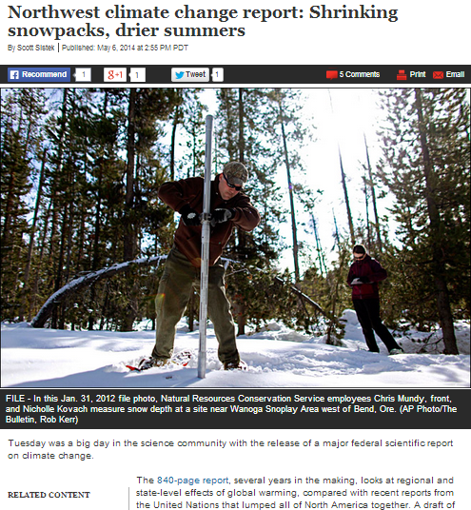
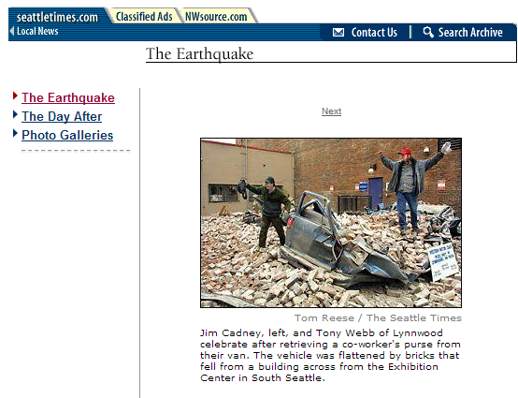
Natural Hazards Planning

Slide 2
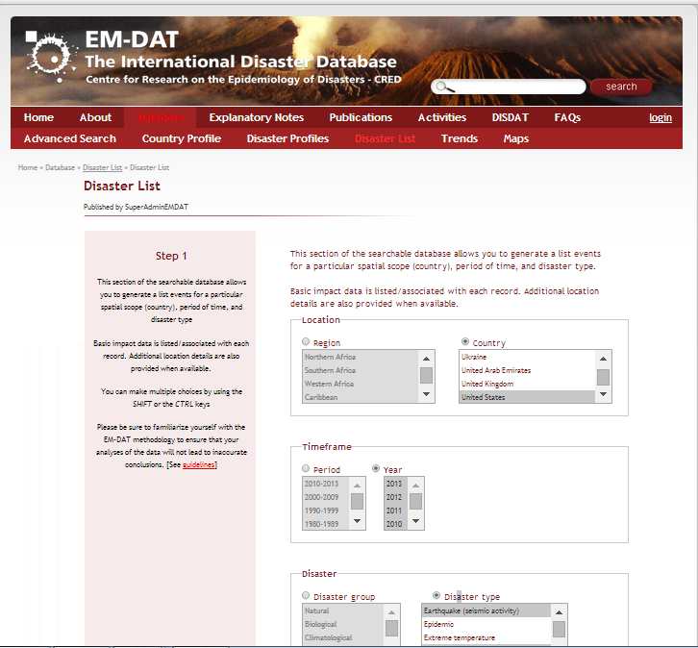
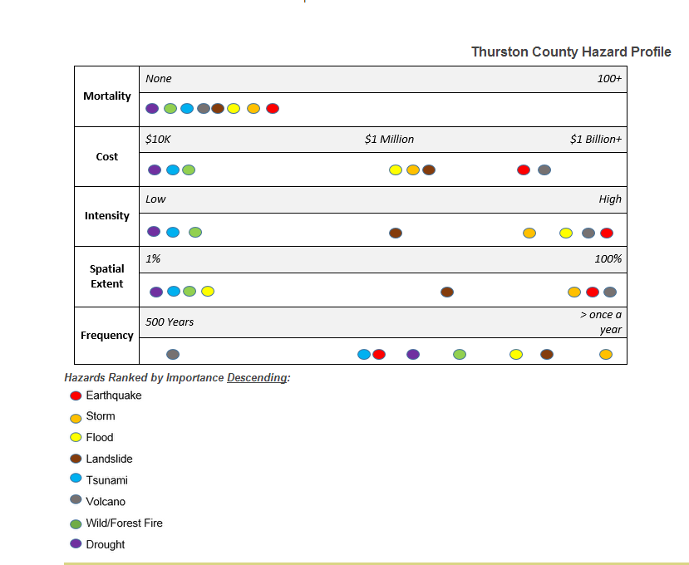
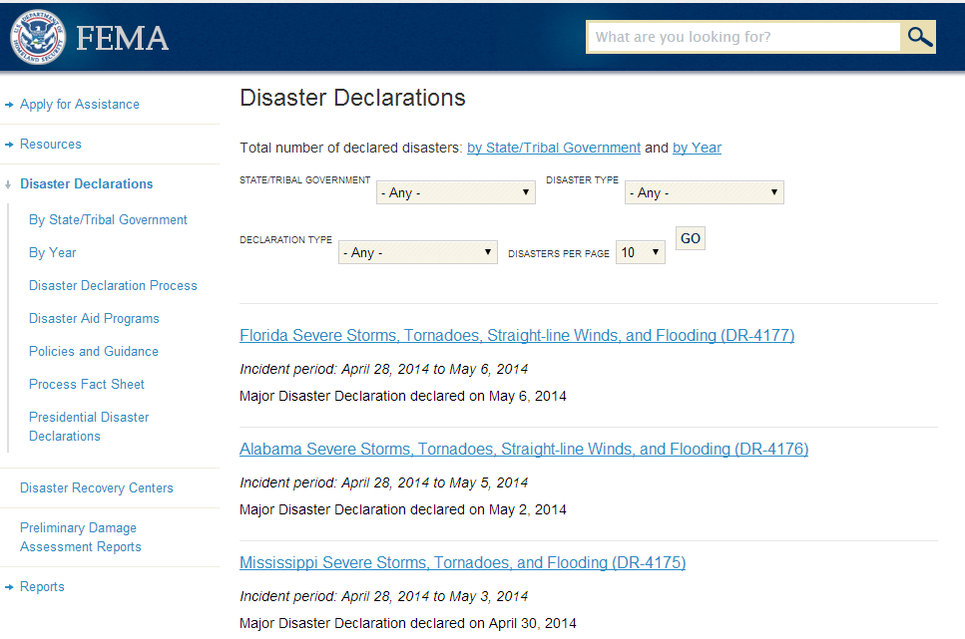
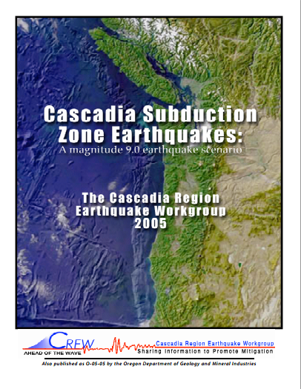
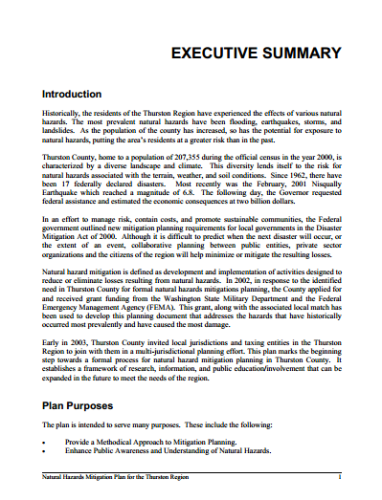
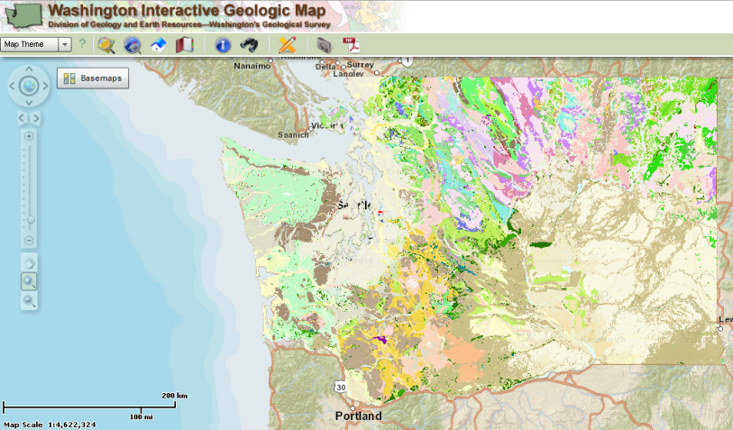
Priority Hazards
Earthquakes
Winter storms

Slide 3
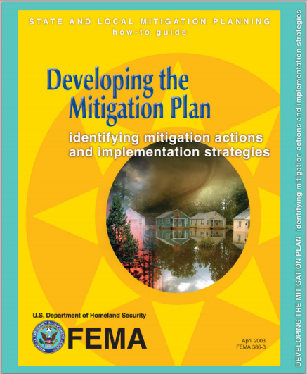
ASSIGNMENT: Developing Community Mitigation Strategies
Students will develop a framework for reducing loss of life and infrastructure damage from natural hazard events by selecting and combining mitigation tools, based upon the needs and culture of a community.

Slide 4
Mitigation Strategy Development Process
Earthquake Goals:
Reduce loss of life
Reduce recovery time
Earthquake Objectives:
Retrofit 50% URMs in urban centers
Require code compliance or retrofitting of all hospitals
Strengthen weakest 10 % of bridges on interstates
Require flexible pipe connections on new water/sewage main systems
Earthquake Mitigation Options:
Public education campaign on dangers of URMS
Rapid visual assessment to identify high risk URMs
Disclosure of URM risks mandatory in real estate sales
Financial incentive program for voluntary retrofitting
Publish a retrofitting design toolkit
Phased in mandatory retrofitting program for high risk URMs
??

Slide 5
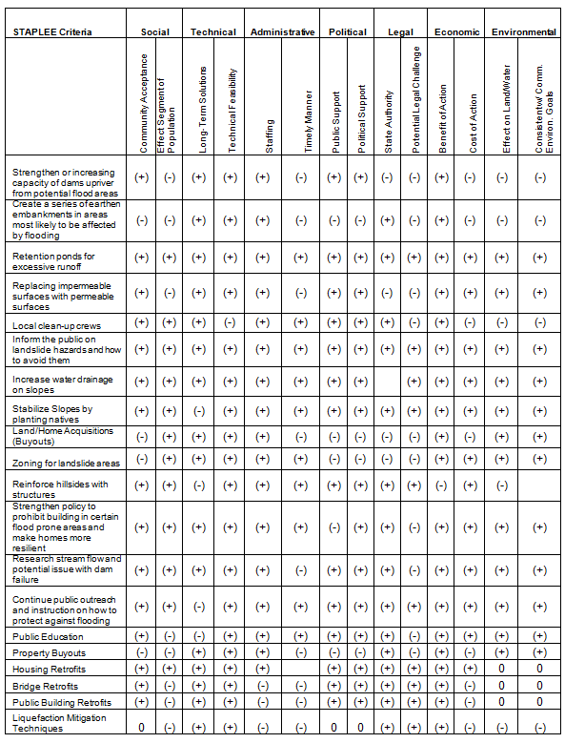
STAPLEE CRITERIA
 |  | Social |  | Technical |  | Admin |  | Political |  | Legal |  | Economic |  | Environmental
Type | Mitigation Options | Community Acceptance | Compliant with values | Effectiveness | Long Term | Workforce | Funding | Political Support? | Cost efficient | Practicality | Ordinances | Cost Vs. benefit | Outside Budget funding needed? | Negative effect on land/water? | Negative effect on local species?
 | Hazard Mapping | + | + | - | + | - | + | + | + | + | + | + | - | - | -
Flood and Winter Storm Mitigation Options | Pervious surfaces | + | + | + | + | + | - | - | - | - | + | - | + | - | -
 | Riparian Buffers | + | + | + | + | + | + | + | + | + | + | + | - | - | -
 | Flood proofing | + | + | + | + | + | + | + | + | + | + | + | - | - | -
 | Planting Wind-Resistant tree species | + | + | + | + | + | + | + | + | + | + | + | - | - | -
 | Meteorological monitoring | + | + | + | - | - | - | + | - | + | + | + | + | - | -
 | Early warning alert systems | + | + | + | - | + | + | + | + | + | + | + | - | - | -
 | Shatter-resistant window for major facilities | + | + | + | + | + | - | + | - | - | + | - | + | - | -
 | Wind Proofing | + | + | + | + | + | + | + | + | + | + | + | - | - | -
 | Capital improvement plans-Public | + | + | + | + | + | + | - | + | - | - | + | - | - | -
 | Capital Improvement Plans-Private | + | + | + | + | + | + | - | + | - | - | + | - | - | -
 | School preparedness education within school curriculum | + | + | + | + | + | + | + | + | + | + | + | - | - | -
 | Increase public service announcements | + | + | + | + | + | + | + | + | + | + | + | - | - | -
 | “Severe Weather Week” Public outreach | + | + | - | + | + | + | + | + | + | + | + | - | - | -
 | Bolster building codes and construction methods for heavy winds | + | - | + | + | + | + | - | + | + | + | + | - | - | -
 | Creating Safe Zones in Public spaces | + | + | + | + | + | + | + | + | + | + | + | - | - | -
 | Required annual evacuation drills | + | + | + | + | + | + | + | + | + | + | + | - | - | -
 | Diagonal bracing on Hospital roofs | + | + | + | + | + | + | + | + | + | + | + | - | - | -
 | Retrofit water and sewer pump stations against high wind | + | + | + | + | + | + | + | + | - | + | + | - | - | -
 | Mandatory backup generators in lifeline facilities | + | + | + | + | - | + | + | + | + | + | + | - | - | -

Slide 6
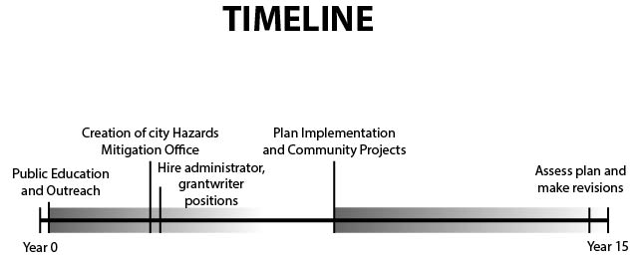
Mitigation Strategies
Priority Hazards Kenai Peninsula
Tsunami
Earthquake
Avalanches
Volcanoes
Expand Tsunami Ready Programs to small towns
Earthquake Preparedness Education Campaign
Avalanche forecasting
Volcano preparedness awareness
Lahar zone mapping and restricted zoning

