Slide 1
Engaged Sustainability Implementation Program
Wednesday, May 27th, 2015
12:30-6:00 PM, Shouvlin Student Center, Wittenberg University
Workshop Leadership: Sarah Fortner (Geology & Environmental Science),Amber Burgett (Biology), Dave Finster (Chemistry), Ruth Hoff (World Languages & Cultures)
Other involved in this grant: Elizabeth George, Jeremiah Williams, Sheryl Cunningham
This work is supported by a National Science Foundation (NSF) collaboration between the Directorates for Education and Human Resources (EHR) and Geociences (GEO) under grant DUE - 1125331.
Disclaimer: Any opinions, findings, conclusions or recommendations expressed in this website are those of the author(s) and do not necessarily reflect the views of the National Science Foundation.
Notes:
Read title and ask Molly to speak about technology/chat.

Slide 2
Workshop Goals
Describe Overarching InTeGrate Project & Goals of this Effort
Introduce Key Framework for InTeGrate Module Development & Guide to Revisions
Develop a sustainability learning goal for your course that is: interdisciplinary, measureable, & considers fit with your other course/program requirements
Suggestions on fit issues from our pilot experience
Reporting Instruments
6) Course Details & Implementation Timeline

Slide 3
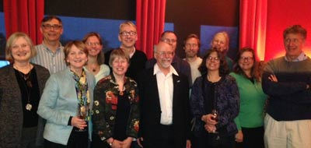
A five-year community effort to improve geoscience literacy and build an interdisciplinary workforce prepared to tackle environmental and resource issues
What is InTeGrate?
InTeGrate Leadership team, March 2013
2012-2016
http://serc.carleton.edu/integrate
Notes:
Taken from: http://serc.carleton.edu/integrate/workshops/2yc_webinar/index.html#products

Slide 4
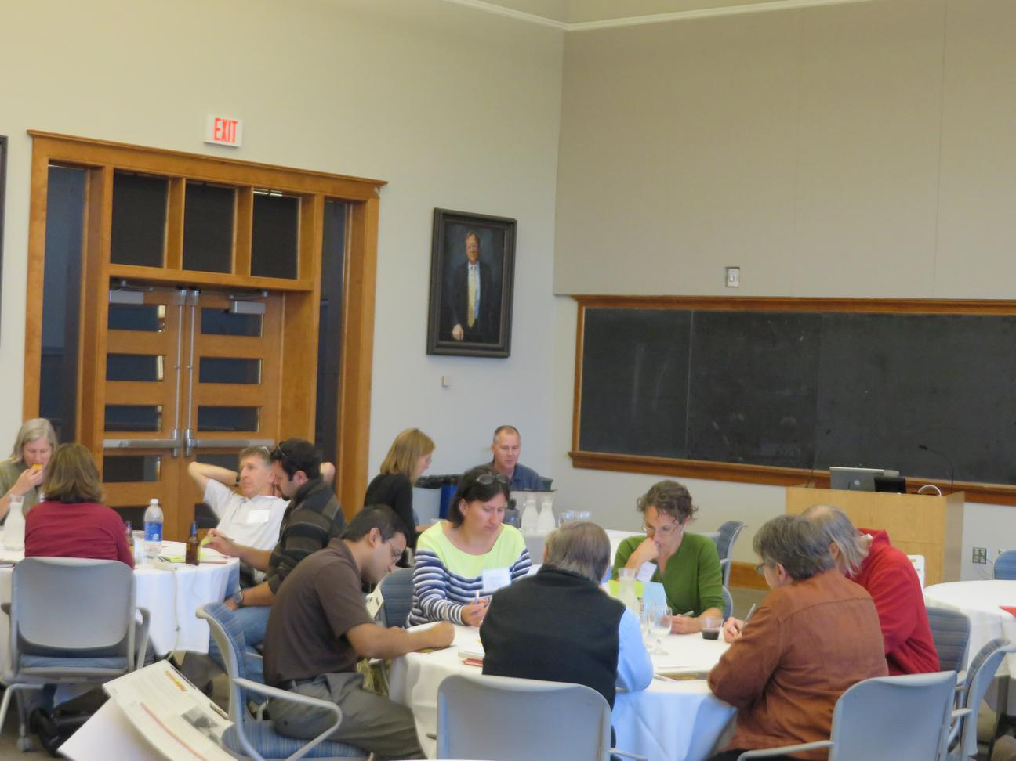
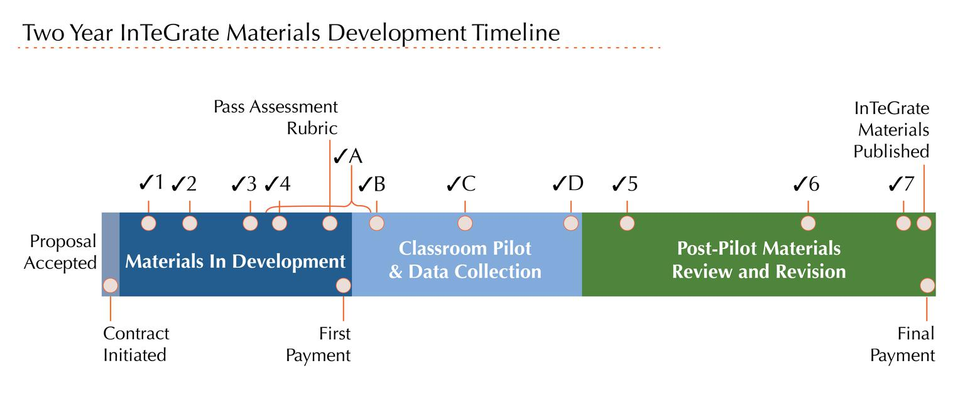
InTeGrate Materials
InTeGrate materials were designed and tested by your peers — faculty and instructors at diverse institutions across the country.
Each 2-3 week module was created, tested, and refined over a 2-year time period by a team of three authors.
Modules in development continue to grow in the disciplines they address
Teams work together to create new InTeGrate teaching materials at an InTeGrate authors meeting.
Notes:
Adapted from: http://serc.carleton.edu/integrate/workshops/2yc_webinar/index.html#products

Slide 5
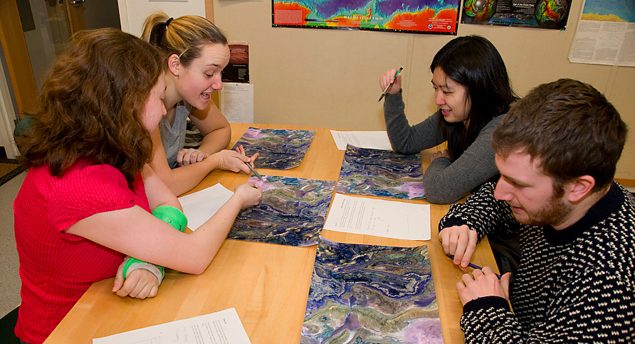
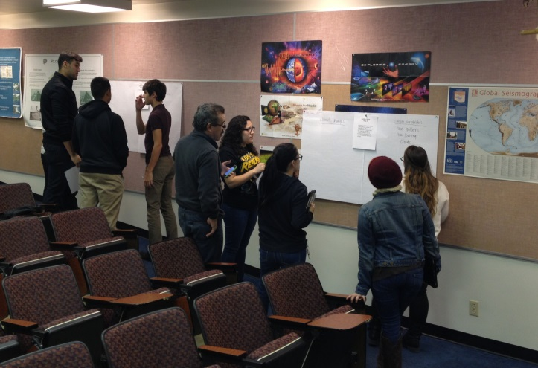
InTeGrate Materials
Students in jigsaw group.
Materials were designed to be adaptable to a wide variety of classrooms and settings:
community college
large research institution
online
in a large lecture hall
small seminar
Activities focus on engaging students in hands-on learning.
Students doing a gallery walk.
Notes:
Taken from: http://serc.carleton.edu/integrate/workshops/2yc_webinar/index.html#products

Slide 6
InTeGrate Implementation Programs
Develop a new vision for how geoscience is positioned in higher education,
Infuse geoscience throughout the curriculum,
Leverage existing geoscience, environmental science, and engineering programs to address solutions for societal problems, and
Engage younger students in the geosciences as a mechanism for increasing geoscience enrollment.
Contribute to a workforce that is prepared to address sustainability challenges
Sustainability will only be achieved through collaboration
http://serc.carleton.edu/integrate/about/implementation_programs.html
Notes:
Note that while goals are from a geoscience perspective, sustainability requires interdisciplinary solutions

Slide 7
InTeGrate Implementation Programs
Results from implementation efforts are shared as projects develop
& in online reporting so that others can learn from diverse models
http://serc.carleton.edu/integrate/programs/implementation/index.html
First Wave
Grand Valley State
Gustavus Adolphus
Stanford
Pennsylvania State
University of Texas, El Paso
Washington State Colleges & University
Wittenberg University
20 Implementation Programs will be funded in total
Notes:
Note that while goals are from a geoscience perspective, sustainability requires interdisciplinary solutison

Slide 8
Goals of this Effort:
Embedding geoscience sustainability modules in established courses across a breadth of disciplines and encourage student engagement
Broadening participation in sustainability and active learning pedagogies through a workshop to expand the adoption of sustainability curriculum
Creating deep learning opportunities in sustainability through program development across the Wittenberg experience (First-Year Experience, Cultures and Language Across the Curriculum, Environmental Science) and into the broader Wittenberg, Springfield, Clark County, and SOCHE community
http://serc.carleton.edu/integrate/programs/implementation/program3/index.html

Slide 9
Icebreaker:
Share (15 minutes):
(1) Name and institution
(2) Course title and 30-second description of course
(level, audience, why you have selected this course to implement an InTeGrate module)
(3) Why you have chosen to participate in this project?
(4) What InTeGrate module are you considering using? Why?
(5) Tell your group members something about yourself that they would not guess to be true!

Slide 10
In your small group, please identify & record shared goals.
What would you like to see come out of this effort (beyond your own course)?
(15 min)
We will collect, compile, & share small group responses & responses. These may help us identify growth opportunities, areas of mutual interest.

Slide 11
Participants:
Name, brief description of course or department, institution
James Allan, Political Science, Wittenberg University
Beth Bridgeman, Agrarian Systems, Antioch College
Sheryl Cunningham, Communication Course, Wittenberg University
Alejandra Gimenez-Berger, Art History Course, Wittenberg University
Ed Hasecke, Political Science, Wittenberg University
Kim Landsbergen, Soils Course, Antioch College
Nancy McHugh, Science in a Societal Context, Wittenberg University
Michelle McWhorter, Biology course, Wittenberg University
Dave Miller, Physical Geology, Clark State/Wittenberg University
Danielle Poe, Food Justice, University of Dayton
Barbara Sanborn, Energy, Antioch College
Tim Wilkerson, l'Environnement naturel des francophones, Wittenberg University
Jeremiah Williams* , Physics, Wittenberg University
(*absent)

Slide 12
A rigorous rubric was used to build
InTeGrate Curriculum
Please use the rubric if you plan to customize/revise content
6 contact hours of material
Workshop leaders are available to consult.

Slide 13
Rubric Areas:
1) Content guidance:
2) Learning objective guidance
3) Assessment & measurement
4) Resources & materials
5) Instructional strategies
6) Alignment

Slide 14
Rubric Areas:
1) Content guidance:
Improve student understanding of the nature and methods of geoscience and developing geoscientific habits of mind
Foster systems thinking
2) Learning objective guidance
3) Assessment & measurement
4) Resources & materials
5) Instructional strategies
Learning activities develop student metacognition
6) Alignment

Slide 15
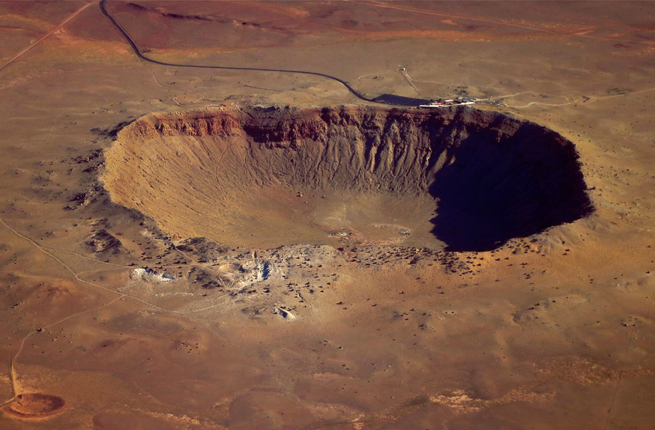
Geoscientific Habits of Mind:
Fundamental role of observation
Consideration of spatial and temporal organization of earth materials
Dynamic Earth History shaped by long-lived low impact processes & short duration high impact processes
Valuing collaboration to move forward the understanding of the earth.
Impact crater
Notes:
https://www.flickr.com/photos/jurvetson/7299795758/
Meteor Crater from the south, photographer Steve Jurvetson
CC 2.0

Slide 16
Systems Thinking:
A system has multiple interacting parts which are interrelated.
Reservoirs provide storage of a material, such as carbon dioxide in Earth's atmosphere.
Matter or energy can be exchanged among components of the system.
A system can undergo feedback which alters the rate of change.
Adapted from: http://serc.carleton.edu/integrate/teaching_materials/systems_what.html

Slide 17
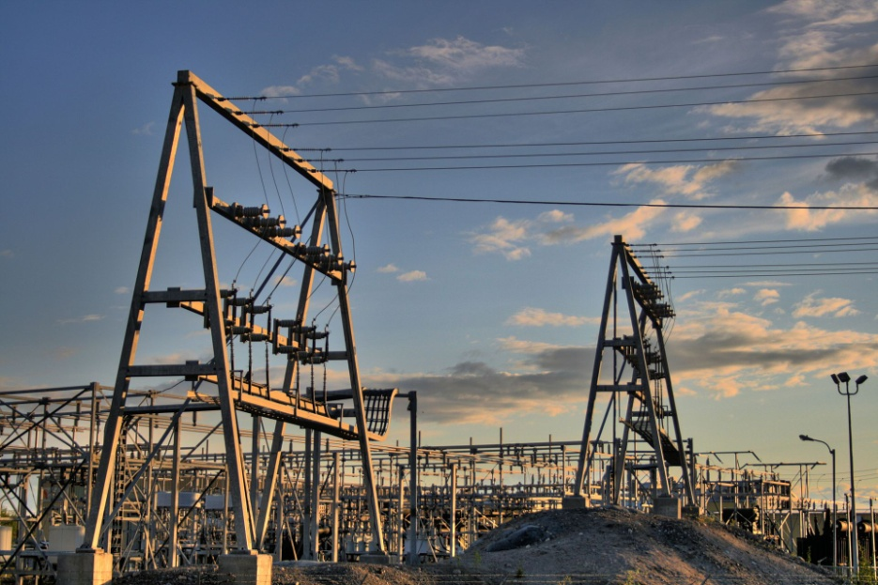
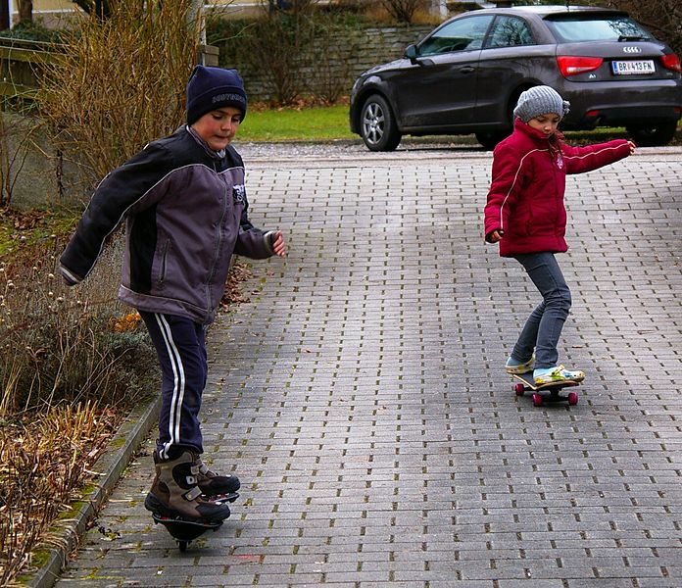
Compare information and natural hazards & risk mitigation strategies that would be important for.
Elementary School Students
Utility companies
Elementary school students
Substation in Canada
(Building systems thinking through: identifying components & interactions)
InTeGrate Module: Map Your Hazards! – Assessing Hazards, Vulnerability and Risk
Notes:
Elementary school students - Public domain image from Werner100359. Substation - Public domain image from WinterCity296 WinterforceMedia.
http://upload.wikimedia.org/wikipedia/commons/a/a1/Boy_and_girl_on_skateboards.JPG
http://en.wikipedia.org/wiki/Electric_power_distribution#mediaviewer/File:NCPC_Power_Plant_Yellowknife_Northwest_Territories_Canada_08.jpg

Slide 18
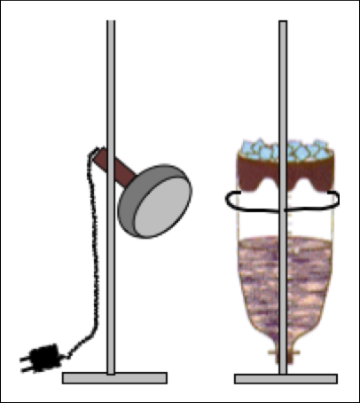
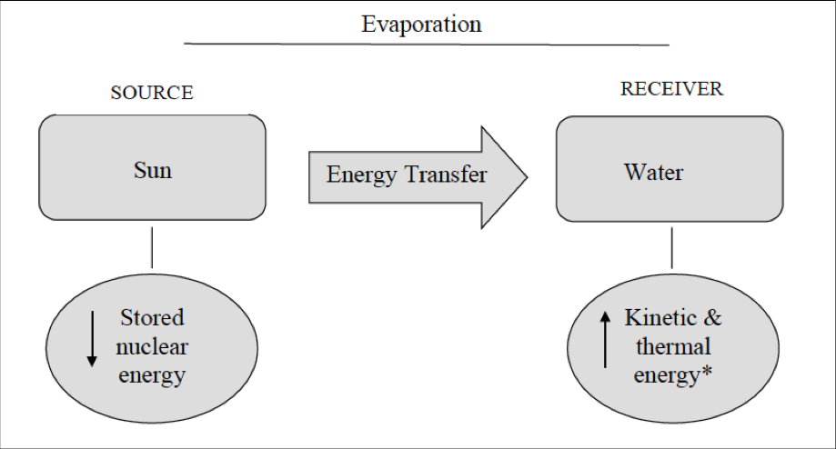
Unit learning goal: Students will construct a model of the hydrologic cycle as an analogy for how water moves through and between Earth systems.
(Building systems thinking through: identifying driving forces and fluxes)
InTeGrate Module: Interactions between Water, Earth's Surface, and Human Activity

Slide 19
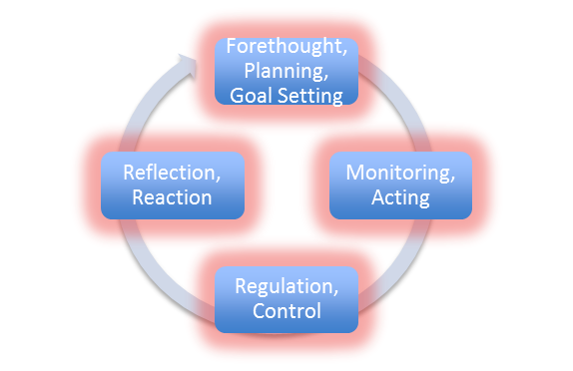
Metacognition is broadly defined as thinking about thinking, and includes activities such as:
Learning about how people learn
Developing an awareness of one's own learning processes
Monitoring one's learning strategies and assessing their effectiveness (self-regulation, self-monitoring, or self-assessment)
Consciously managing one's own motivation and attitudes toward learning
Making adjustments to one's learning strategies when appropriate
http://serc.carleton.edu/NAGTWorkshops/metacognition/introduction.html

Slide 20
What is the difference between studying & learning?

Slide 21
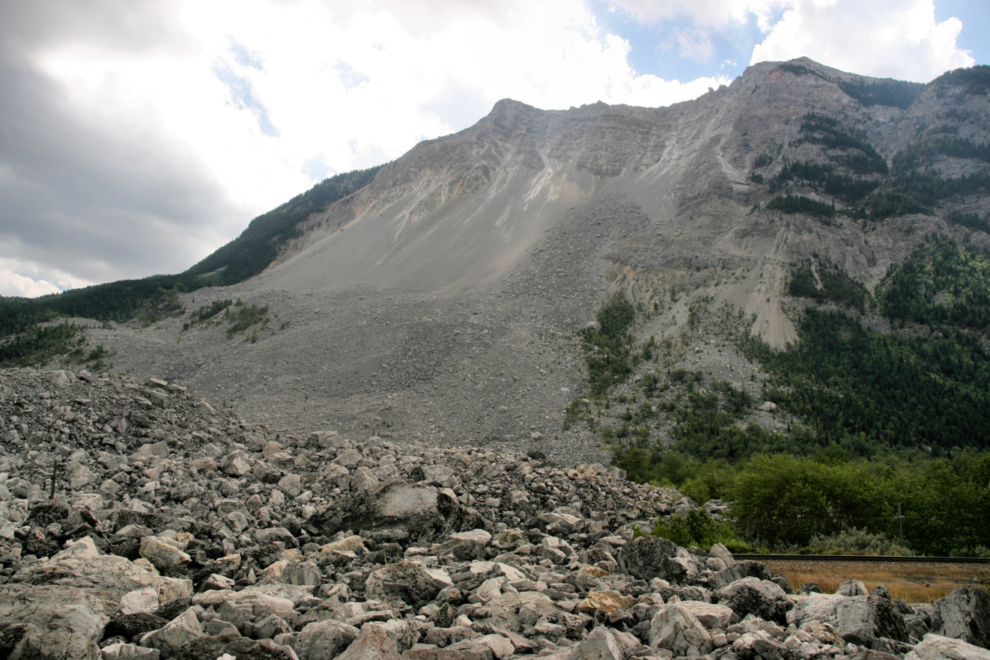
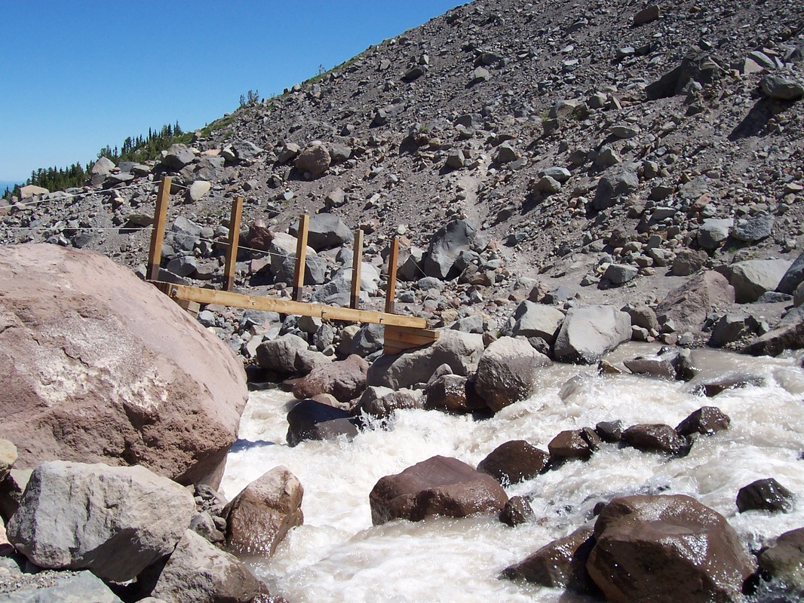
Which environment is most erosive?
Mountains?
Marek Slusarczyk cc
Pre-activity used to determine mental model
InTeGrate Module: A Growing Concern
Notes:
Image 1: Frank Slide, CanadaCC BY 2.5 view terms
Author: Marek Ślusarczyk or www.microstock.pl. In case of any doubts feel free to e-mail me: marek (at) microstock pl.
http://en.wikipedia.org/wiki/Frank_Slide#mediaviewer/File:Frank_Slide,_Canada.jpg
Image 2: Sarah Fortner, Mount Hood, Eliot Stream

Slide 22
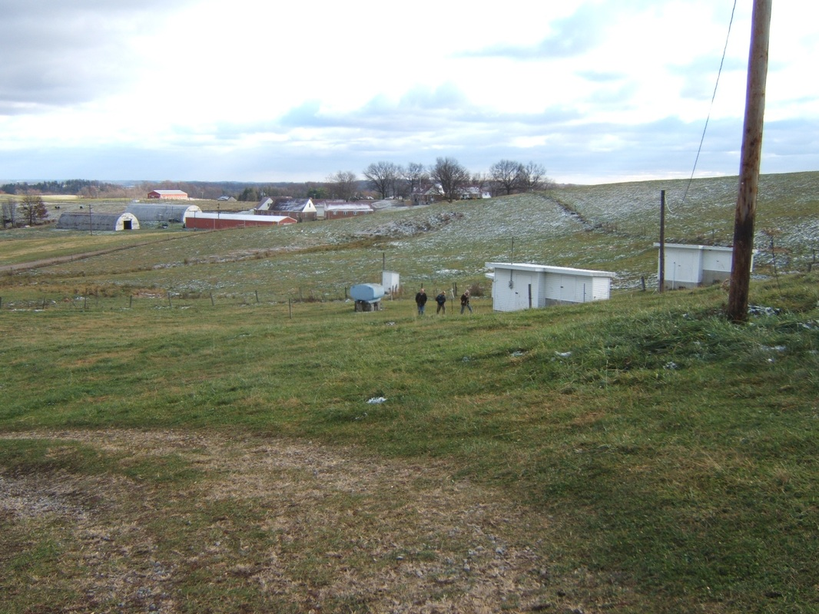
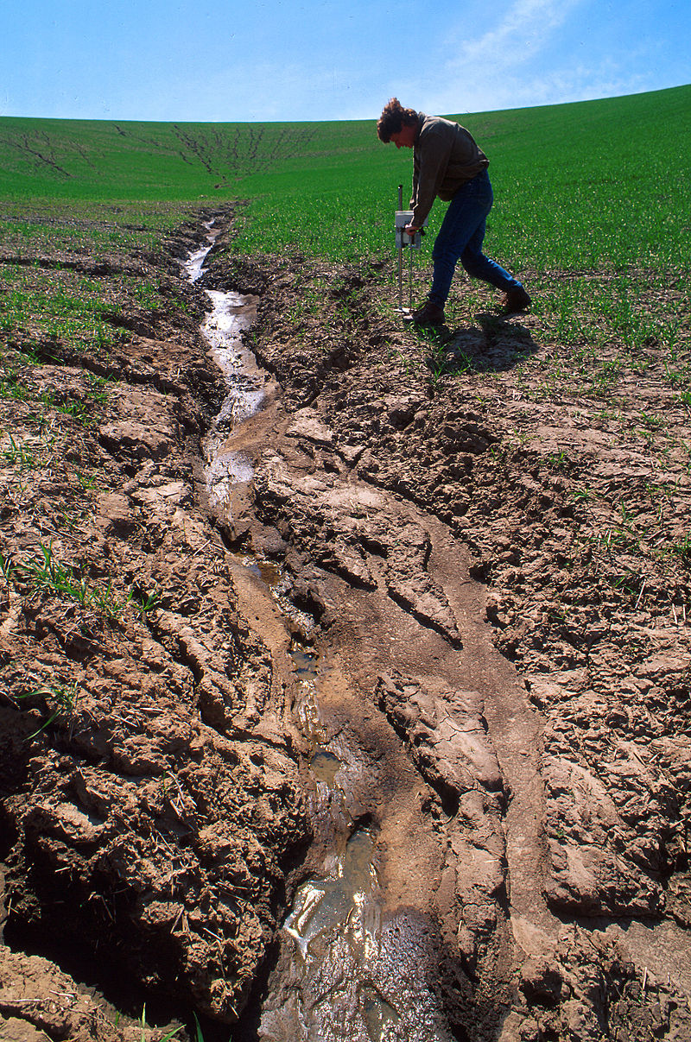
Or agricultural landscapes?
InTeGrate Module: A Growing Concern
Notes:
Image 1: Sarah Fortner, North Appalachian Experimental Watershed, Coshocton, Ohio
Image 2: http://www.ars.usda.gov/is/graphics/photos/k5951-1.htm, CC Public Domain, Pullman Washington Wheat Field

Slide 23
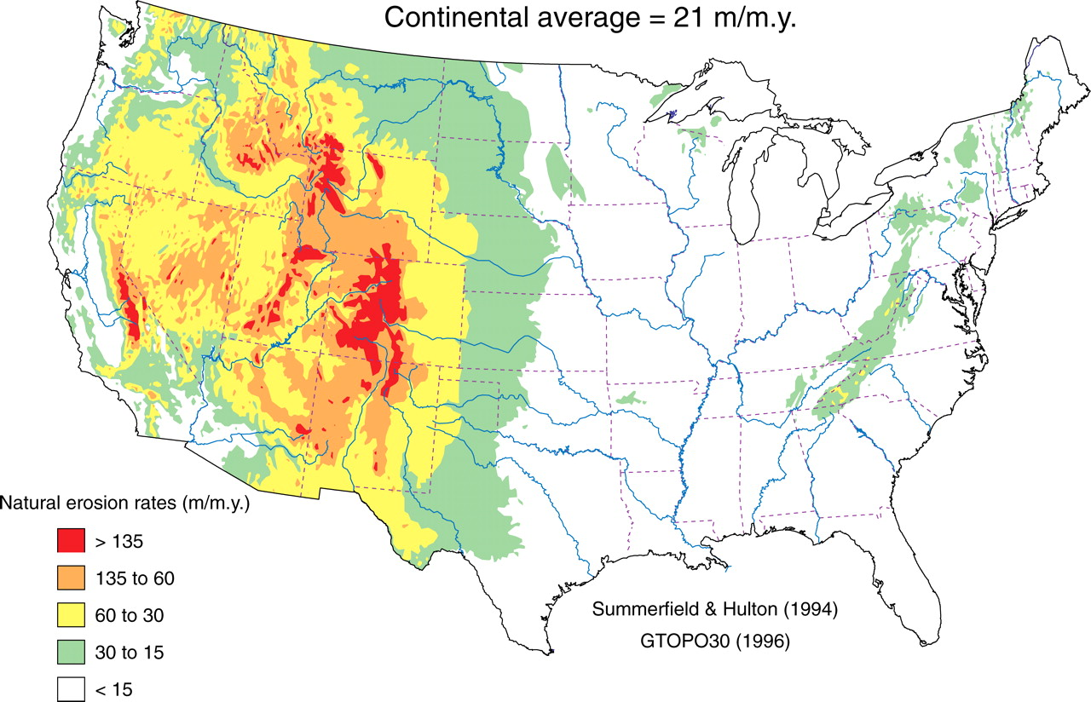
Continental average = 21 m/my
A
Natural erosion rates (m/my)
Identify units of erosion measurement.
What is the average natural erosion rate in millimeters per year (1 meter = 1000 millimeters)?
Use the map legend to identify which types of landscapes have the highest natural (not impacted by humans) erosion rates and predict why these locations have the highest rates.
Figure 6. Estimates of average natural erosion (denudation) rates inferred from GTOPO30 area-elevation data and global fluvial erosion-elevations relations from Summerfield and Hulton (1994). Mean rate of denudation for the entire area of the contiguous United States is ∼21 m/m.y.
(Wilkinson and McElroy, 2007, GSA Bulletin January/February, 2007 vol. 119 no. 1-2 140-156 )
Notes:
Approved by GSA Bulletin for use by instructors and students working working with 'InTeGrate: Interdisciplinary Teaching about Earth for a Sustainable Future’.
http://gsabulletin.gsapubs.org/content/119/1-2/140.abstract

Slide 24
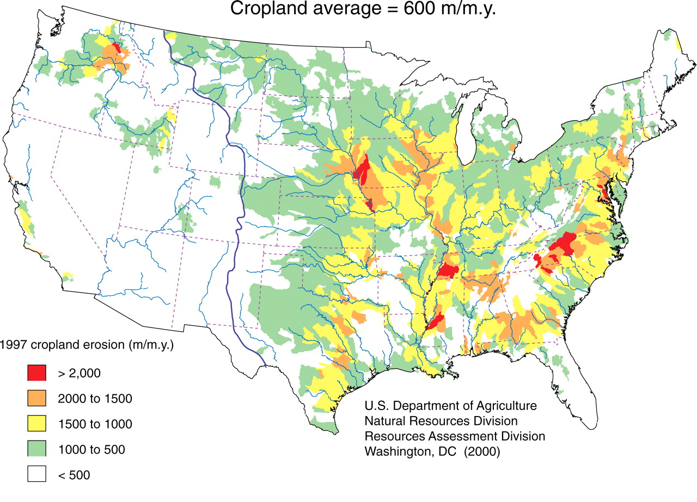
Average Erosion from Human Activity = 600 m/my
B
erosion rates (m/my)
Use the map legend to identify which types of landscapes or environments have the greatest erosion from human activity.
How does that average rate compare to the average natural rate of erosion?
Predict the potential source of human erosion in Figure B.
(Wilkinson and McElroy, 2007, GSA Bulletin January/February, 2007 vol. 119 no. 1-2 140-156 )
Notes:
Approved by GSA Bulletin for use by instructors and students working working with 'InTeGrate: Interdisciplinary Teaching about Earth for a Sustainable Future’.
http://gsabulletin.gsapubs.org/content/119/1-2/140.abstract

Slide 25
Post-activity reflection:
Does what you learned today through exploring the figures of natural and cropland erosion support or conflict with your
initial perceptions of erosion?
InTeGrate Module: A Growing Concern

Slide 26
Post-activity reflection:
What one thing that you learned in this class surprised you?
And what one thing have you learned here that is most relevant to your own life?
InTeGrate Module: Climate of Change
Notes:
A standard wrapper.

Slide 27
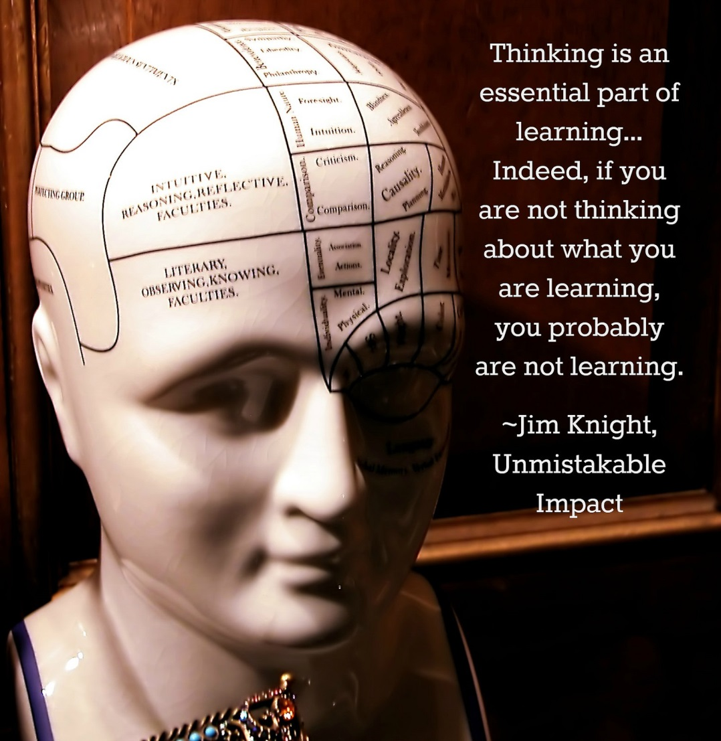
Remind students that you are asking them to reflect because it is associated with improving and deepening their learning
Notes:
Metacognition
By: Denise Krebs
CC: 2.0
https://www.flickr.com/photos/mrsdkrebs/14887464025/in/photostream/

Slide 28
COFFEE BREAK

Slide 29
Learning Goals
(Amber Burgett)

Slide 30
Implementation Strategies:
What we learned during our Spring 2015 Pilot
(Amber Burgett, Ruth Hoff)

Slide 31
Think-Pair-Share
What challenges do you foresee in your course?
Discuss paths to success.

Slide 32
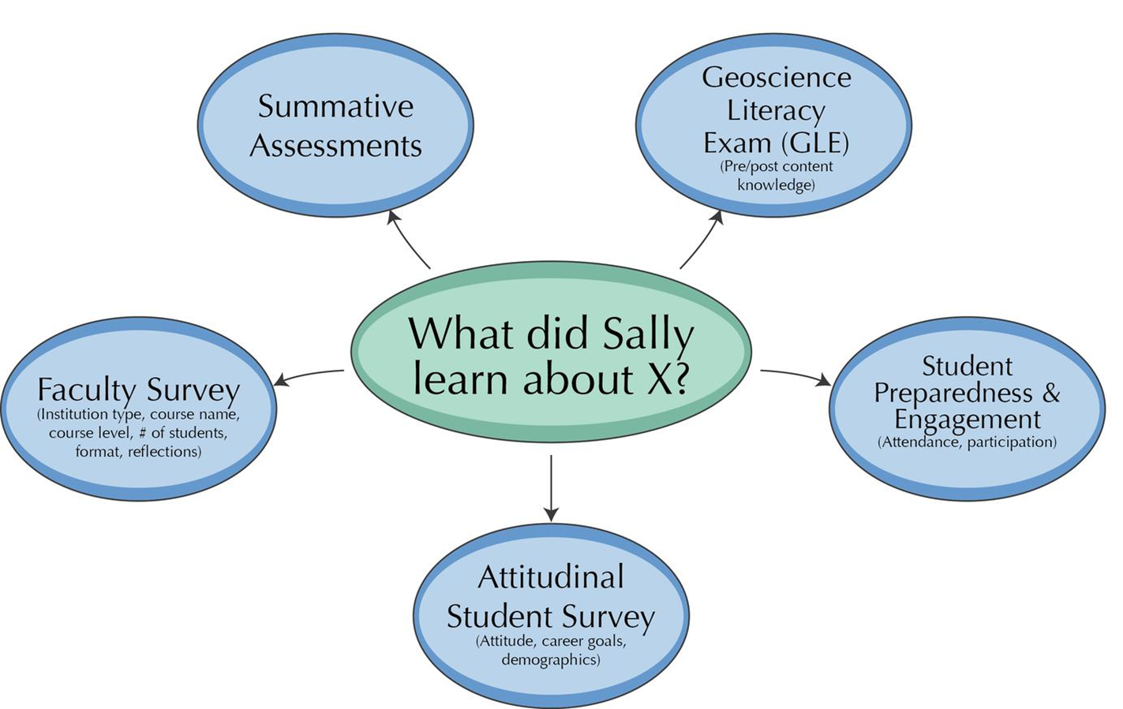
Data Collection:

Slide 33
Reporting Responsibilities:
1st week of class: Student Release Form (hard copy), Geoscience Literacy Exam (hard copy), Attitudinal Survey (online)
Syllabus with an interdisciplinary sustainability learning goal
Last week of class: Geoscience Literacy Exam (hard copy), Interdisciplinary/Systems-Thinking Essay Questions that are graded for credit at the end of your course(hard copy), Attitudinal Survey (online), Short faculty reflection
Scan & upload hard copies to your reporting page, & make sure students are completing attitudinal survey (# complete appears on reporting page).
Notes:
A standard wrapper.

Slide 34
Please Submit Your
Implementation Timeline & Questions
Notes:
A standard wrapper.

Slide 35
Thank you!
Notes:
A standard wrapper.

