Slide 1
Landscape and Environmental Change
Unit 1: Mass Wasting Quantification
Hurricane María Introduction
Stephen Hughes, University of Puerto Rico
Bobby Karimi, Wilkes University
Version: January 10, 2019
Notes:
DO REMEMBER to include attribution information for all the figures you include. Even if you took the picture or made the diagram, it will make it easier later if we just have that recorded.
ALSO – it is much easier to make notes (at least preliminary ones) for each slide NOW compared to several months later. Think about the information that future instructors using this materials will need to know in order to understand what the point of the different slides are. If all the relevant text is on the slide, notes may not be necessary, BUT if there are images, most likely some notes will be needed for future users.

Slide 2
Hurricane María Impacts
Deaths: between 3,000 and 4,000
        Exact value unknown:
        https://edition.cnn.com/2018/08/29/us/puerto-rico-growing-death-toll/index.html
Customers without power/water
  100% of Puerto Rico (more than 3.5 million people)
  Full power restored 11 months later
    https://www.nytimes.com/2018/08/14/us/puerto-rico-electricity-power.html
Landslides: more than 40,000
    https://sites.google.com/a/upr.edu/geology/research/slides-pr
Other effects:
  Very little or no communication (phone, internet, radio) for at least two weeks after the storm made landfall
  Food and water shortages
  Various mountain communities cut off for days or several weeks
  Lines at gasoline stations for over 12 hours
  Damage of large reservoir spillway (Lago Guajataca)
    https://youtu.be/LBa8X03fVQg

Slide 3
Videos
Watch the following videos on YouTube.
  https://youtu.be/gBAPgNi0kA0
    Satellite imagery of Hurricane María moving over Puerto Rico
  https://youtu.be/fwPTGmA8lD4
    Strong winds in the municipality of Toa Baja during Hurricane María
  https://youtu.be/bZIAHu-yhOI
    Landslide in the mountainous region of the municipality of Ponce during Hurricane María

Slide 4
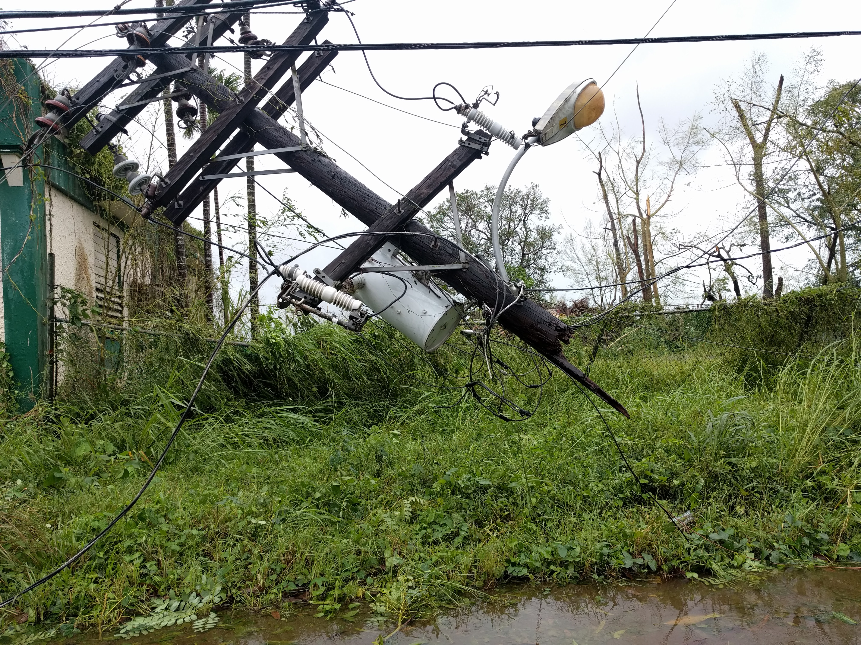
Electrical system damage along in PR-108 in Mayagüez after Hurricane María in Puerto Rico. Photo from 21 September 2017 by Stephen Hughes

Slide 5
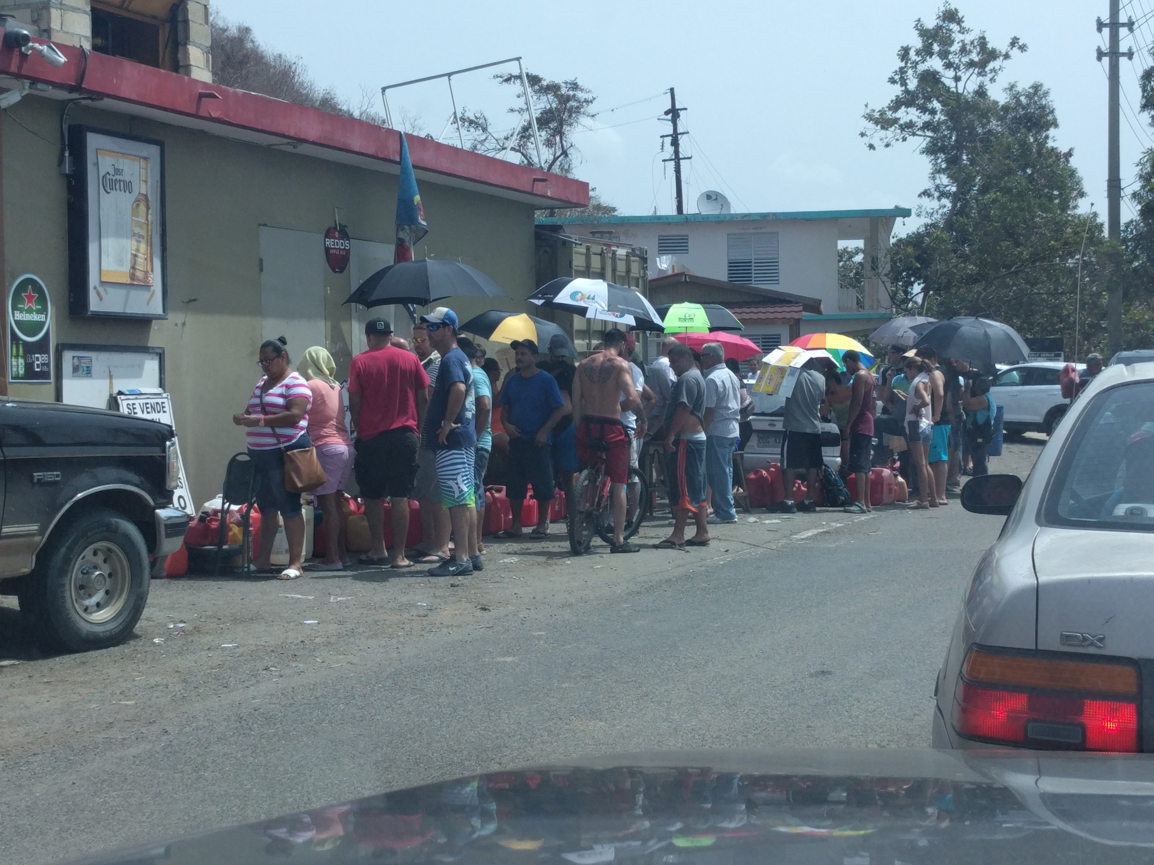
People waiting in line for gasoline in Añasco, Puerto Rico, after the passing of Hurricane María in Puerto Rico. Photo taken 26 September 2017 by Stephen Hughes

Slide 6
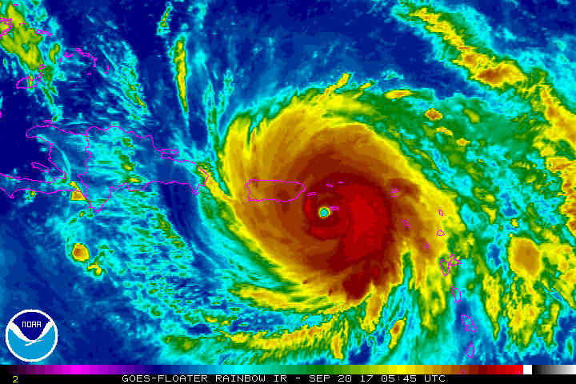

Slide 7
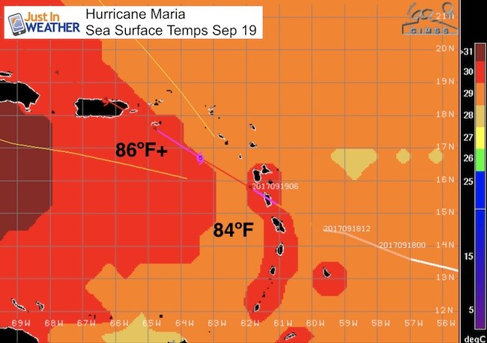
Hotter Sea Surface Temperature Promotes Tropical Cyclone Development
Notes:
Used with permission from Just In Weather, LLC. Image downloaded from: https://i1.wp.com/justinweather.com/wp-content/uploads/2017/09/Maria_SST.jpg?fit=650%2C458&ssl=1

Slide 8
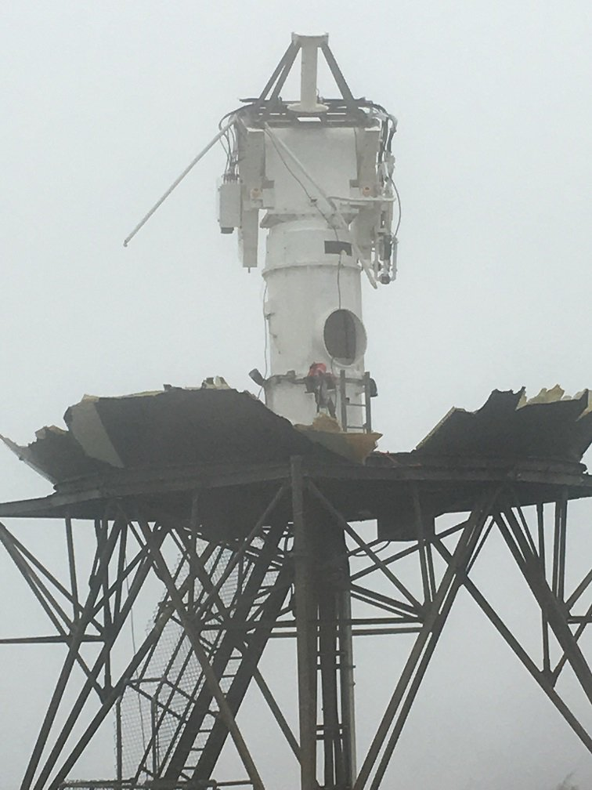
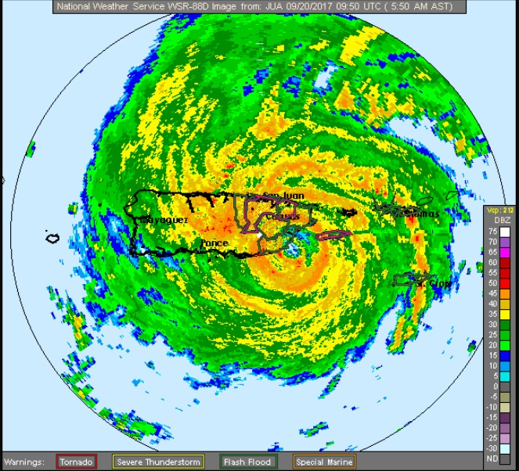
Hurricane María Rain
Radar destroyed upon landfall in SE Puerto Rico
https://en.wikipedia.org/wiki/Hurricane_Maria#/media/File:Puerto_Rico_weather_radar_after_Hurricane_Maria_(2).png
Scattered radar pieces explored 28 October 2017: https://www.youtube.com/watch?v=8dMwrHh_bo0
Last radar image before going off line,
Photo: National Weather Service

Slide 9
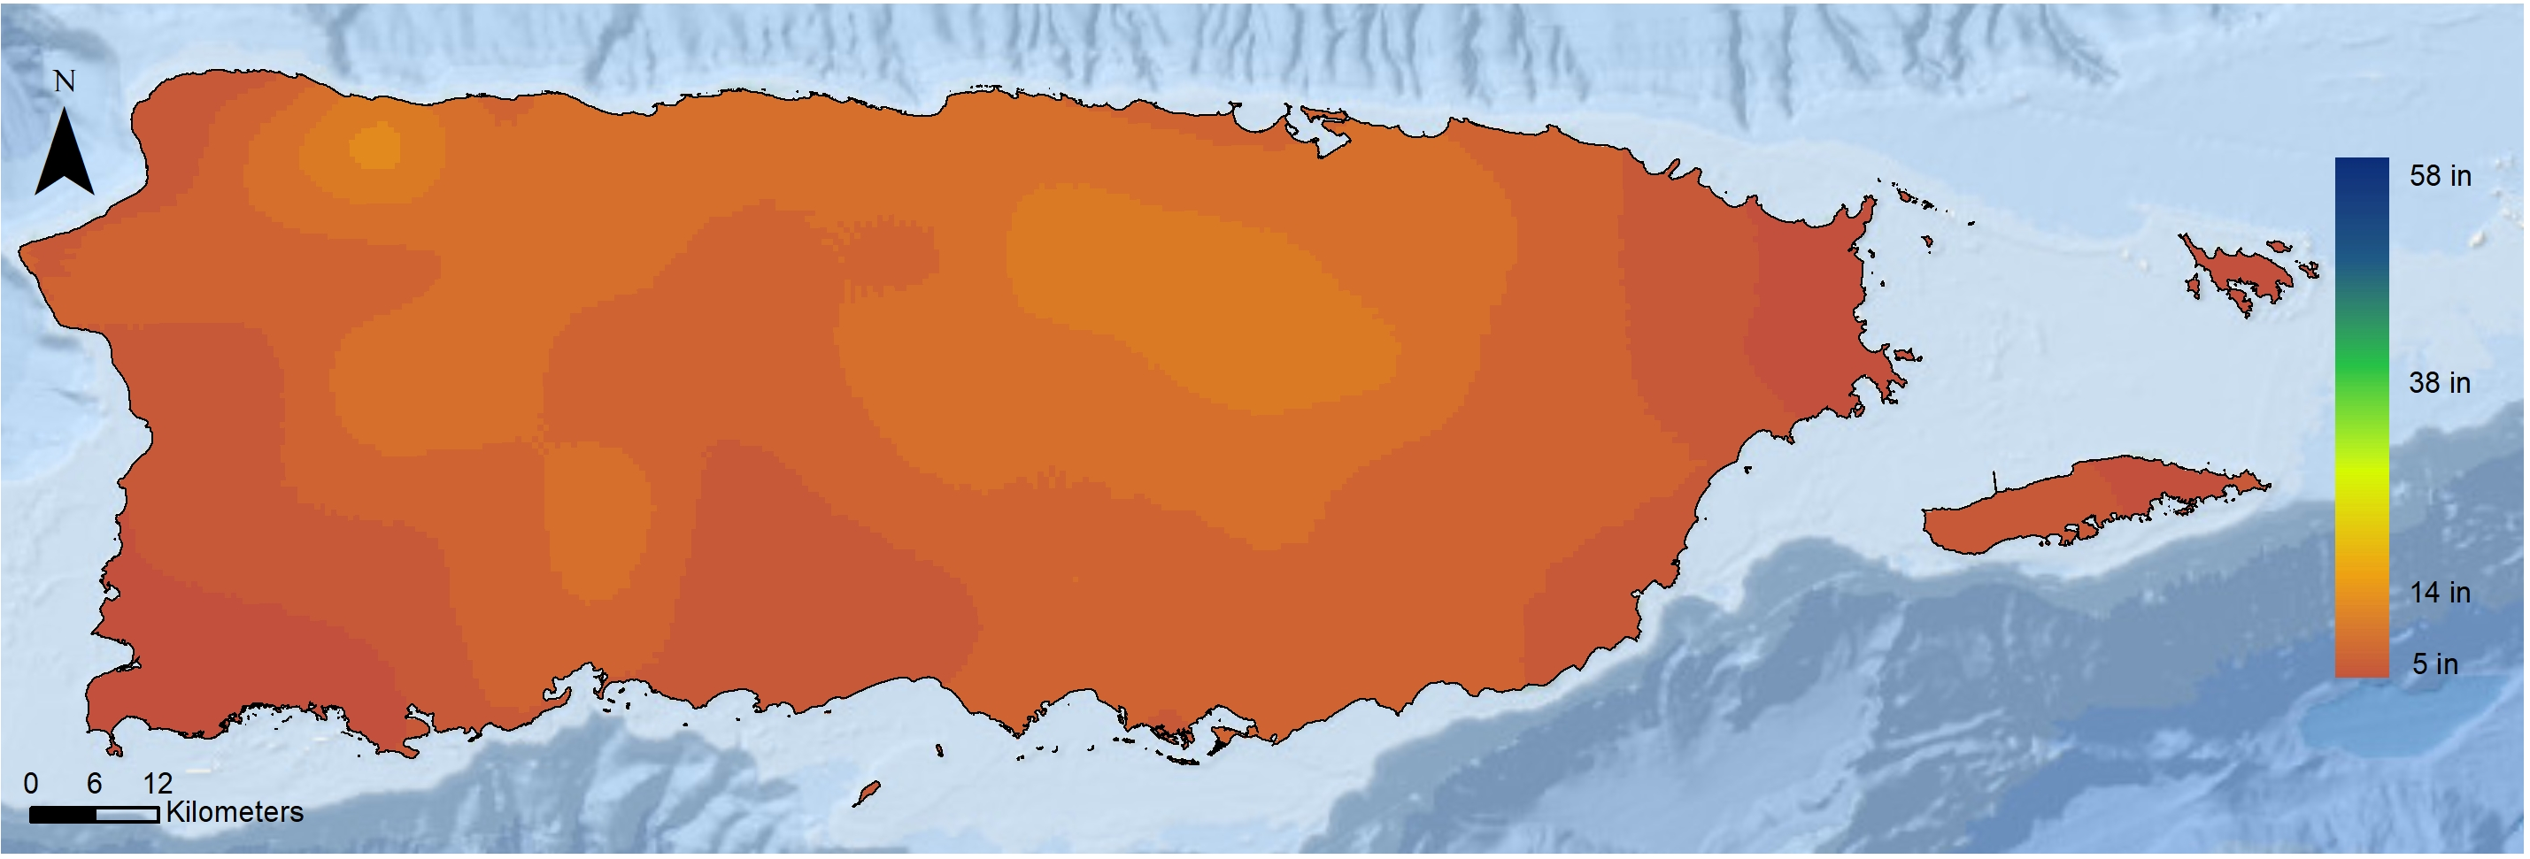
Hurricane María Rain
Accumulation estimates range widely from 14 to 60 inches of maximum precipitation.
NASA GPM Satellite (September 20–21)

Slide 10
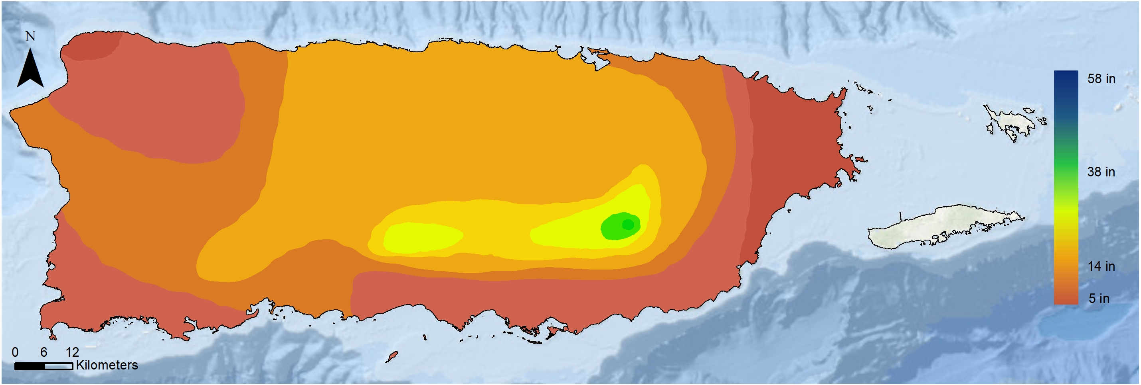
Hurricane María Rain
Accumulation estimates range widely from 14 to 60 inches of maximum precipitation.
National Hurricane Center (September 19–21)

Slide 11
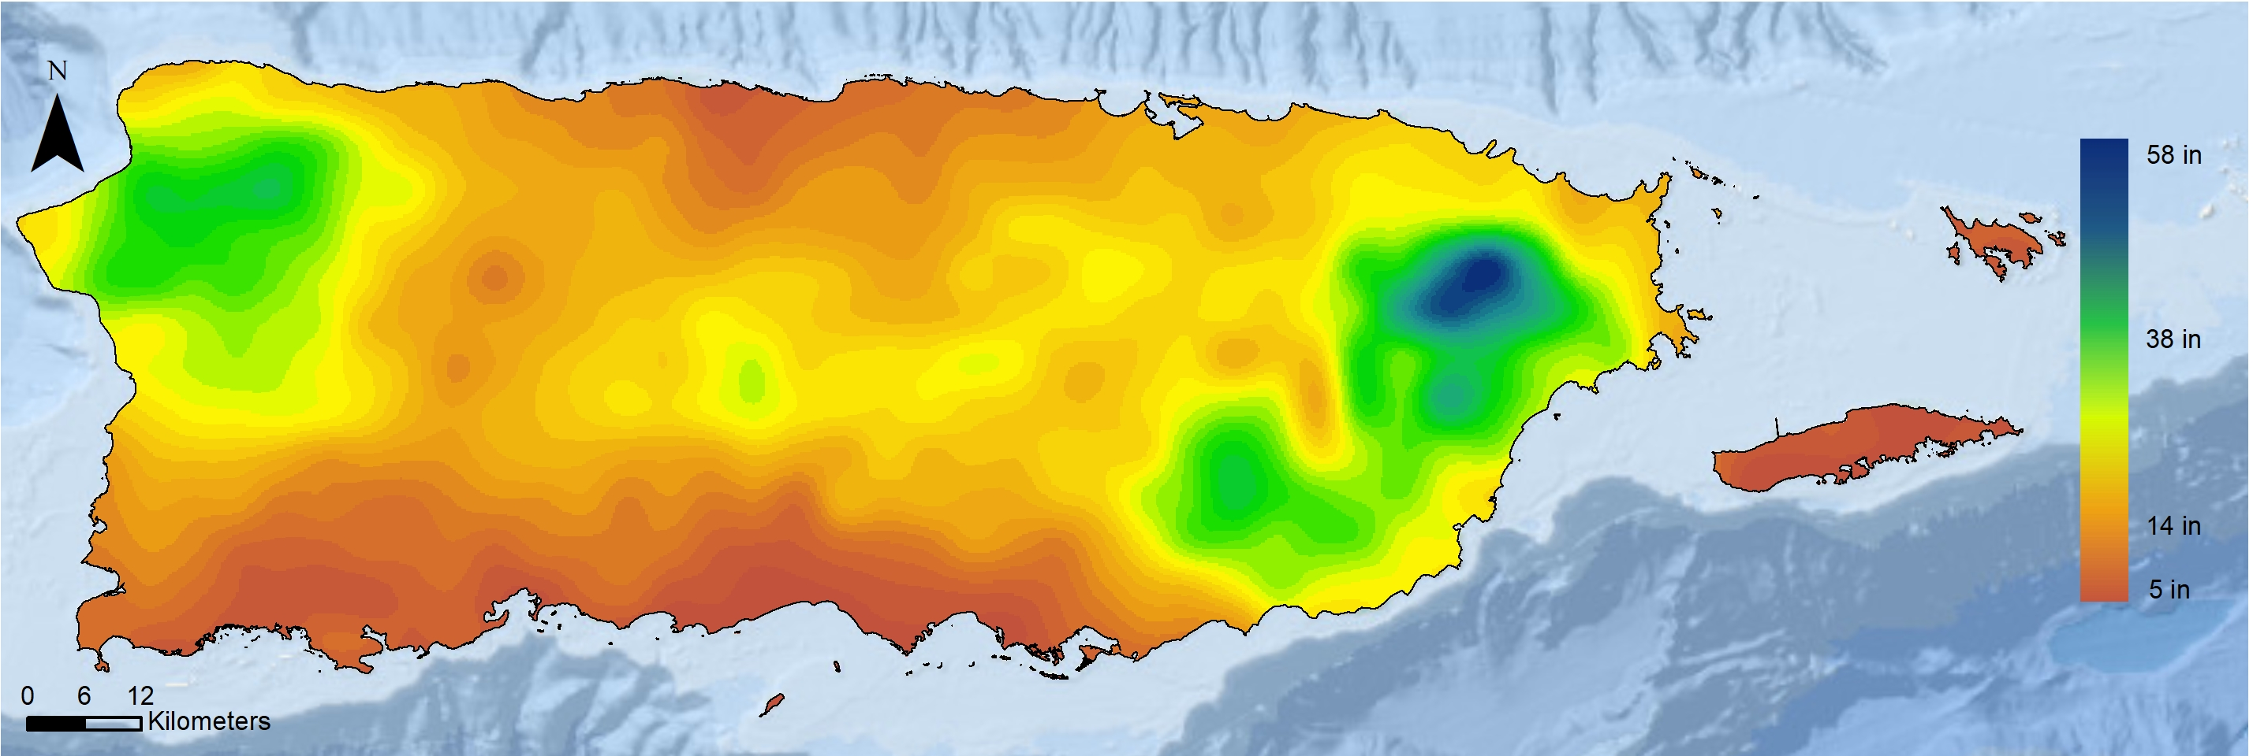
Hurricane María Rain
Accumulation estimates range widely from 14 to 60 inches of maximum precipitation.
National Weather Service QPE (September 20–21)

Slide 12
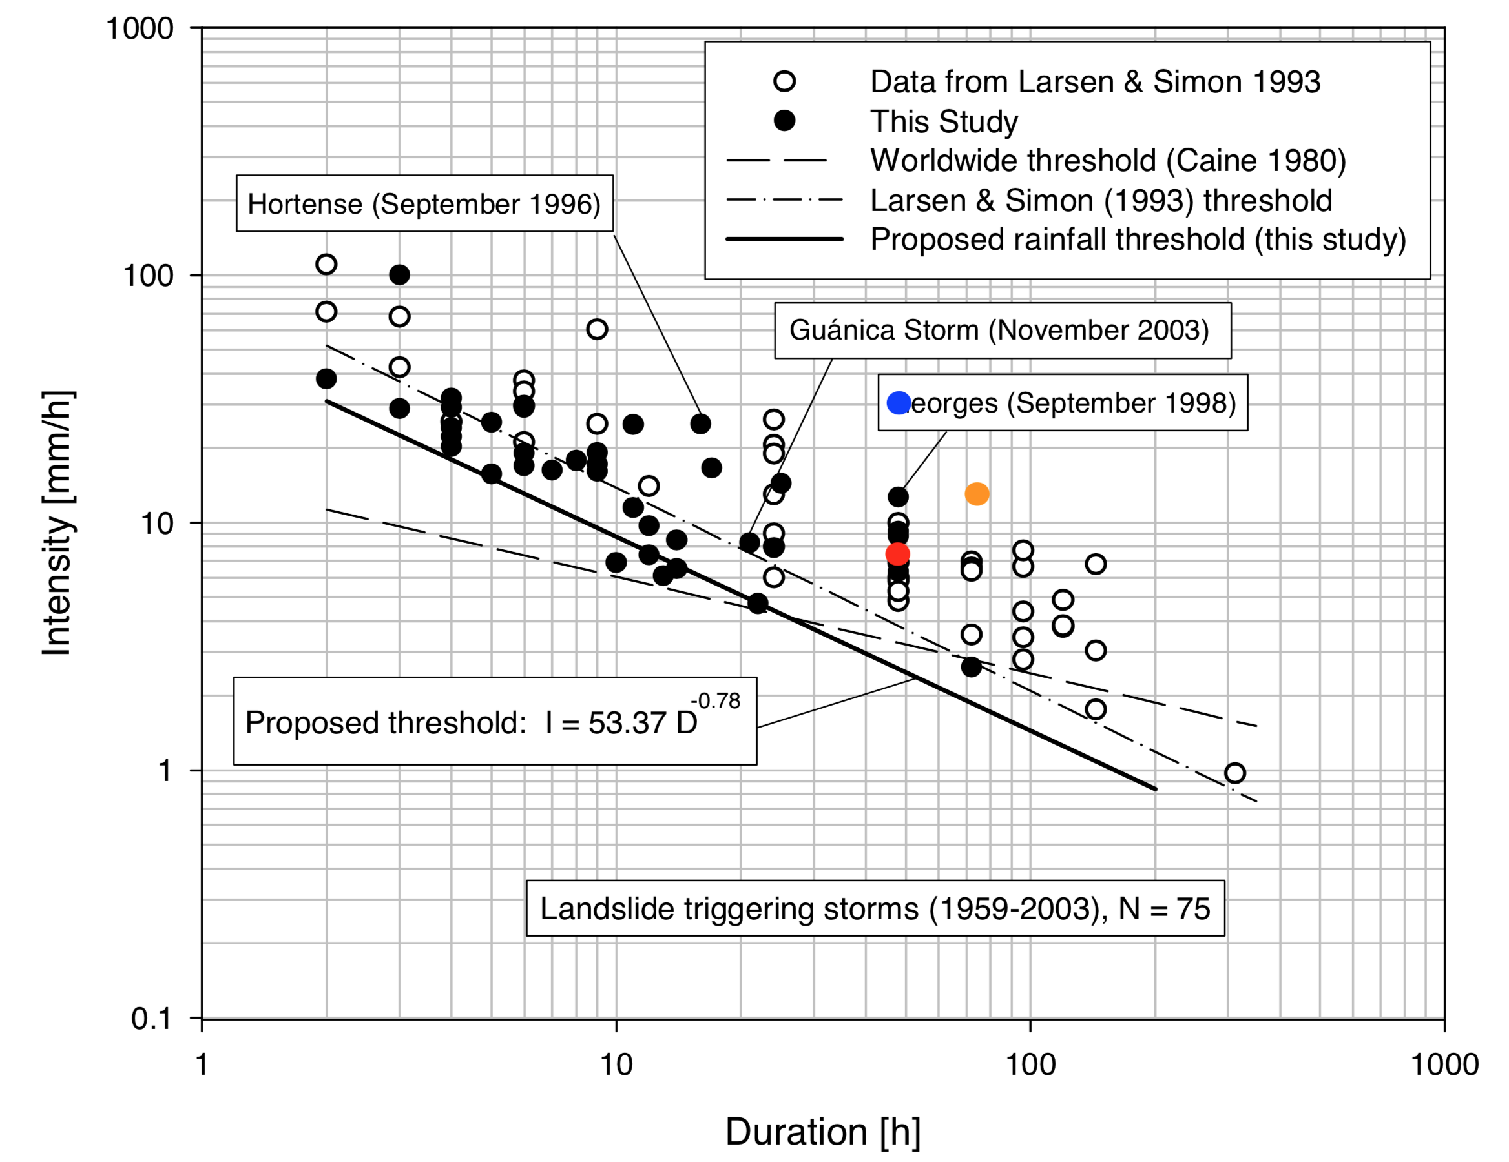
Hurricane María Rain
The absolute amount of rain for the event remains unknown, but totals undoubtedly surpassed a threshold defined for rainfall-induced landslides in Puerto Rico.
NWS Hurricane María
NASA Hurricane María
NHC Hurricane María
Modified from Pando et al. (2005) and Larsen and Simon (1993)

Slide 13
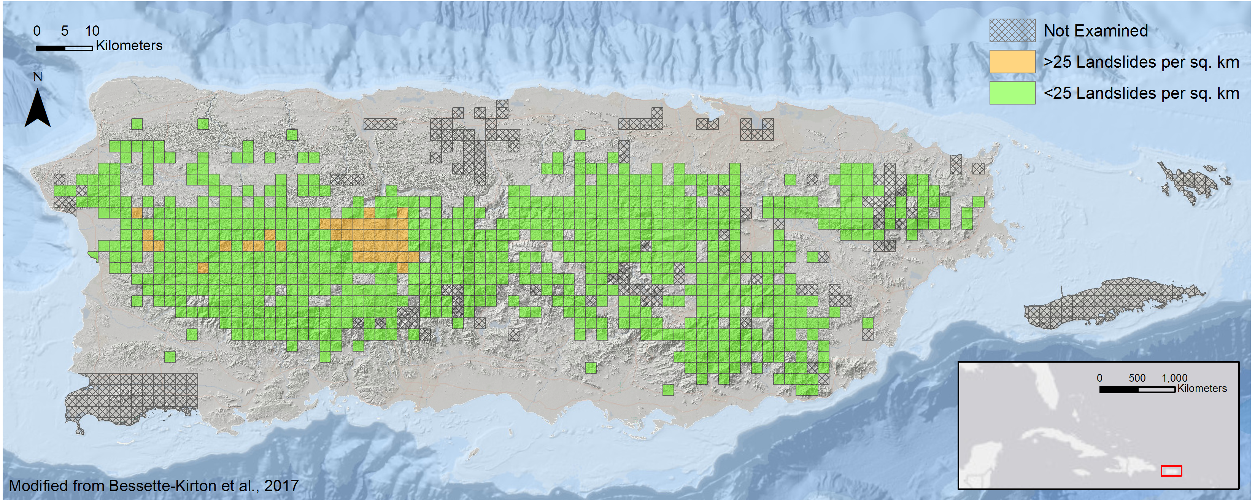
Hurricane María Landslides
The USGS Landslide Hazards group issued a preliminary assessment of mass wasting across the island.

Slide 14
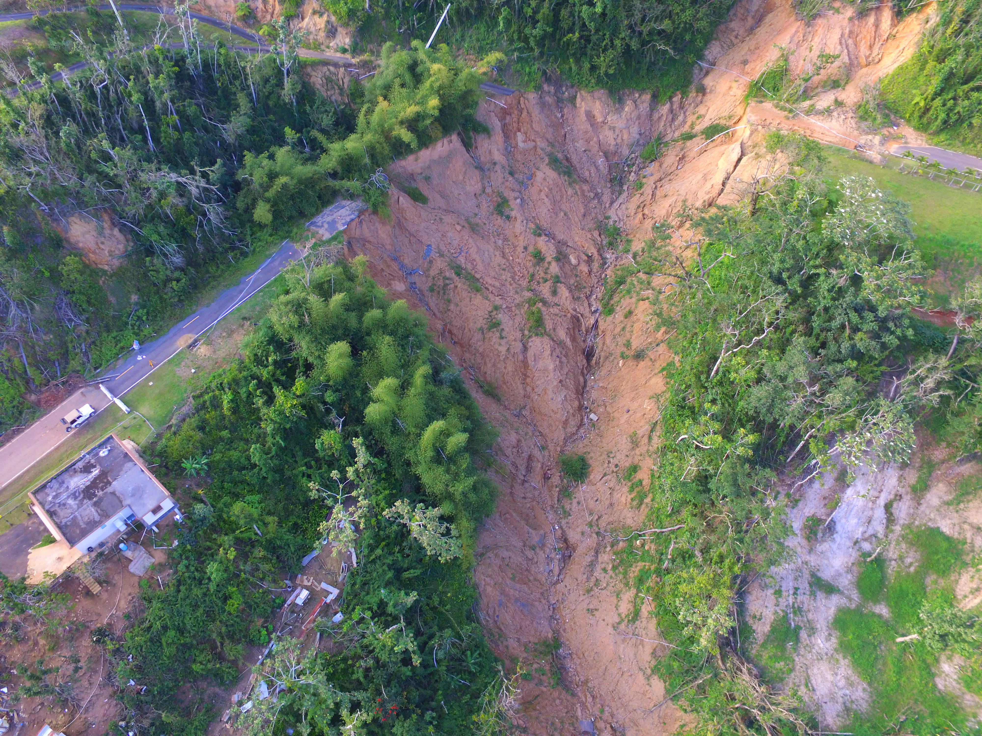
Hurricane María Landslides
Barranquitas, Puerto Rico
Photo: Stephen Hughes

Slide 15
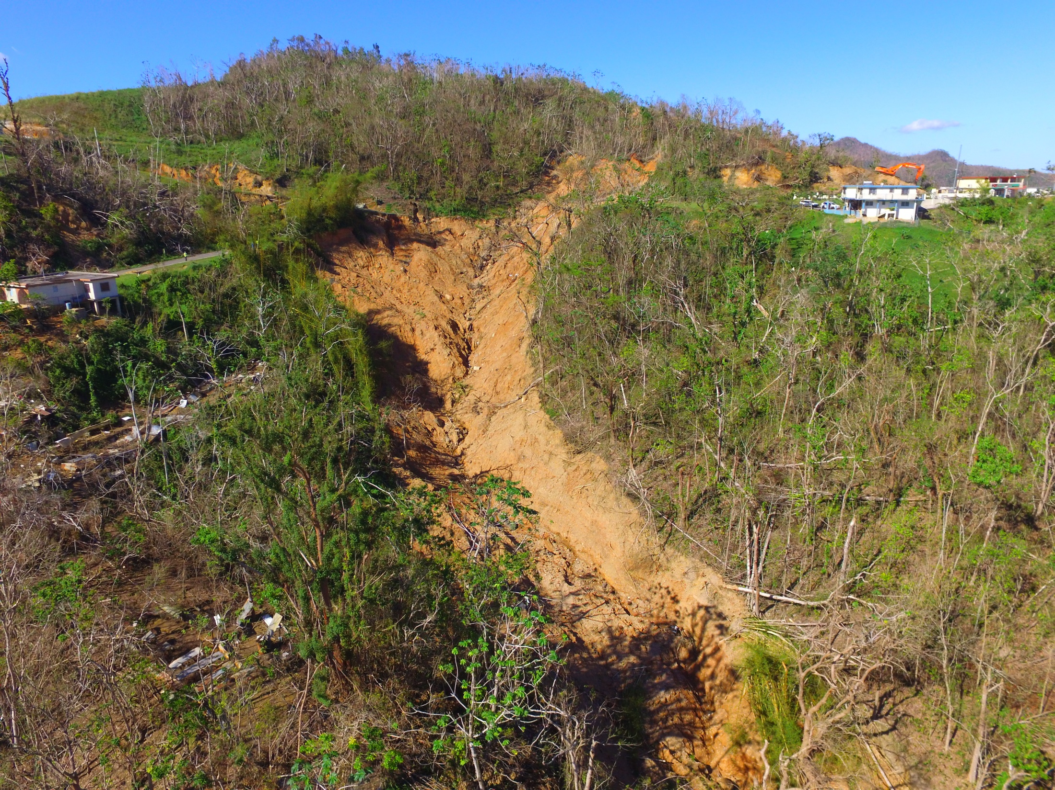
PR-143 in Barranquitas, Photo: Stephen Hughes

Slide 16
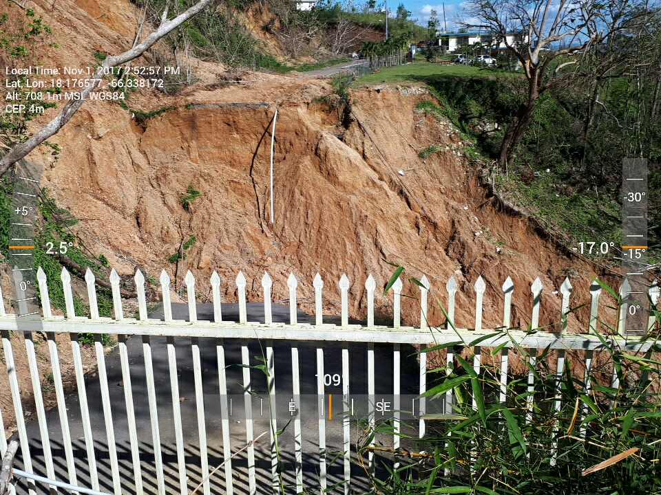
PR-143 in Barranquitas, Photo: Stephen Hughes

Slide 17
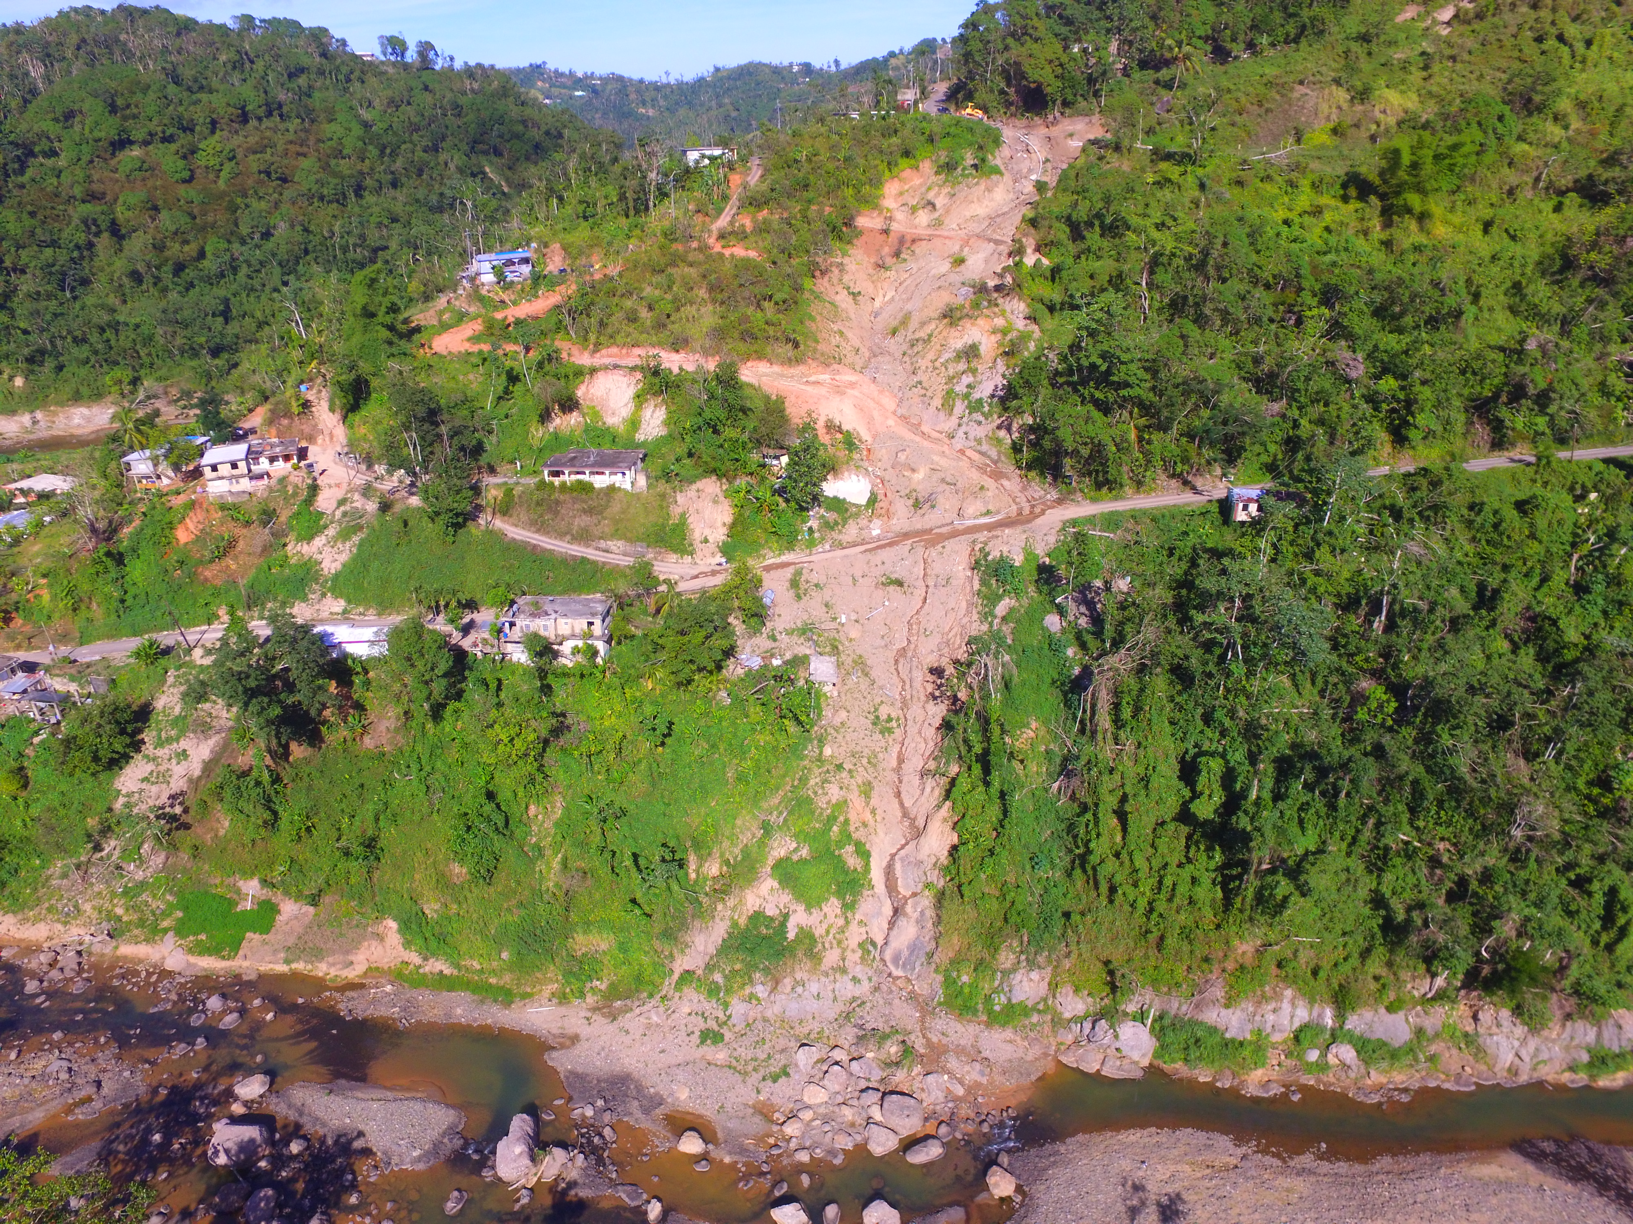
Hurricane María Landslides
**Assignments 1 and 2 will focus on data collected from this site.**
Lares,
Puerto Rico
Photo: Stephen Hughes

Slide 18
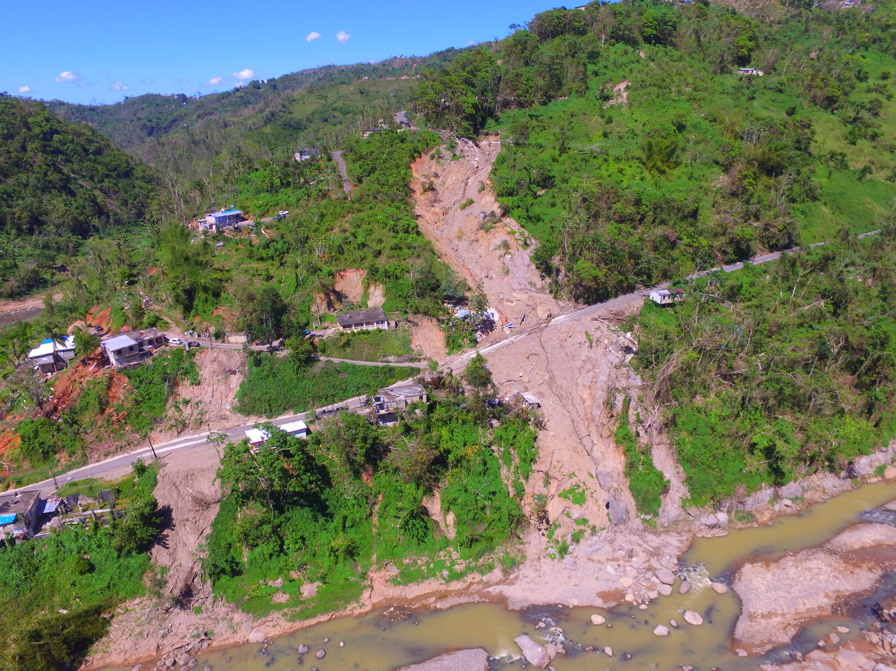
PR-431 in Lares, Photo: Stephen Hughes

Slide 19
PR-431 in Lares, Photo: Stephen Hughes

Slide 20
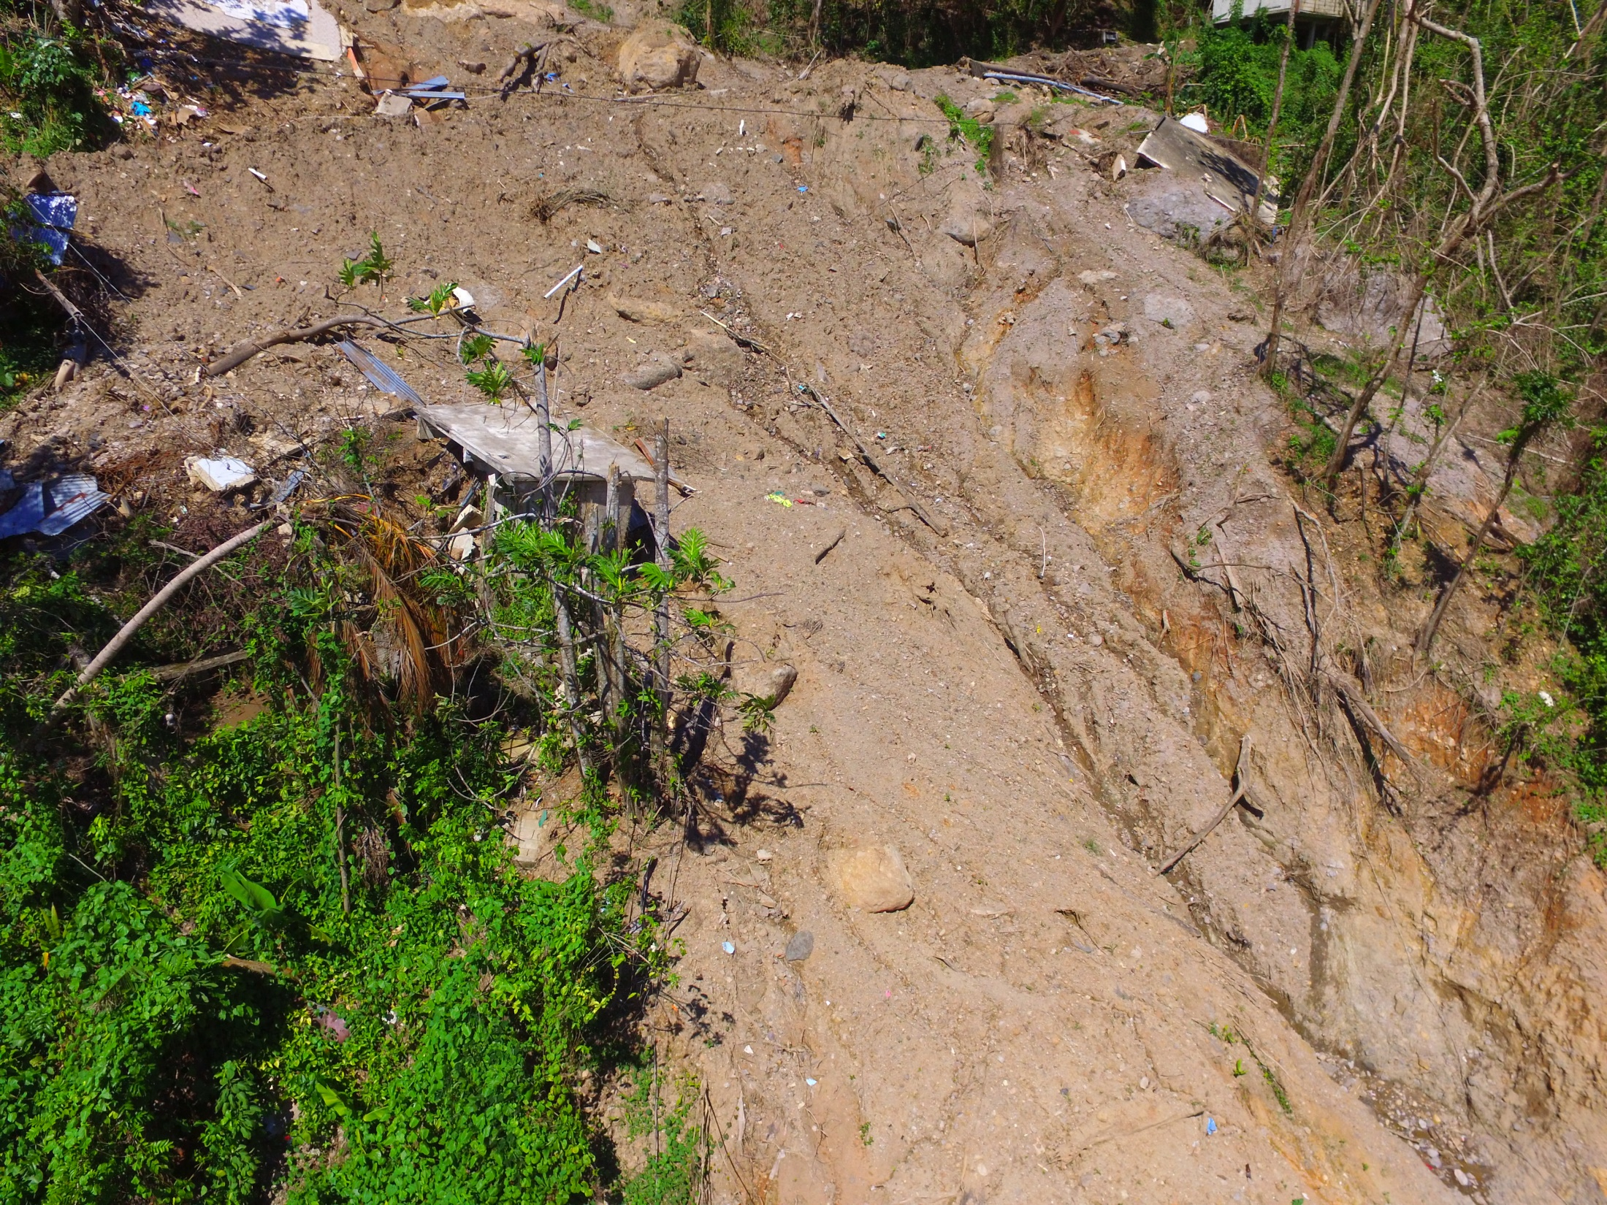
PR-431 in Lares, Photo: Stephen Hughes

Slide 21
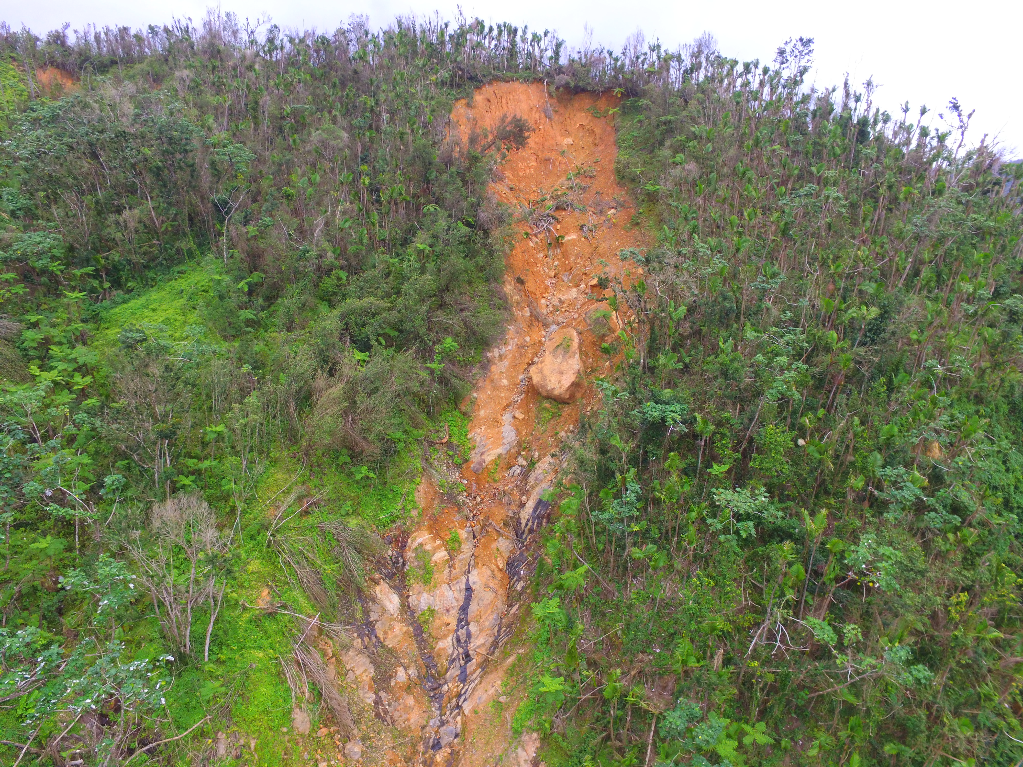
Hurricane María Landslides
Naguabo, Puerto Rico
Photo: Stephen Hughes

Slide 22
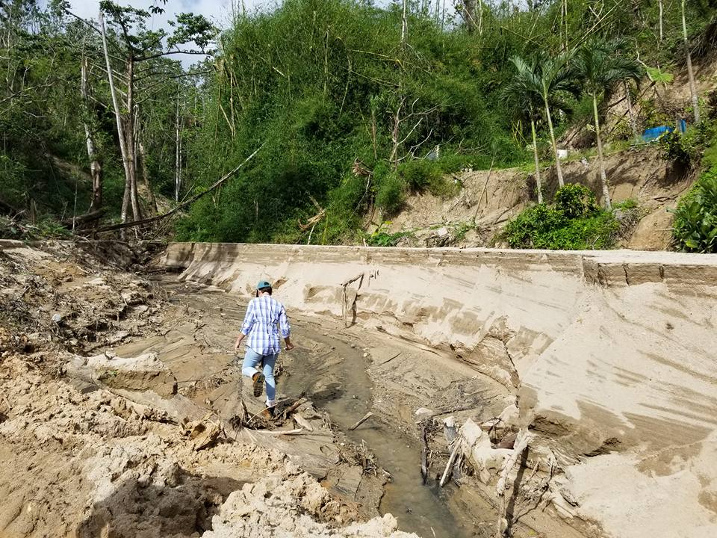
Hurricane María Landslides
Sediment liberated by mass wasting deposited down channel.
Utuado,
Puerto Rico
Photo: James Joyce

Slide 23
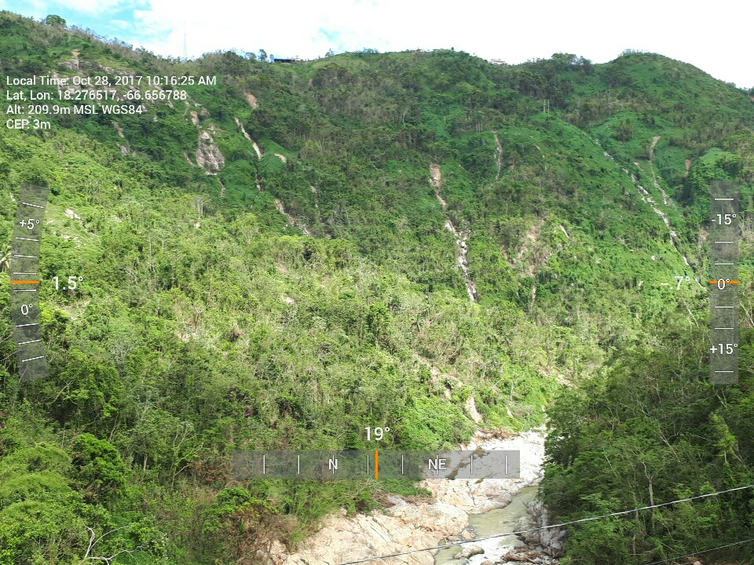
Lago Caonillas Dam Looking Downstream (Utuado), Photo: Stephen Hughes

Slide 24
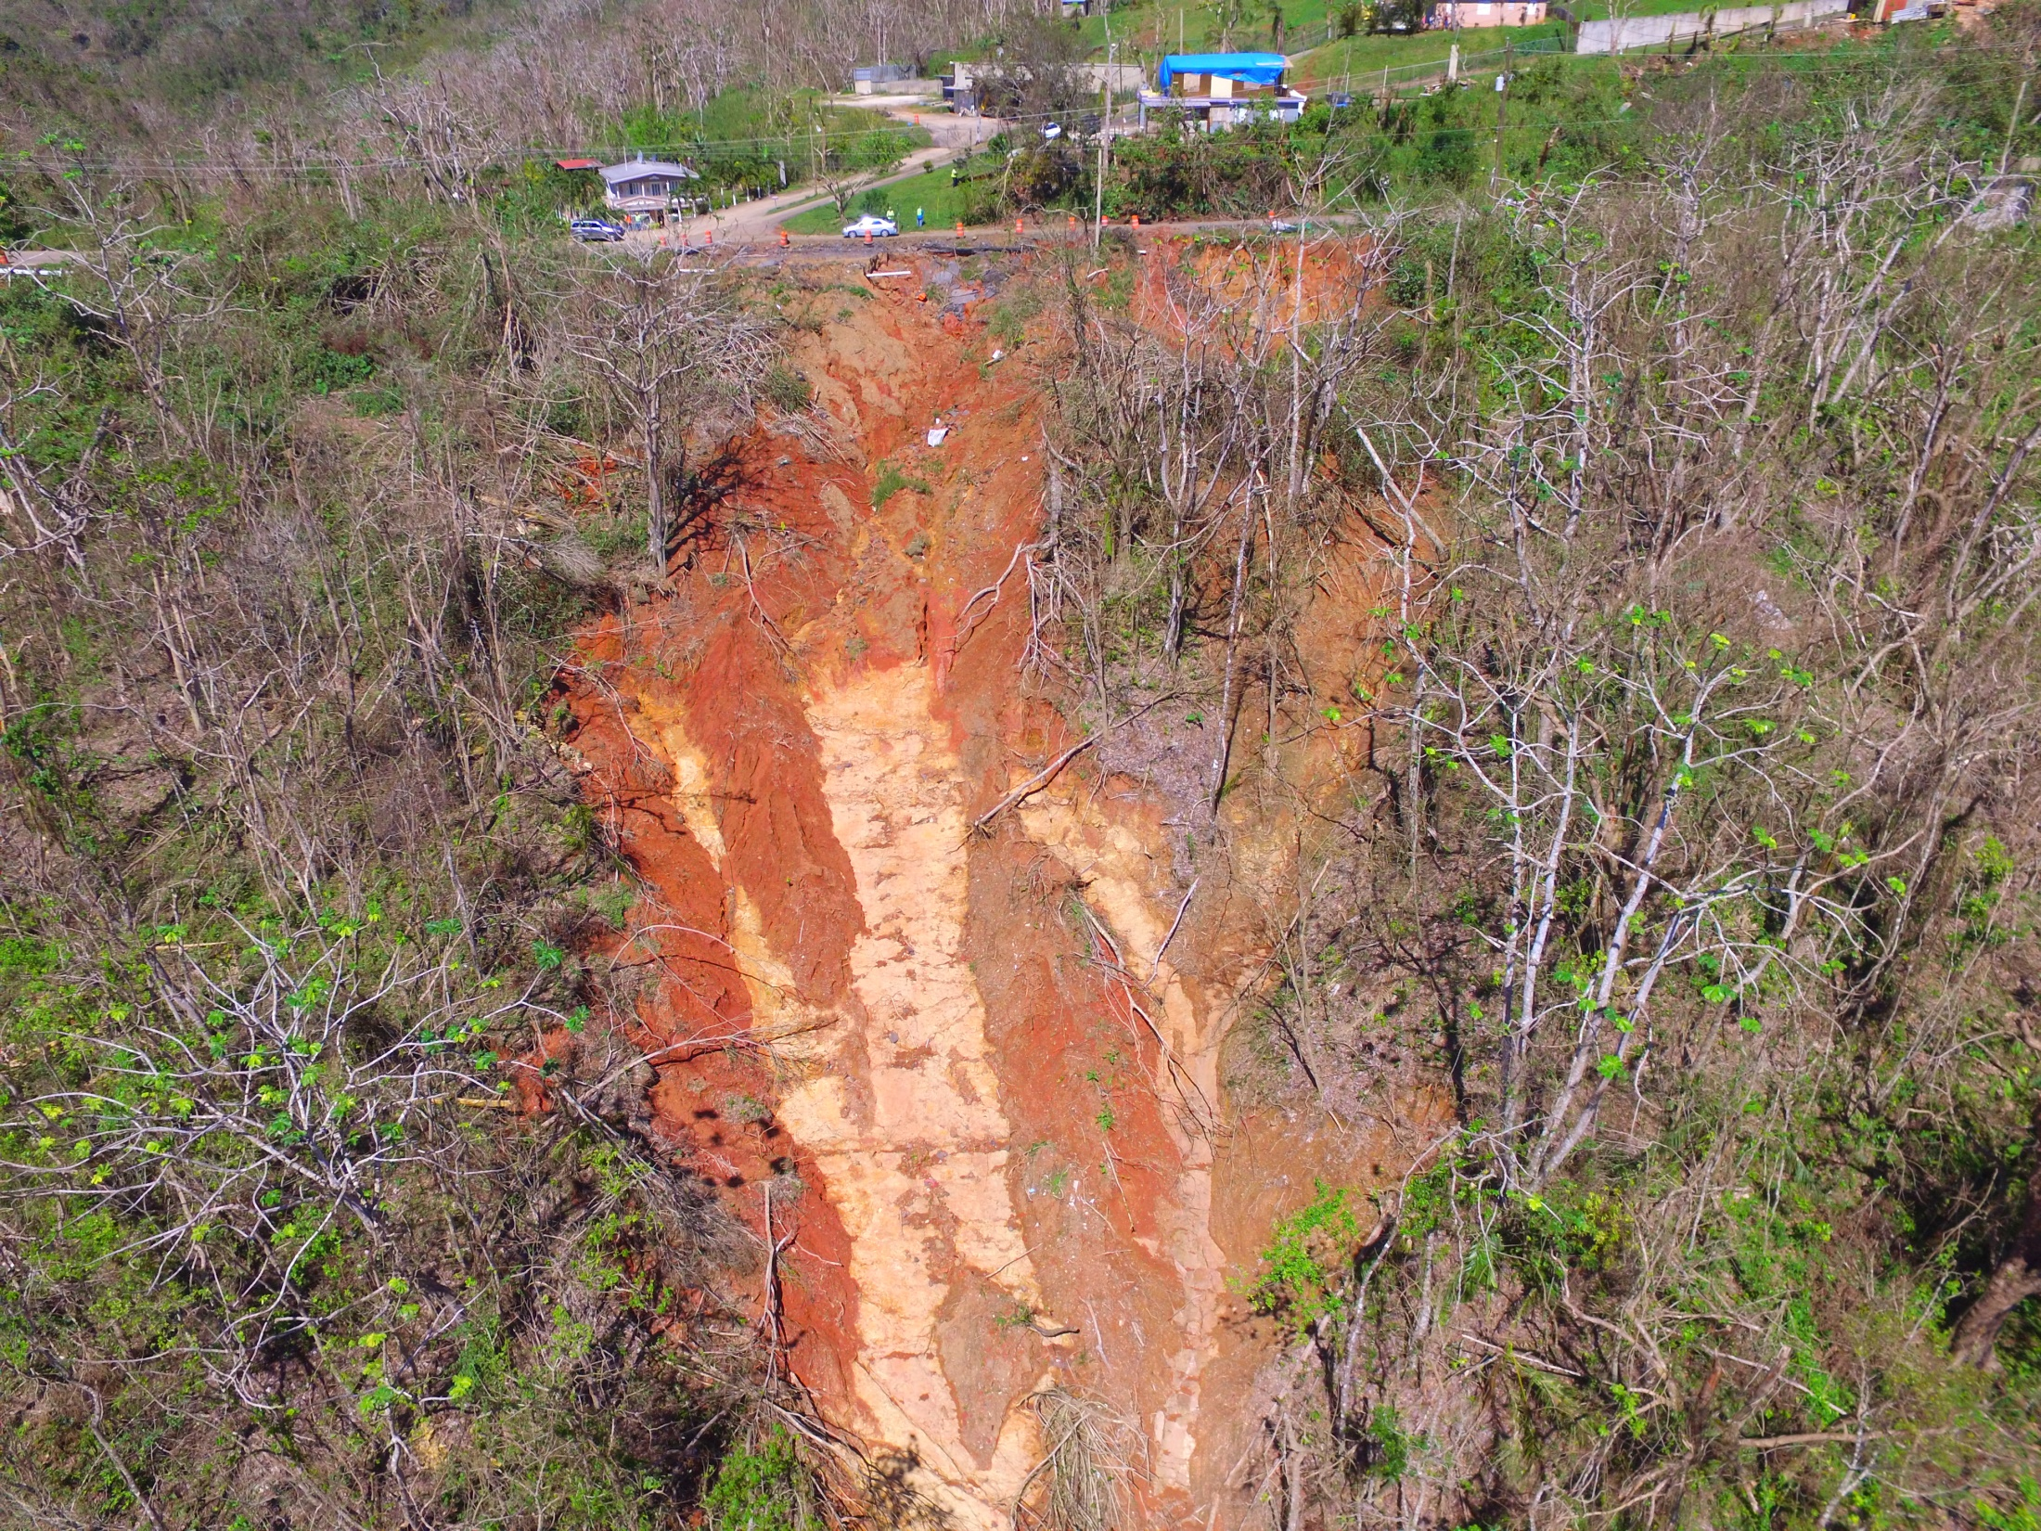
PR-143 in Coamo/Orocovis, Photo: Stephen Hughes

Slide 25
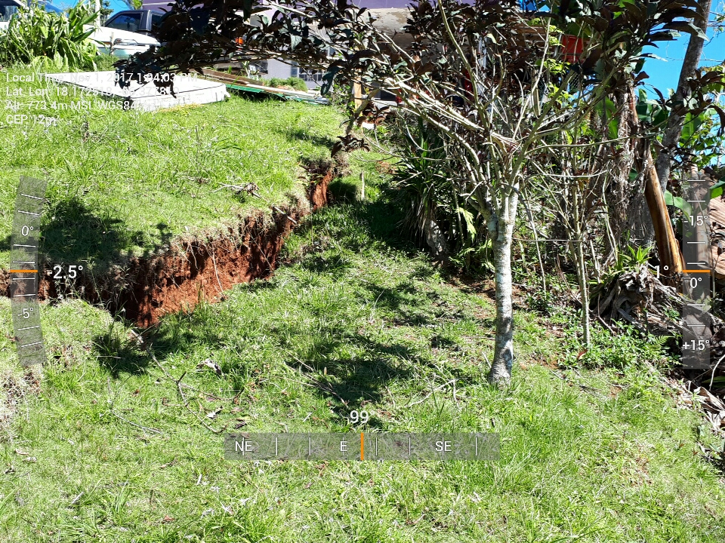
PR-143 in Coamo/Orocovis, Photo: Stephen Hughes

Slide 26
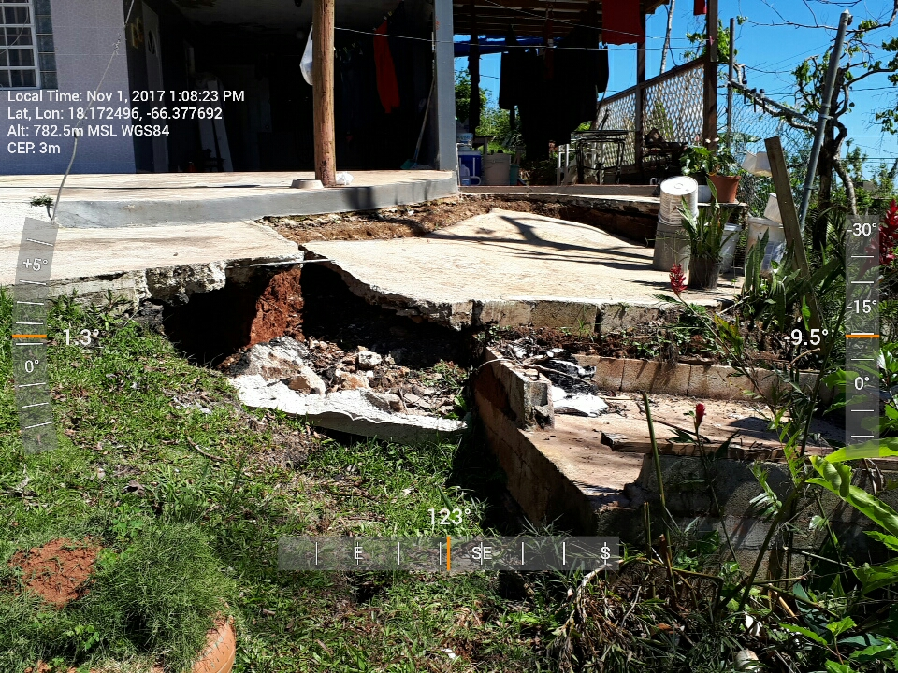
PR-143 in Coamo/Orocovis, Photo: Stephen Hughes

Slide 27
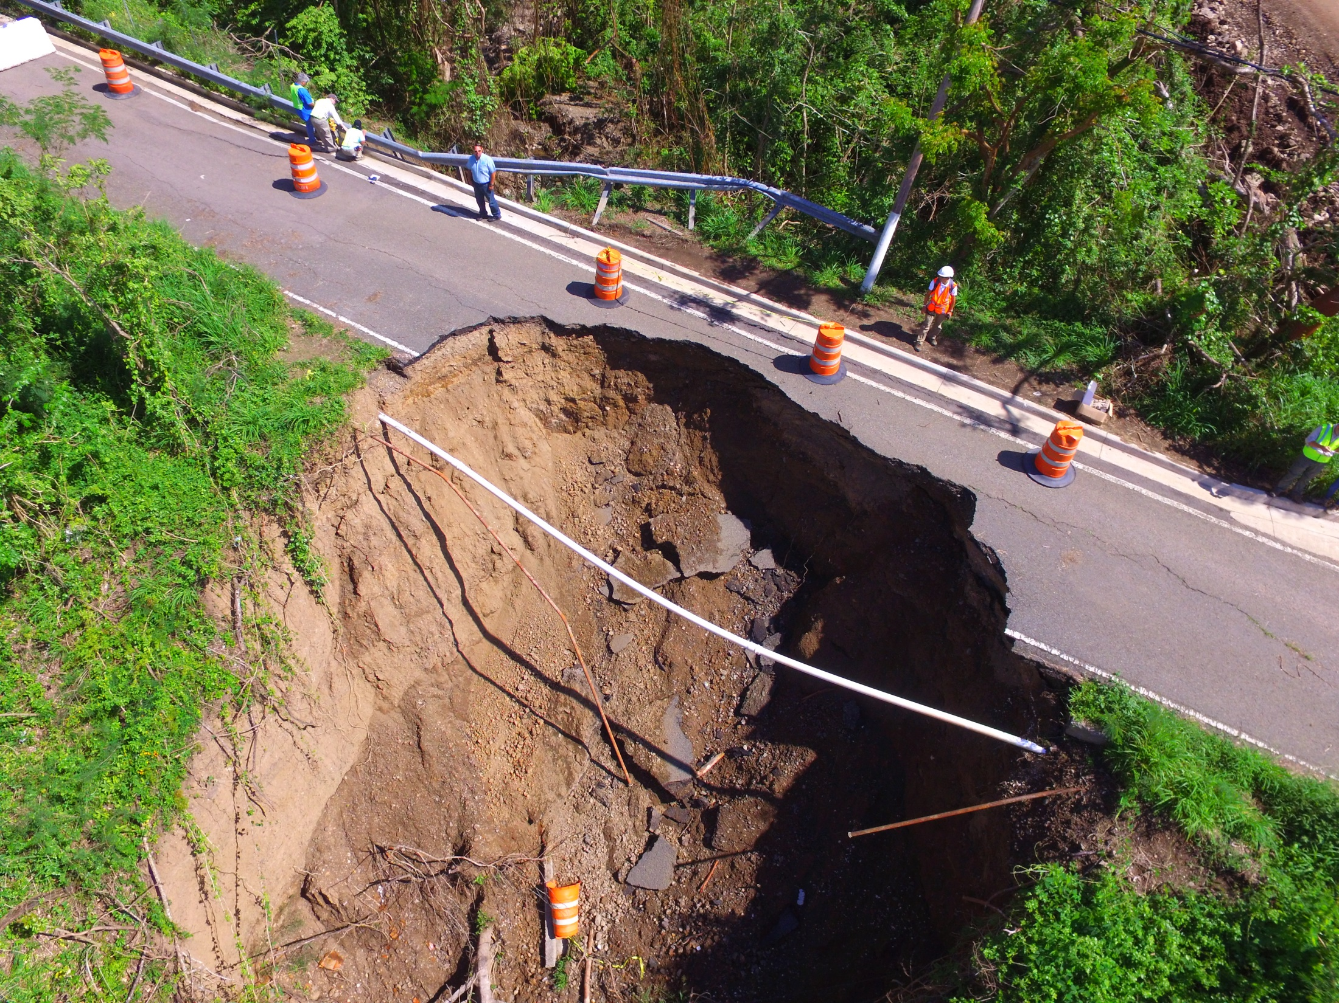
PR-555 in Coamo, Photo: Stephen Hughes

Slide 28
Hurricane María Landslides
Why the “hotspot” near the center of the island?

Slide 29
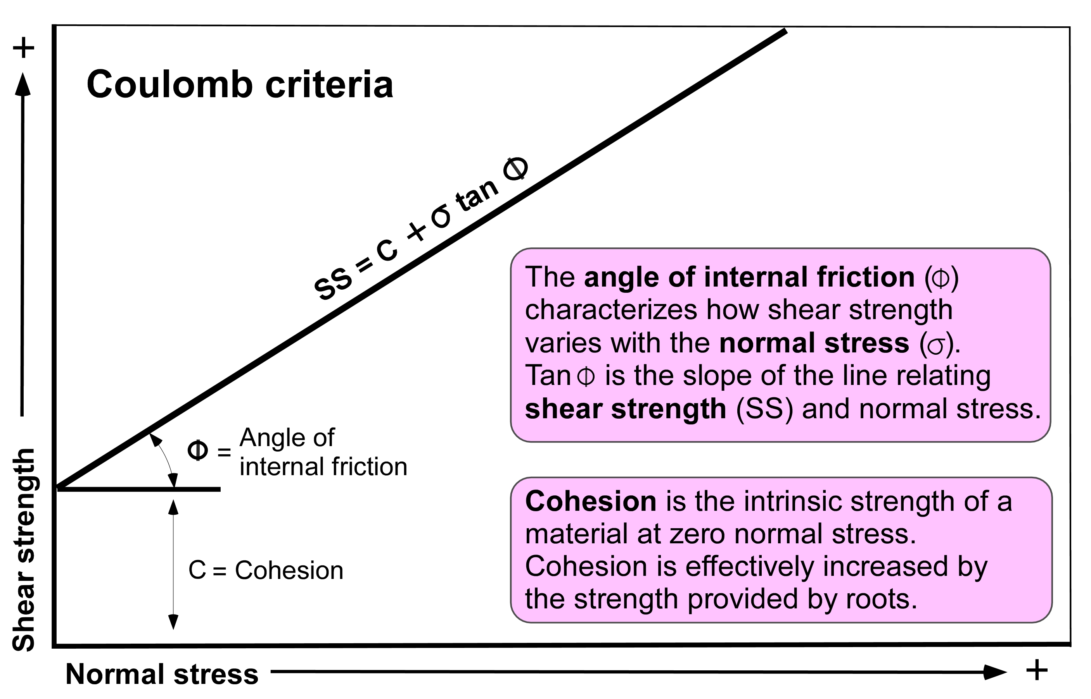
Strength of Rock and Soil:
Parameters important for movement of hillslope materials
Coulomb criteria
After Bierman and Montgomery, 2014
The ability of material to resist shearing stress is called its Shear Strength (SS).

Slide 30
Strength of Rock and Soil
After Bierman and Montgomery, 2014
Shear Strength is a product of three components:
Angle of internal friction (φ)
Cohesion (C)
Normal stress (σ) - material’s unit weight perpendicular to the slope
per unit area of the slope less the buoyant force due to any
interstitial water

Slide 31
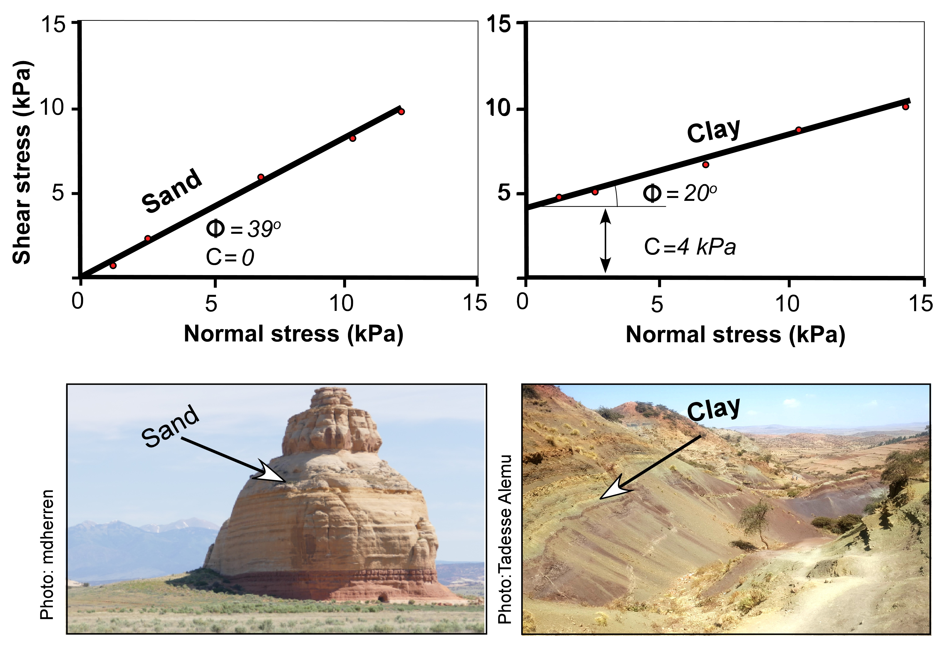
1. Angle of internal friction (φ)
2. Cohesion (C)
Material properties defined by:
After Bierman and Montgomery, 2014

Slide 32
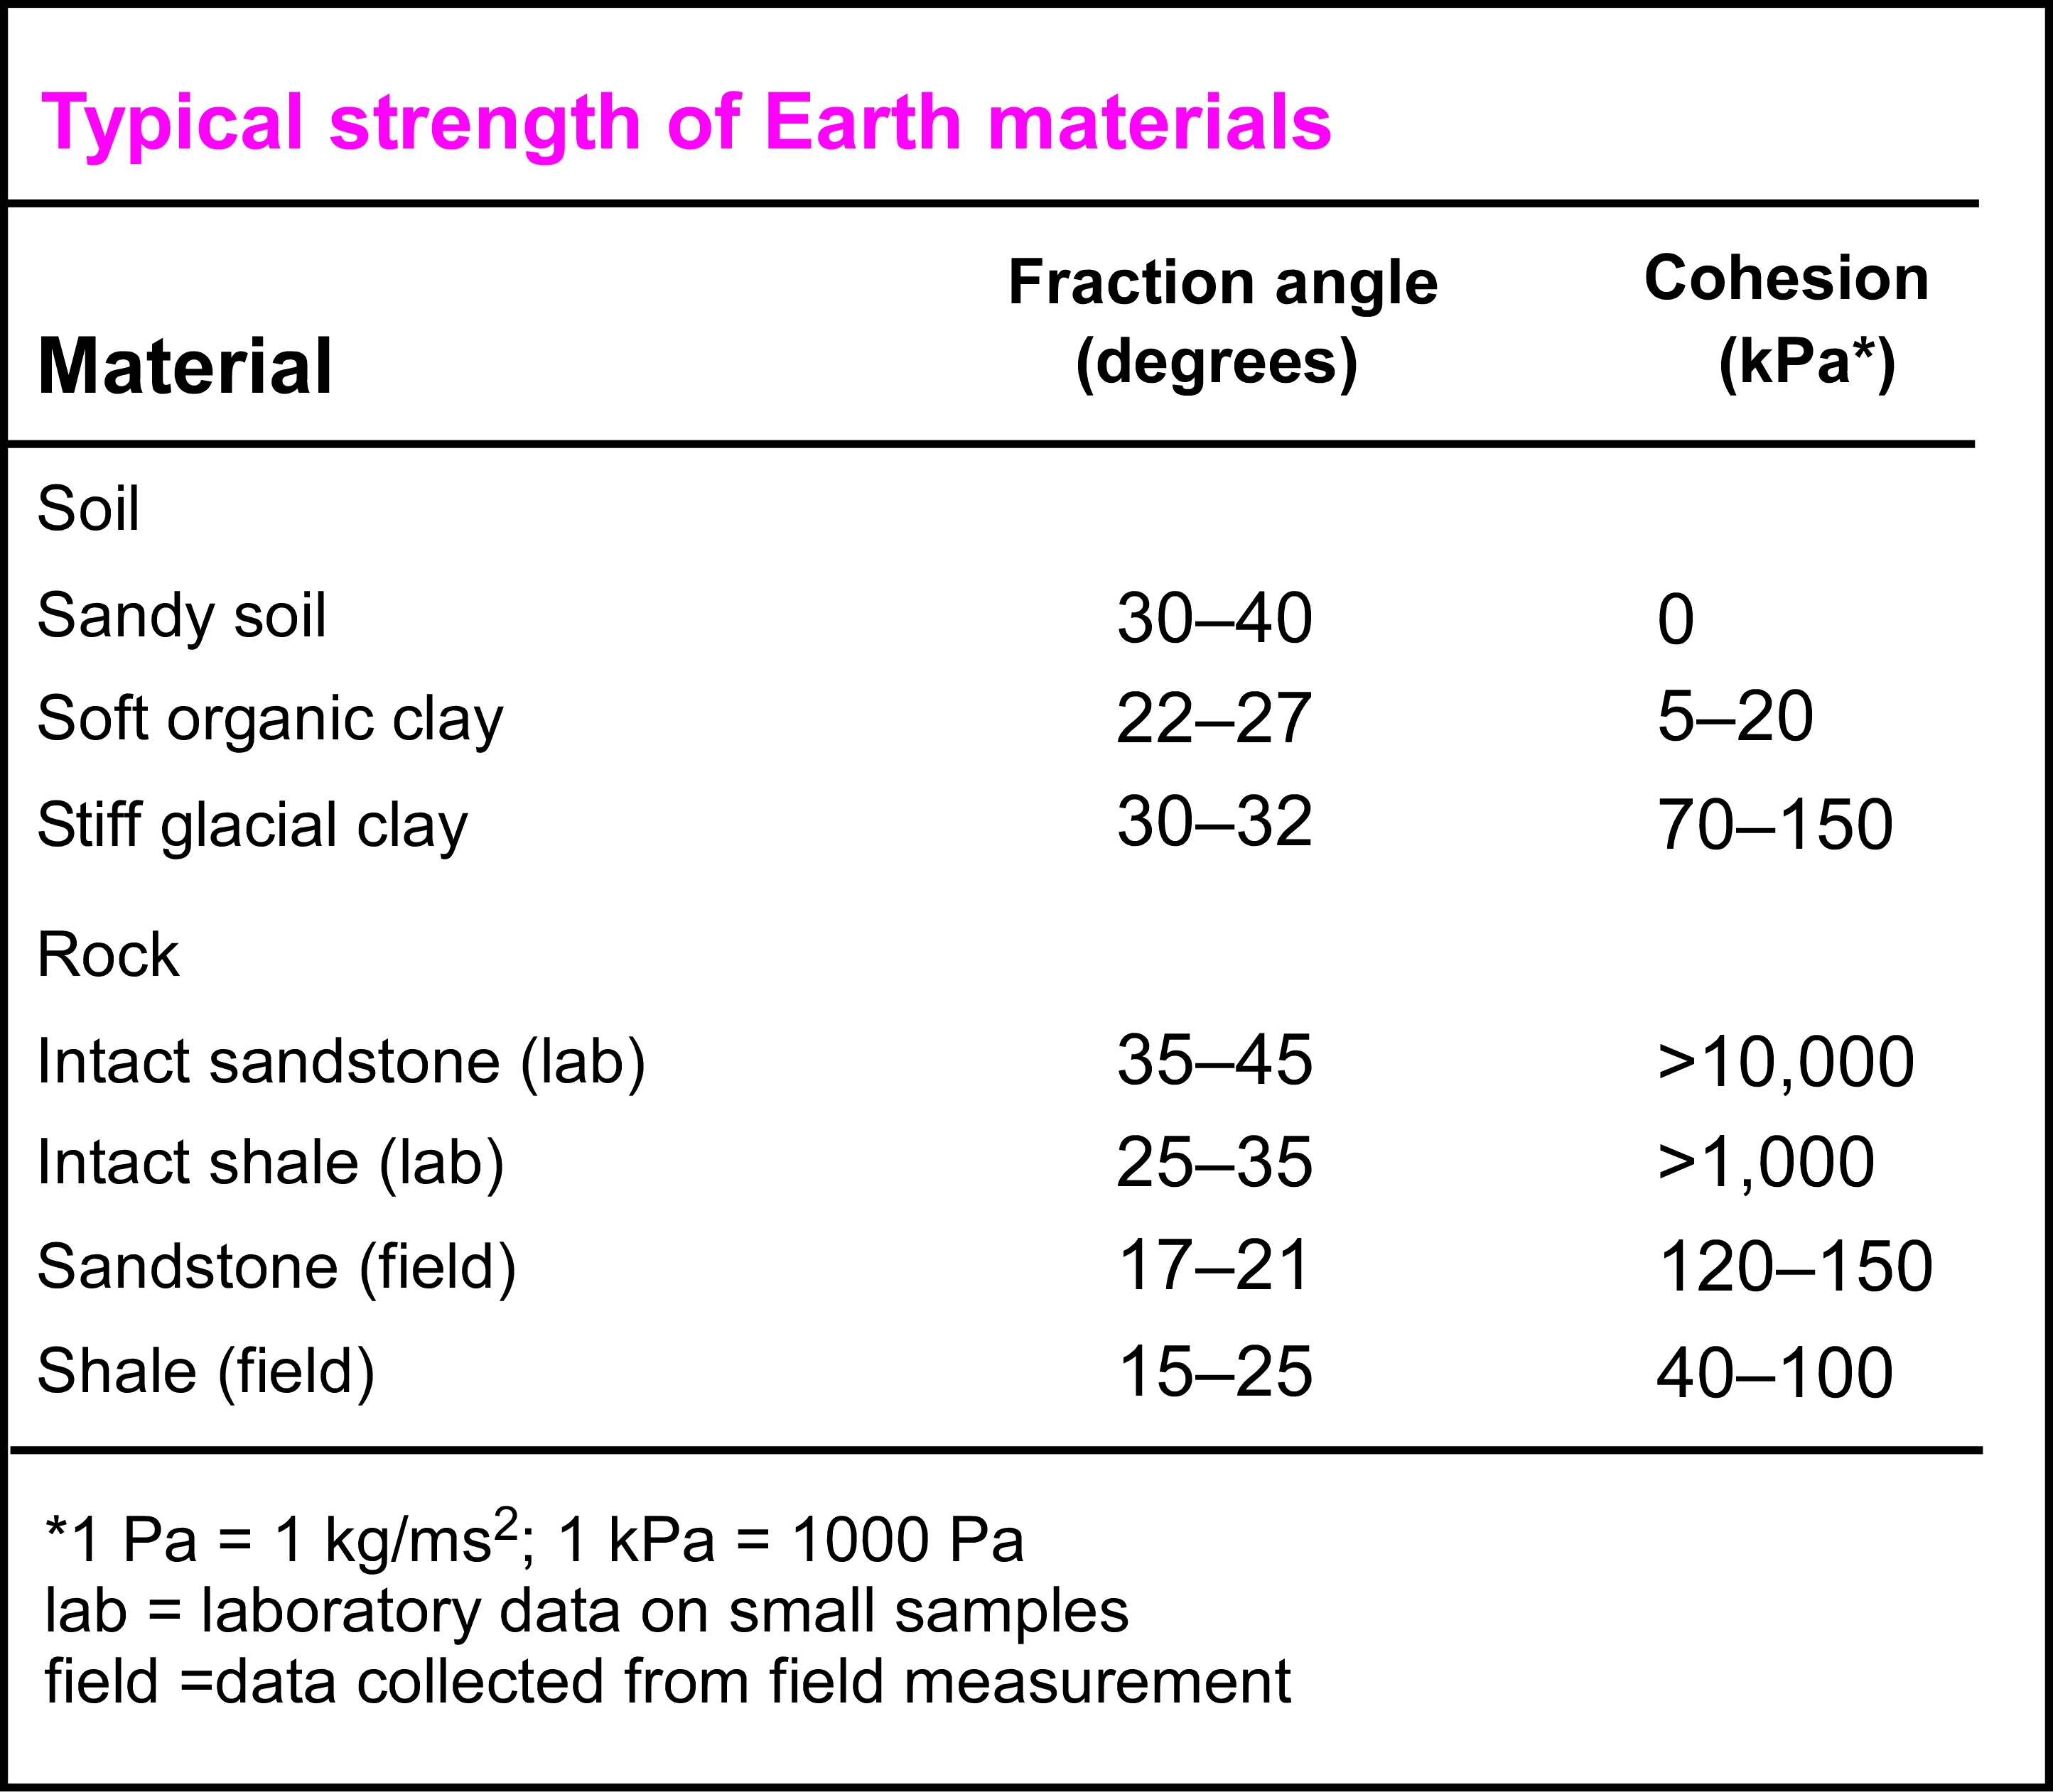
Material properties define the
Angle of internal friction (φ) and Cohesion (C)
After Bierman and Montgomery, 2014

Slide 33
Material properties define the
Angle of internal friction (φ) and Cohesion (C)
After Bierman and Montgomery, 2014

Slide 34
Hurricane María Landslides

Slide 35
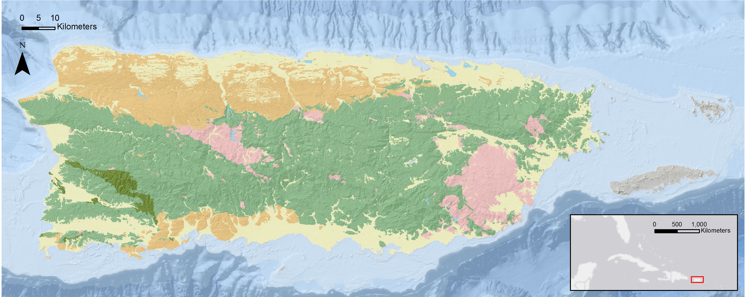
Hurricane María Landslides
Carbonate
Volcanic/Volcaniclastic
Intrusive
Serpentinite

Slide 36
Hurricane María Landslides
Carbonate
Volcanic/Volcaniclastic
Intrusive
Serpentinite
Utuado Granodiorite Pluton

Slide 37
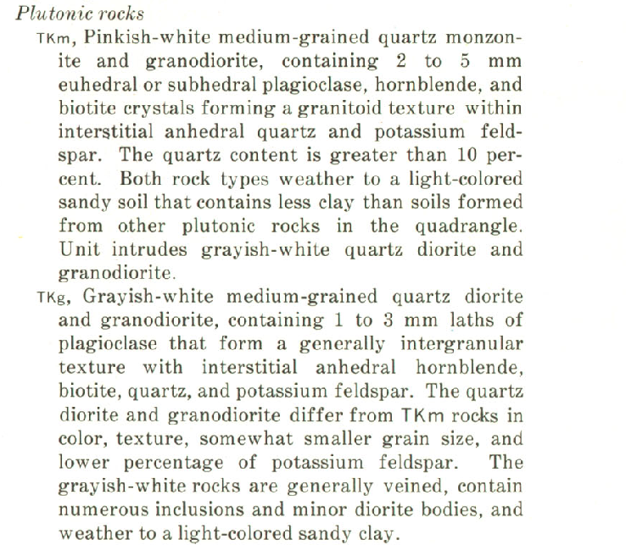
Utuado Pluton
Mattson, 1968

Slide 38
Utuado Pluton
Mattson, 1968

Slide 39
Hurricane María Landslides
Carbonate
Volcanic/Volcaniclastic
Intrusive
Serpentinite

Slide 40
Hurricane María Landslides

Slide 41
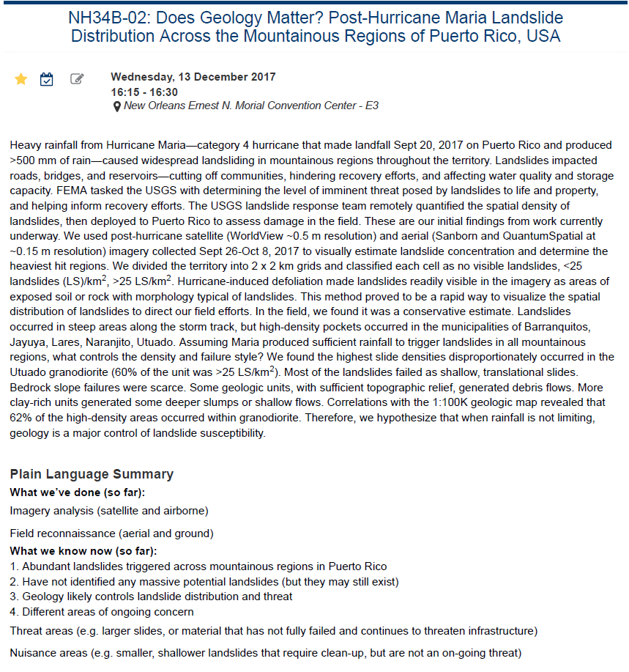
Hurricane María Landslides
YES!
Cerovksi-Darriau et al., 2017
3. Geology likely controls landslide distribution and threat

Slide 42
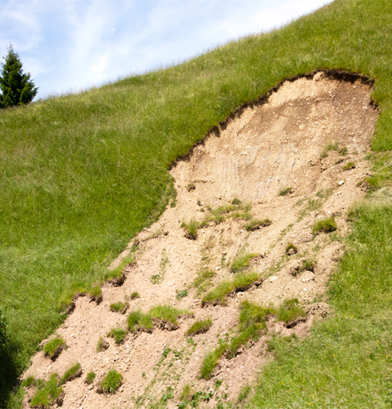
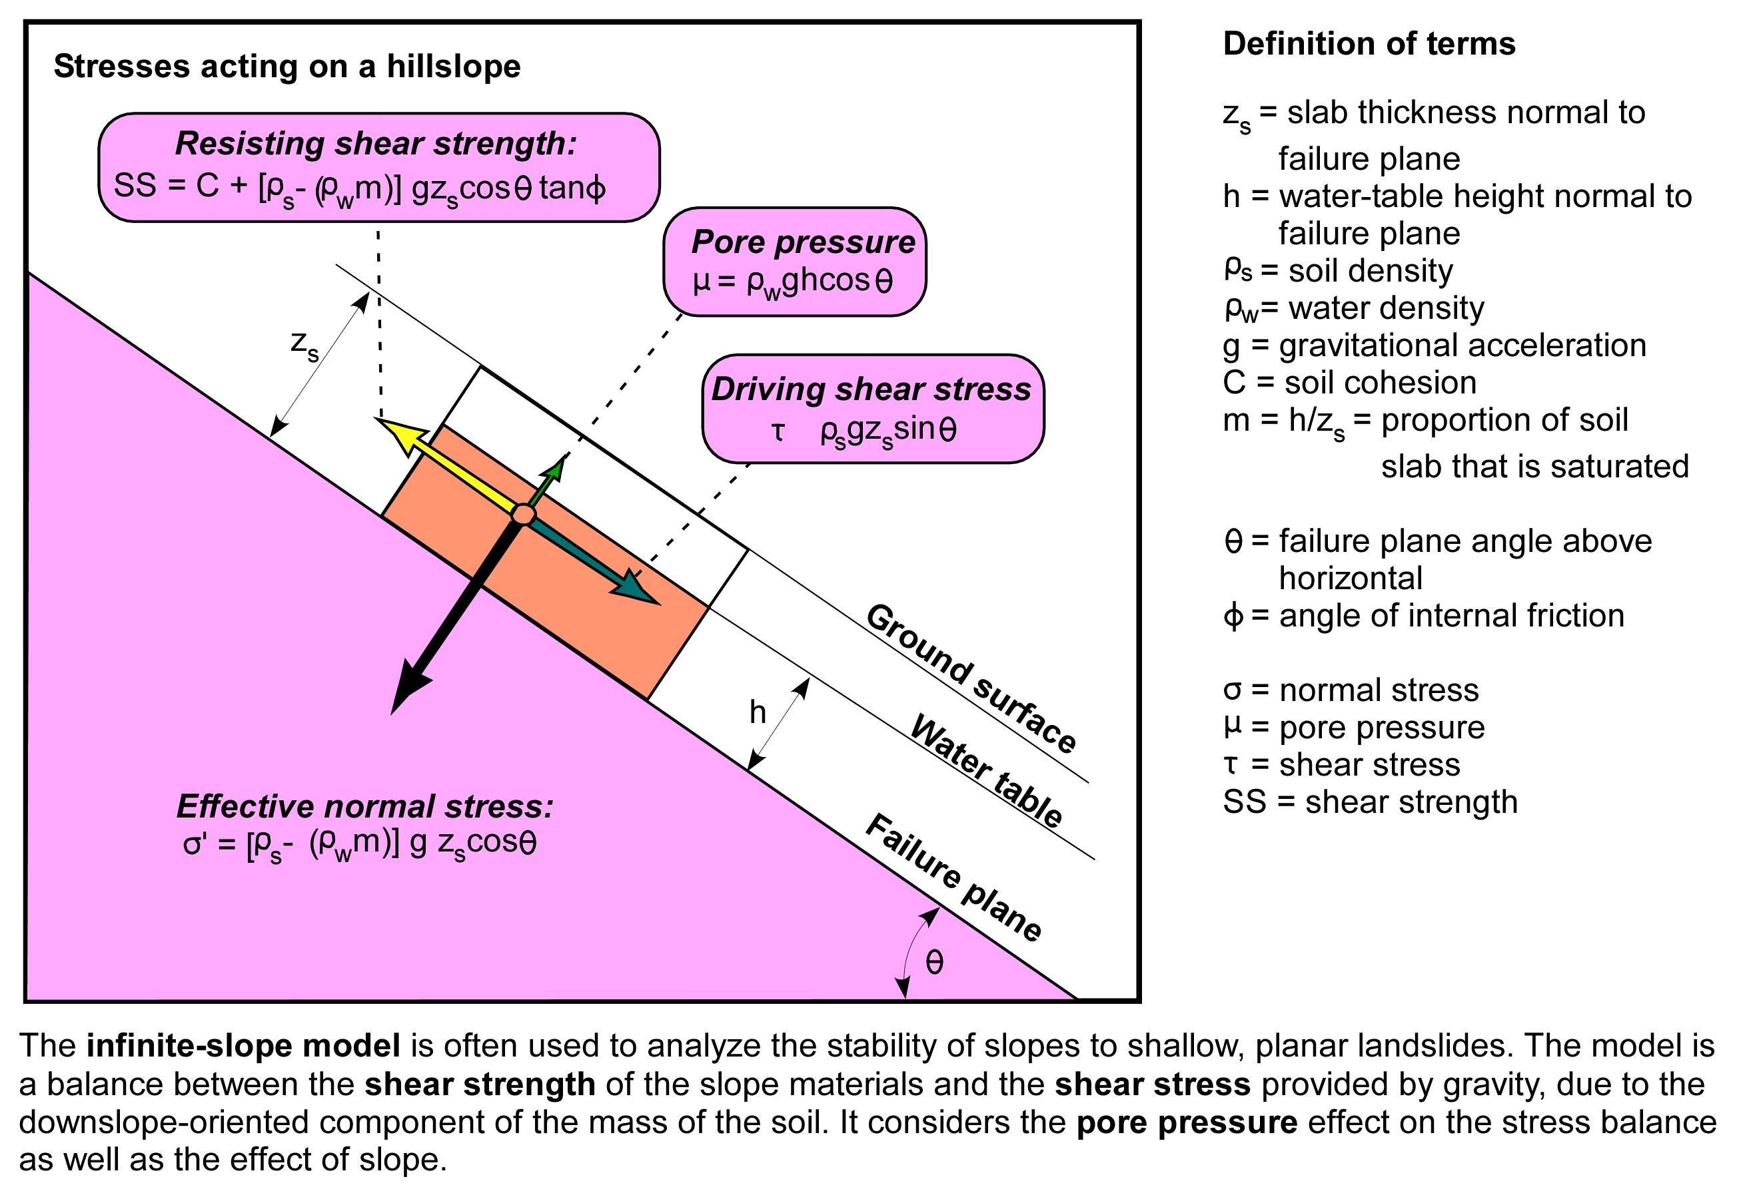
Infinite Slope Model:
Resisting vs. Driving Forces
Resisting
Driving
After Bierman and Montgomery, 2014

Slide 43
Hillslope Factor of Safety (FS)
From Bierman and Montgomery, 2014
Stable slopes have FS > 1
FS = 1 at moment of failure
FS $<$ 1 unstable or failed slopes (had)
$$FS=\frac{resisting}{driving}=\frac{C+[ρ_{s}−(ρ_{w}m)gz_{s}cosθtanΦ}{ρ_{s}gz_{s}sinθ}$$

Slide 44
Guided Discussion for Unit 1
The landslides shown on the previous slides were caused by excessive rainfall. What other natural phenomena can cause mass wasting?
Notes:
Earthquakes and Volcanic Eruptions

Slide 45
Guided Discussion for Unit 1
How can scientists use landslide identification and inventories to plan for future events?
Notes:
Empirical observations to guide hazard mapping.

Slide 46
Guided Discussion for Unit 1
What factors do you assume are most important for landslide susceptibility?
Notes:
Slope, geologic substrate, soil, curvature, distance from road, hillslope aspect, etc

Slide 47
Guided Discussion for Unit 1
How could an investigator integrate site specific observations into an effective hazard prediction tool for a much larger area?
Notes:
GIS

