Slide 1
Guiding Principles for GETSI/InTeGrate Modified from presentations by David Steer (U of Akron)
The webinar begins at:
1 pm PT | 2 pm MT | 3 pm CT | 4 pm ET
For audio, call: 1-877-668-4490
(or 1-408-792-6300)
Access Code: 579 671 806 Press *6 to mute and unmute (but hopefully we won’t need any muting)

Slide 2
Goals for this Webinar
Discuss in more depth the components of the Guiding Principles within the module design rubric
Consider examples of how the Guiding Principles might be met in the Year 1 GETSI modules

Slide 3
Linking Goals and Process: The Materials Design Rubric
Guiding Principles
Learning Goals and Outcomes
Assessment and Measurement
Resources and Materials
Instructional Strategies
Alignment
GETSI-specific Instructional Strategies

Slide 4
Guiding Principles for Materials Development
Grand Challenges
Interdisciplinary problems (geoscience & social science tied together)
Nature and methods of science
Authentic geodesy data and inquiry
[System thinking]
Notes:
These guiding principles are near the same as InTeGrates and are pulled from the first section of the the Materials Development Rubric.
The only changes are that “geodesy” was replaces for “geoscience” in D and the Systems Thinking in E will not be as strongly emphasized in GETSI.

Slide 5
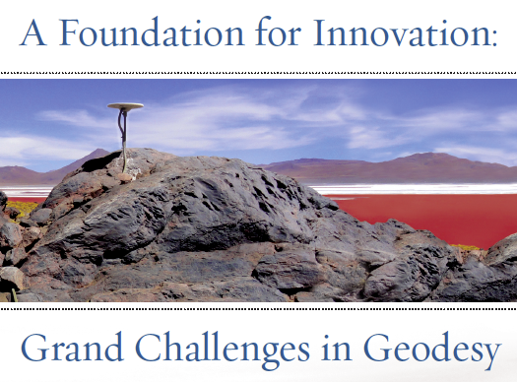
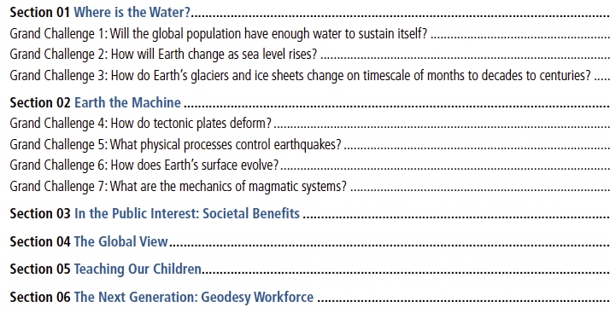
Grand Challenges Geodesy/GETSI --subset of these of particular societal importance

Slide 6
A. Grand Challenges – GETSI Year 1
Intro level – understanding changes in sea level and ice mass
Majors level – understanding earthquake processes and hazards

Slide 7
B. Interdisciplinary problems (geoscience & social science tied together)
Using GETSI Year 1 module topics, what are some possible ties to societal issues or social science that could be included?
Majors - Trying to get students to think about potential damage to infrastructure/buildings; maps w/ key features; identify things at risk
Intro – soil moisture, aquifer depletion, sites on the coast
Are there regional difference within the modules?
Yes, multiple sites are great if feasible
Students need to actually be asked to wrestle with the societal implications, not just the instructor knowing there is a connection
Elucidating difference between hazard and risk
Notes:
Notes taken during the webinar are in grey itallics

Slide 8
C. Nature and methods of science
Integrating Geoscientific thinking into learning materials
→Single most important thing you can do is to simply make your thinking explicit
Think aloud to students as you reason through a geoscientific question
Ask students to explore the uncertainty in data rather than just the data itself
Add reflective prompts to existing activities that involve open-ended inquiry or research projects
Ask students how and why they would address a problem rather than solve the problem (Ex. designing a field investigation)

Slide 9
C. Nature and methods of science
What are ways you help your students learn geoscientific ways of thinking?
Does depend on course level to some extent.
Case studies – combo of open ended questions, more canned prompts
Get students to think about assumptions behind a given question
Guided exercises but with latitude to wander off followed by…
Final large open ended questions (esp. for majors)
Ex. Where do they think the faults are and why they are there? – combo Google Earth images, lit reviews, pull together visually for group to review/see; short report (tries to get students to move to outside CA for sites)
What are possible ways to included this in the identified GETSI topics?
Gareth sees this module as a step on the way to students being ready for including InSAR and LiDAR in larger final project
Data needs to be prepped in advance to at least some extent
Google Earth helps spatially piece things together
Back of envelope calculations help too
Scope of Geologic Time (billions to nanos) is a skill hurdle
Also important to be able to do space-for-time substitutions
Learning how to make appropriate assumptions to move forward

Slide 10
D. Authentic geodesy data and inquiry
Particularly critical aspect of GETSI
Thinking on this is underway
Good resources (esp. for Intro level) are at Teaching with Data on SERC
Do you want to share any thoughts/ideas you have had on how you will use/present data in your modules?
Lidar/InSAR
Probably have both separated and integrated different data sets in different assignments
Regions – CA is data-rich but important to have others too at least for spin off activities
Intro
Prefers to use online data streams because it gets updated continually (ex. stream data or GPS data)
Regions of interest and then guided by questions
Google Earth can be powerful for example on seeing how coasts might change
Many cases make some sort of plot (ok except for really big Intro classes)

Slide 11
E. [Systems Thinking]
Earth is a complex and dynamic system
Students need to understand that changes in one part of the system can affect other parts
Systems thinking strategies
Explicitly highlight connections in discussions/lecture
Concept maps
Case studies
Simple models
Have you used these strategies? How?
Dynamic systems in environmental courses – show gears and have them think-pair-share on IF you change system X, now might that change system Y, etc
Notes:
Although Systems Thinking is a big component of InTeGrate, it is not a stated goal for GETSI. We are retaining it in the Module rubric for consistency and because Systems Thinking is generally a good practice to aim for. However, we will not emphasize as high a level of achievement on this as perhaps an InTeGrate module would.

Slide 12
Linking Goals and Process: The Materials Design Rubric
Guiding Principles
Learning Goals and Outcomes
Assessment and Measurement
Resources and Materials
Instructional Strategies
Alignment
GETSI-specific Instructional Strategies

Slide 13
The Approach
Identify Module Learning Goals
Identify learning outcomes for individual units
Determine how to assess and measure student success on goals and outcomes
Design teaching resources and materials to match assessments
Plan Instructional Strategies to implement teaching resources

