Slide 1


Comparing Student Satisfaction with Textbook Chapters and Adaptive Learning Lessons in an Environmental Geology Course
E. Christa Farmer
Amy Catalano
Adam Halpern
Hofstra University

Slide 2
Adaptive Learning Platform (ALP):
Computer program that can individualize a student’s learning experience.
Seen by many in the textbook industry as the future of learning.

Slide 3
Few studies of ALP effectiveness:
Kulik and Fletcher (2015): effectiveness of “intelligent tutoring systems” as replacement for human tutors
Belland, Walker, Kim, and Lefler (2017): use of “computer-based scaffolding” in STEM education, also as replacement for human tutor
Griff and Matter (2013): effectiveness of LearnSmart, developed by McGraw Hill Higher Education, but didn’t specifically examine student engagement or motivation

Slide 4
Our Research Questions:
Does assigning adaptive learning platform (ALP) modules as homework instead of readings in traditional textbook chapters increase student satisfaction with the course materials?
    assessed using questions taken from Huang and Hew (2016) and Xu, Huang, Wang, and Heales (2014), and original ones.
Does this increase student personal interest in environmental geology?
    assessed using questions slightly modified from Harackiewicz et al. (2008) and Mitchell (1993)

Slide 5
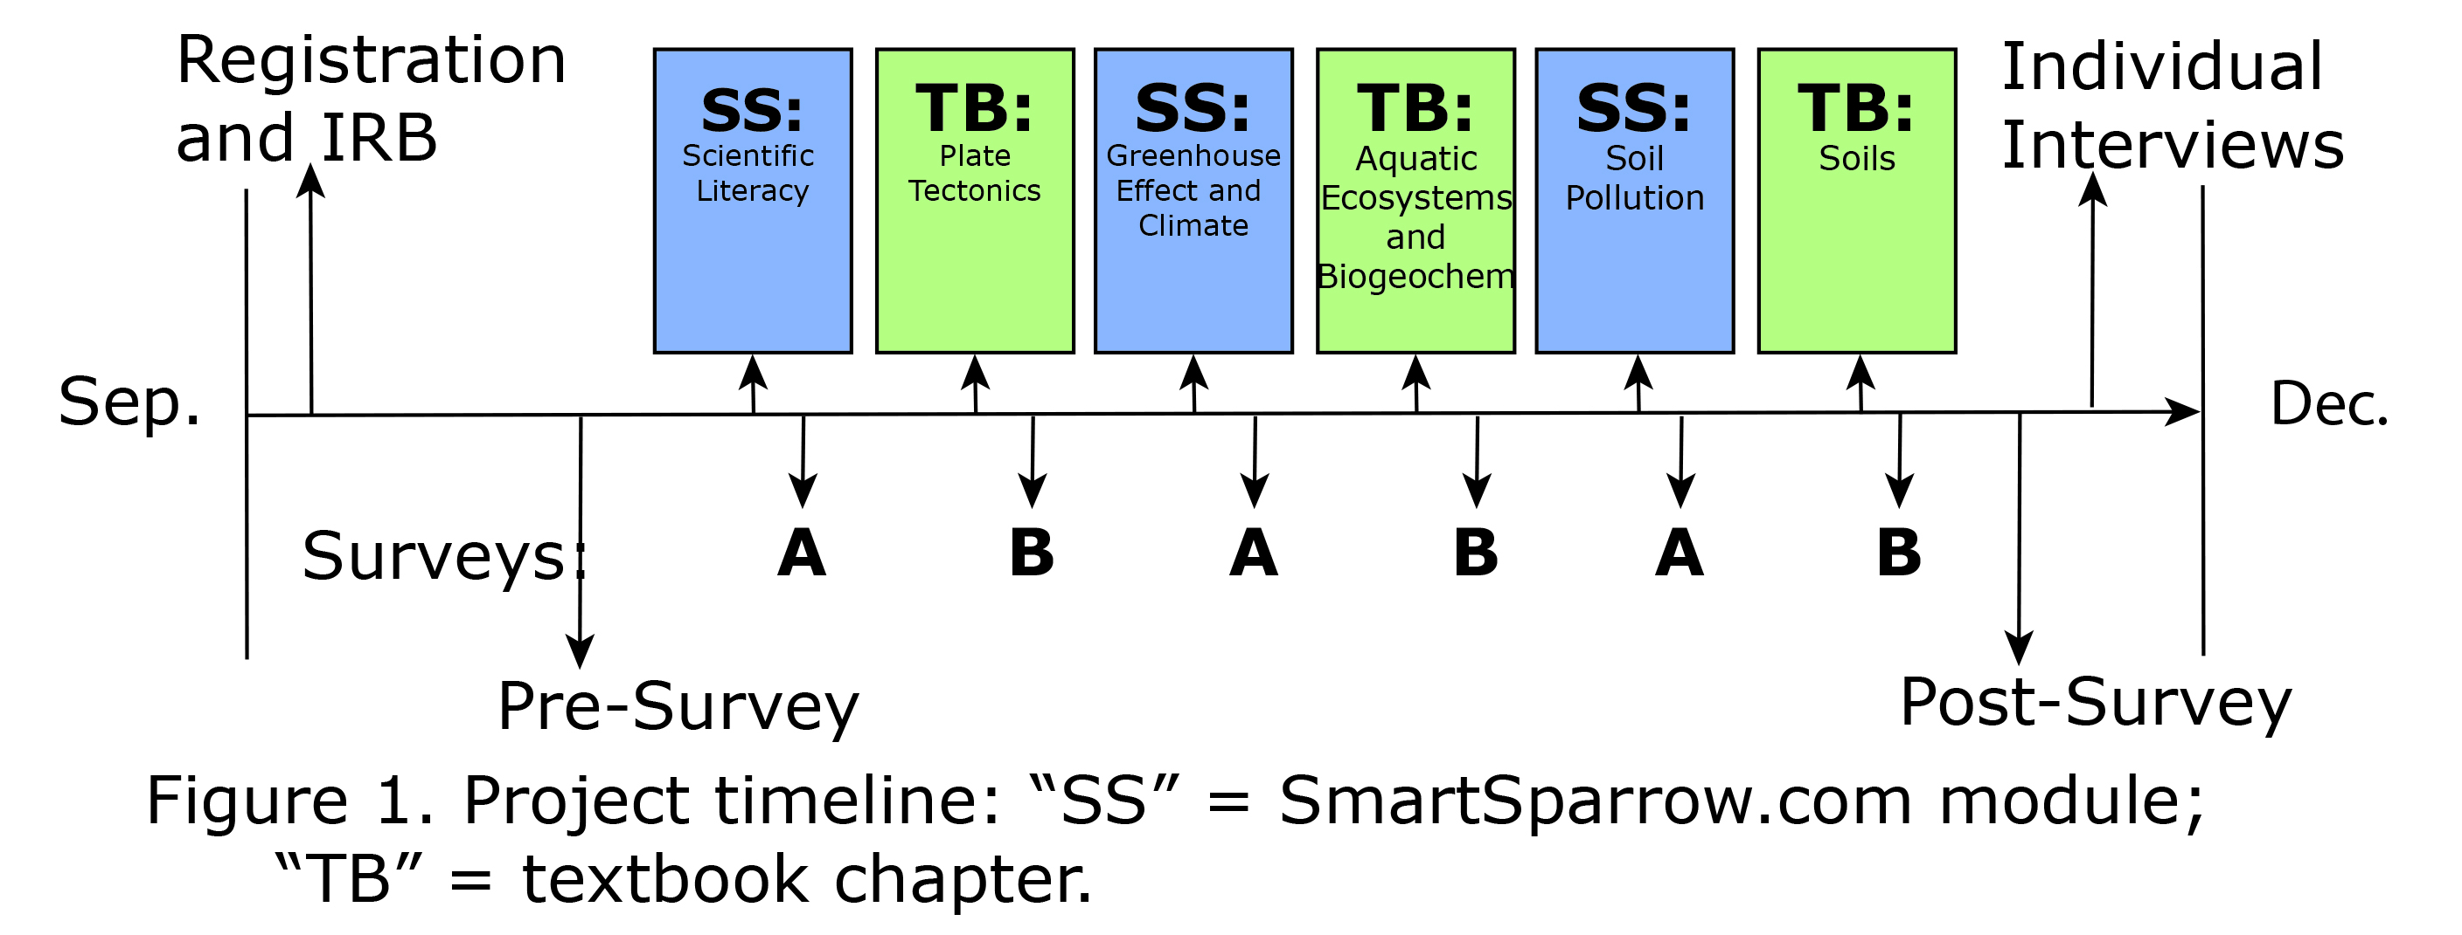
Our study in a nutshell:

Slide 6
A page in the SmartSparrow “Science Literacy” module:

Slide 7
A page in the SmartSparrow “Greenhouse Effect” module:

Slide 8
A page in our SmartSparrow
“Soil Pollution” module:

Slide 9
“Soil Pollution” page, solved:

Slide 10
“Soil Pollution” page, not solved:

Slide 11
Study Participants:
17 students (10 female, 7 male) in GEOL005 Environmental Geology
8 were Geology/Sustainability majors
11 were juniors and seniors
6 had previous experience with interactive learning software
All students completed all surveys
6 student participants were interviewed by 2 study authors who were not teaching the course

Slide 12
Survey Results:
Students consistently preferred the SmartSparrow modules, except for one:
Survey: | A1: satisfaction | A2: satisfaction | A3: satisfaction |  | B1: satisfaction | B2: satisfaction | B3: satisfaction
class avg.: | 18.06 | 11.94 | 19.06 |  | 15.58 | 17.00 | 15.62
SmartSparrow
modules
Textbook
chapters

Slide 13
Interview Results:
4 out of 6 students preferred SmartSparrow modules
5 out of 6 students liked SmartSparrow interactivity and thought it helped them learn, more than just reading
All noted technological issues, especially with the 2nd (“Greenhouse Effect”) module:
  Getting “stuck” on incorrect answer, causing anxiety
  Synonyms not accepted (“breeze” for “wind”)
  Adobe Flash and browser problems
Some concerns expressed were related to using a few modules out of context:
  Material in “review” not included in module previously

Slide 14

Thanks!
Thanks also to the 17 Hofstra GEOL005 students in Fall 2017, and Julie Sexton and 2017 EER participants for study design advice
Questions or suggestions?
E. Christa Farmer: geoecf@Hofstra.edu

