Slide 1
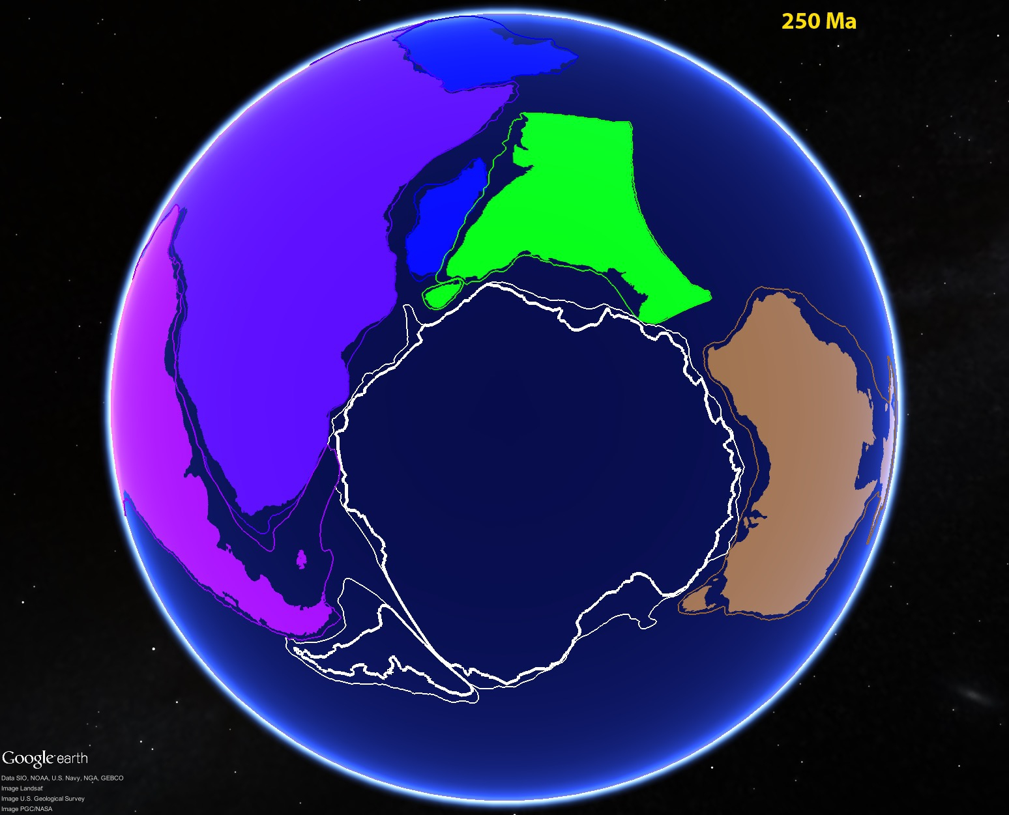



Interactive, Web-Based
Geoscience Education Resources
Steve Whitmeyer, Callan Bentley, Declan De Paor
…with input and help from Mladen Dordevic, Chris Atchison,
and the rest of the GEODE team

Slide 2
Interactive, Web-Based Resources
“Visualization levels” in education
Passive observation – “eye candy”
Student-driven investigation facilitated by
technology
3. Real-time “instantaneous” feedback integrated
with student-driven investigation

Slide 3
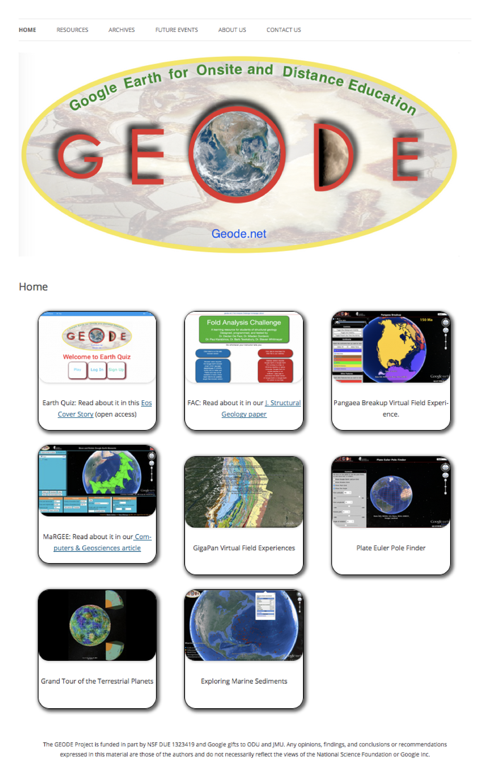

GEODE.net

Slide 4
GEODE.net

Slide 5
GEODE.net

Slide 6
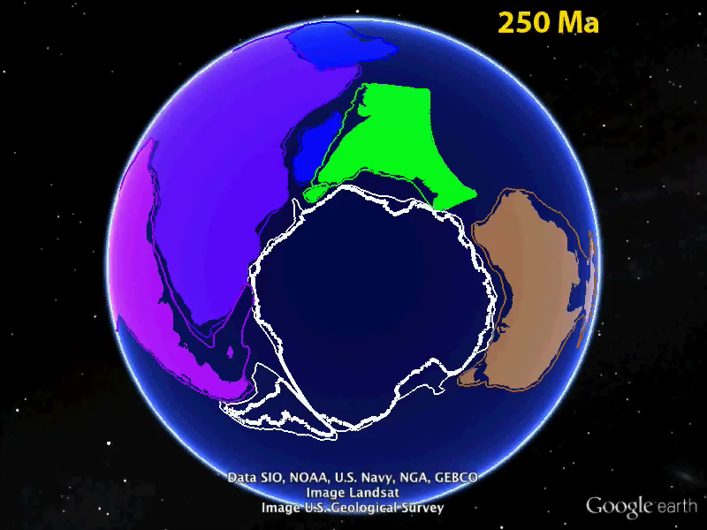
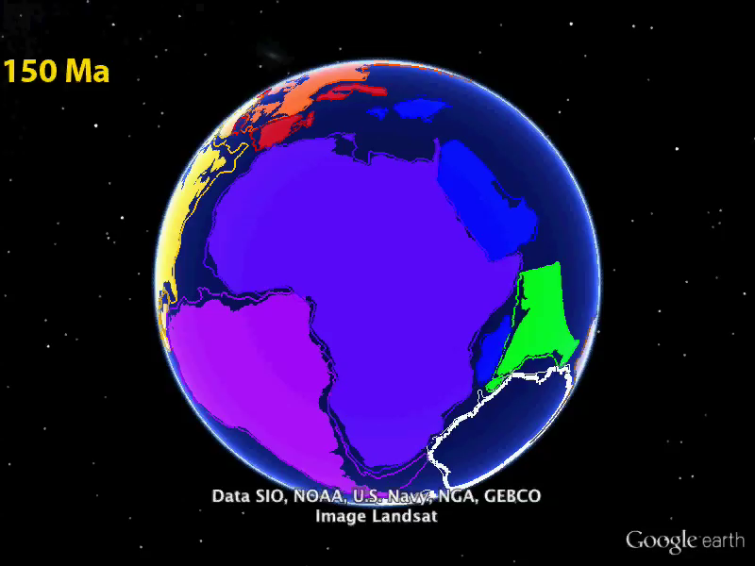
Global Tectonics: Pangaea Breakup
Built with MaRGEE tool:
http://geode.net/margee/
(Dordevic & Whitmeyer, 2015)
Tectonic models:
Rifting of Gondwana

Slide 7
Global Tectonics: Pangaea Breakup
Correlating
mountain
belts
GEODE.net/Pangaea

Slide 8
Global Tectonics: Pangaea Breakup
Correlating
mountain
belts
GEODE.net/Pangaea

Slide 9
GEODE.net

Slide 10
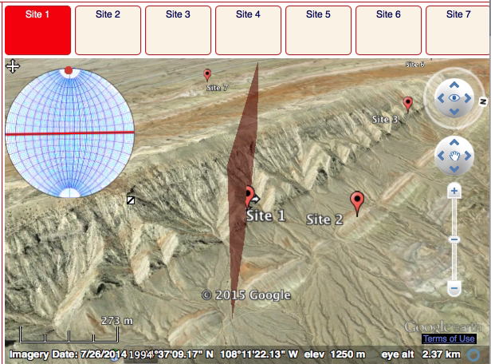
Fold Analysis Challenge
www.geode.net/fac
Sheep Mountain Anticline
Google Earth Plug-in or
Stand-alone GE application

Slide 11
GEODE.net

Slide 12
EarthQuiz.net
Eos: August 2015
EarthQuiz
http://earthquiz.net
Exercises with real-time feedback

Slide 13
EarthQuiz.net
Exercises with real-time feedback

Slide 14
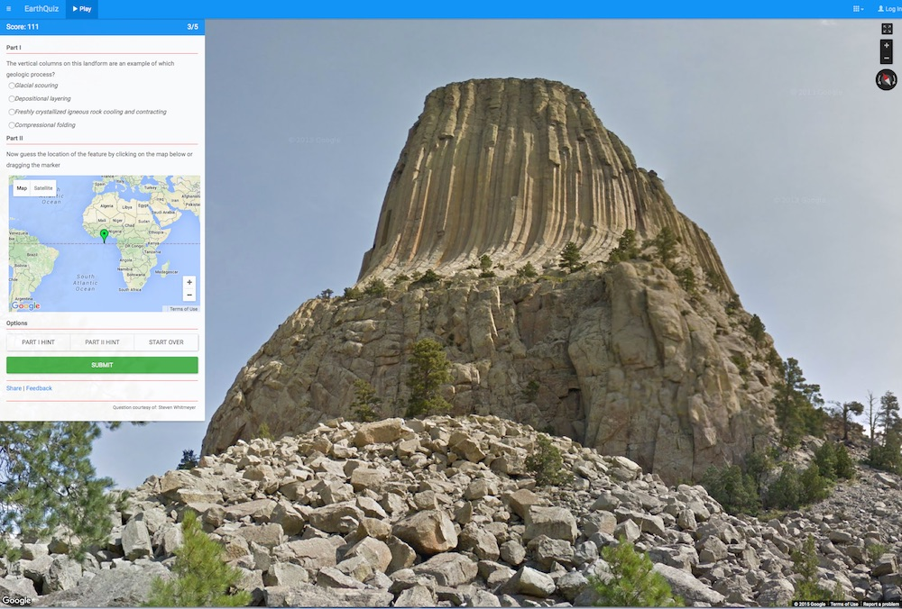
EarthQuiz.net
EarthQuiz:
More than
500 sites /
questions

Slide 15
Interactive, Web-Based
Geoscience Education Resources
Students expect technology-
facilitated, inquiry-based learning.
Instructors need to assess
its effectiveness.

