Slide 1
A five-year community effort to improve Earth literacy and build a workforce prepared to tackle environmental and resource issues
InTeGrate supports integrated interdisciplinary learning about resource and environmental issues across the undergraduate curriculum to create a sustainable and just civilization.
An NSF STEP Center
Notes:
. InTeGrate seeks to transform the role of geoscience in higher education by linking teaching about Earth to the societal issues that our science serves.
Integrate is an NSF STEPcenter funded at $10M community effort
Our motivation is to increase the diversity of geoscience students by linking science to its use and improve the ability of geoscientists to work on complex interdisciplinary societal issues, and improve the ability of society to make use of geoscience.

Slide 2
Notes:
33 sets of materials
600 teaching activities that include these and community contributed examples - many peer reviewed

Slide 3
Materials Design Rubric Ensures
All Materials
Address one or more grand challenges involving the Earth and society,
Develop student ability to address interdisciplinary problems,
improve student understanding of the nature and methods of science and developing geoscientific habits of mind,
Make use of authentic and credible science data to learn central concepts in the context of scientific methods of inquiry, and,
incorporate systems thinking.
Make use of engaged pedagogy, align instruction and assessment, build in metacognition and communication

Slide 5
Tagged to support NGSS implementation
Analyze geoscience data to make the claim that one change to Earth's surface can create feedbacks that cause changes to other Earth systems. HS-ESS2.2
Construct an explanation based on evidence for how the availability of natural resources, occurrence of natural hazards, and changes in climate have influenced human activity. HS-ESS3.1
Analyze and interpret data on natural hazards to forecast future catastrophic events and inform the development of technologies to mitigate their effects. MS-ESS3.2
Evaluate a solution to a complex real-world problem based on prioritized criteria and trade-offs that account for a range of constraints, including cost, safety, reliability, and aesthetics as well as possible social, cultural, and environmental impacts. HS-ETS1.3

Slide 6
Improve Systems Thinking

Slide 7
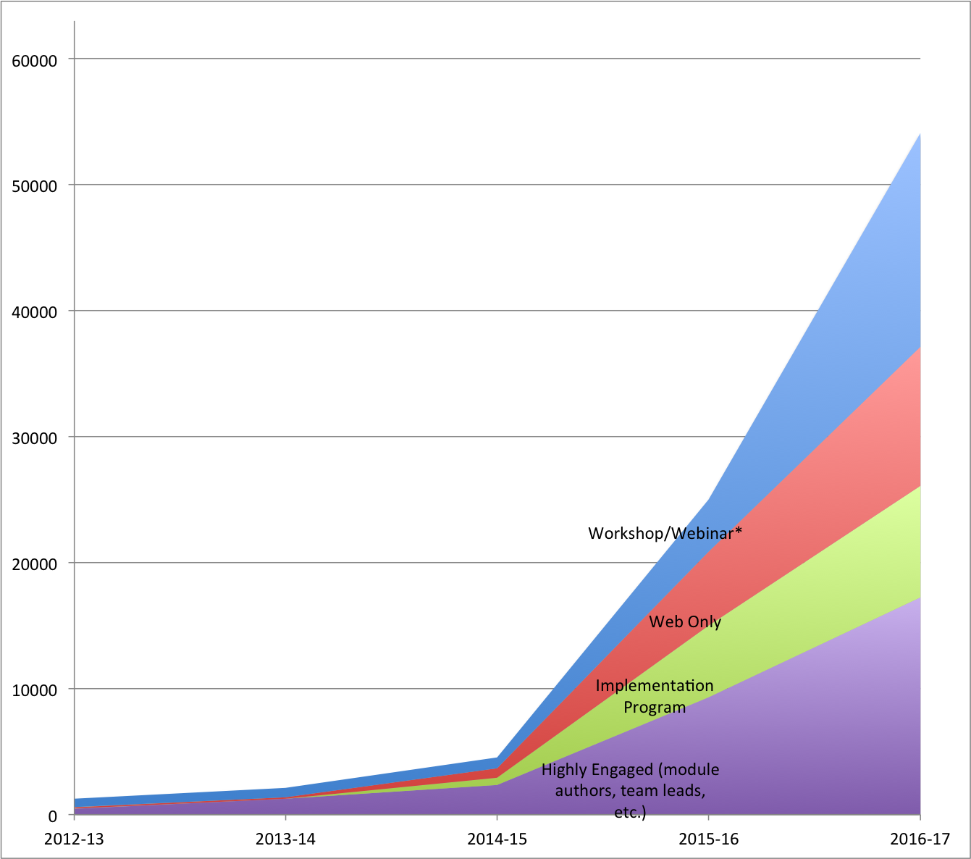
Faculty like and use these materials
Over 1000 faculty from 701 unique institutions have reported teaching courses that adapted, adopted or were inspired by InTeGrate materials enrolling in total more than 70,000 students.
Workshops
/Webinars
Website
Implementation
Programs
Highly Engaged

Slide 8
Notes:
16 programs

Slide 10
