Slide 1
Using data from the Experimental Earthscape Facility (Jurassic tank) to visualize basin-scale stratigraphic architecture
Tom Hickson
University of St. Thomas
St. Paul, MN

Slide 2
First, my bias
For the purposes of an undergrad sed geo course, I view sequence stratigraphy as [merely?] an extension of Walther’s Law, with a great deal of terminology attached
I don’t de-value its utility, I just think that students don’t need the terminological details
To me, interpreting stratigraphy, correlating sections, and understanding basin architecture is all about…

Slide 3
The ‘trinity’
Sign and rate of change of sediment and water supply
Sign and rate of base level change
Uplift or subsidence rate

Slide 4
The ‘problem’
Tough for students to really grasp Walther’s Law and how the ‘trinity’ result in facies shifts
Sequence boundaries, parasequences, flooding surfaces, etc seem fairly abstract without seeing them in their totality
Could I devise a way for students to really understand the big picture, but not get caught up in the details of, say, the Book Cliffs?

Slide 5
I use a physical model and experimental stratigraphy
The Experimental EarthScape Facility (Jurassic Tank)

Slide 6
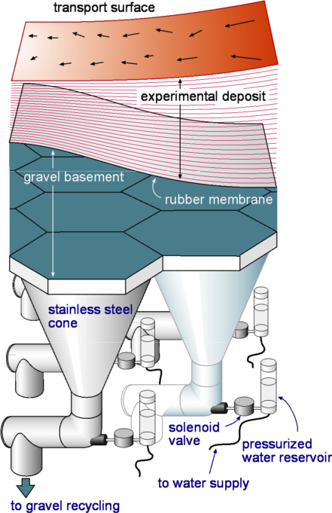
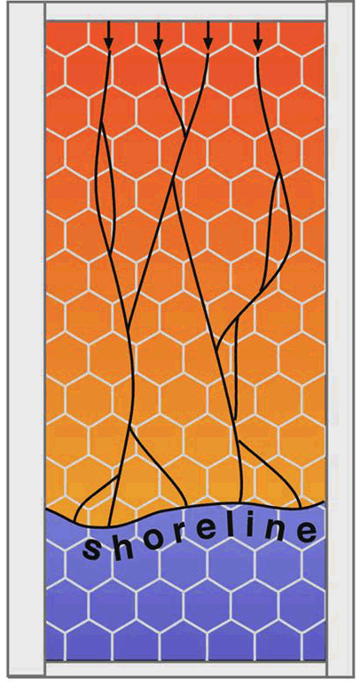

Slide 7

What an experiment would like you to you…
2002 run

Slide 8
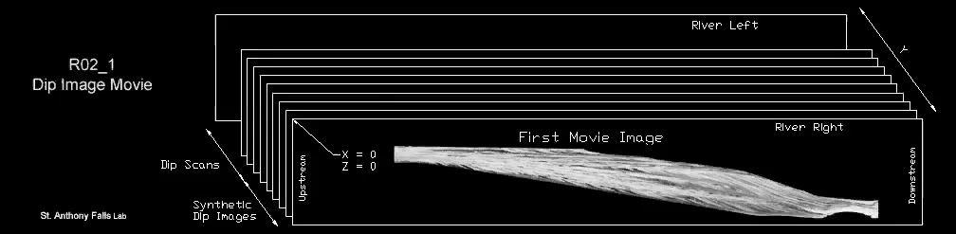
Deposit fly-through

Slide 9
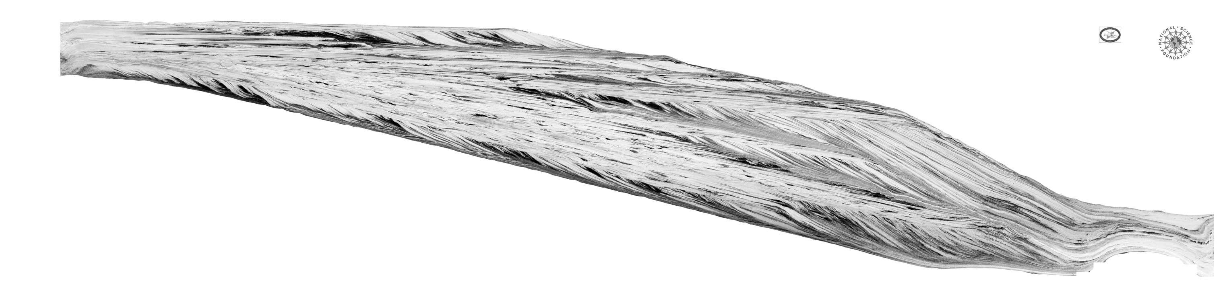
One slice from the centerline

Slide 10
Why use a physical model?
All boundary conditions are known
Perfect ‘exposure’
A much more simple system
Can see the whole basin fill
Allows students some freedom to imagine…

Slide 11
Why not use a physical model?
A bit detached from a real-world example
Have to overcome the ‘strangeness’ of sand and coal
They really need to understand how the experiment worked in some detail

Slide 12
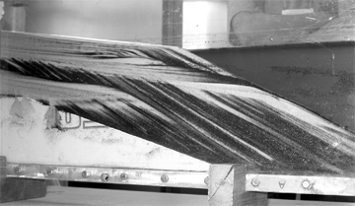
Jurassic Tank Project
Given an image of the deposit and asked to do three things
Start with an exercise using the desktop delta (on SERC site) and a complimentary correlation exercise from SERC.

Slide 13
Jurassic Tank Project
3-week long final project
Very little lecturing on my part
I act as a facilitator
Final product is a poster

Slide 14
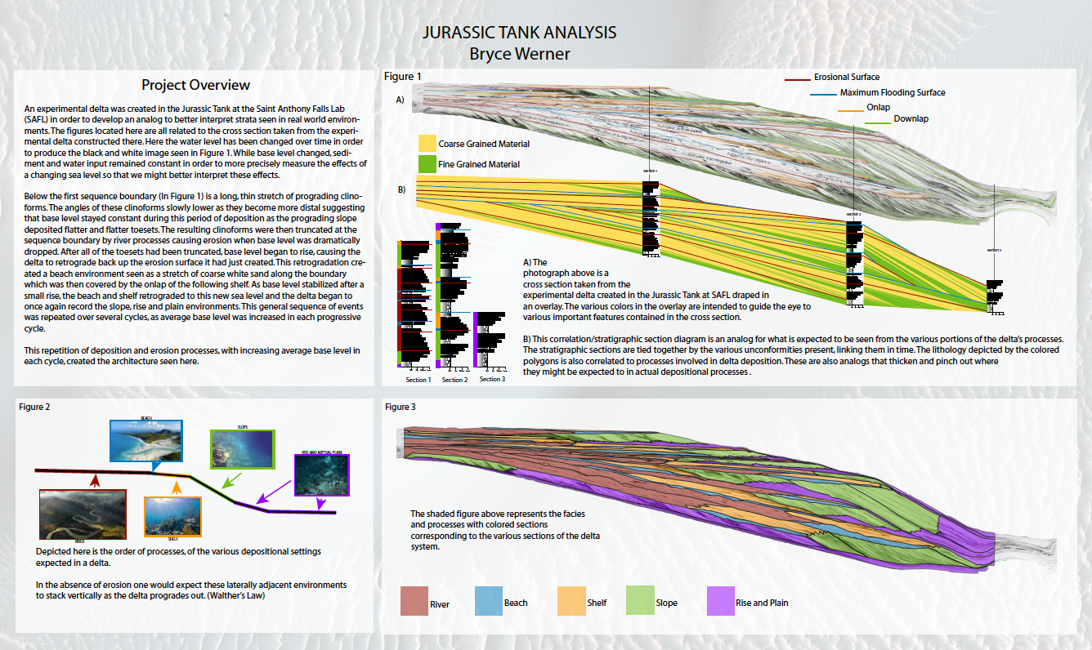

Slide 15
First task
Infer what real-world depositional environments the deposit could represent.
Find pictures of these environments
Understand facies and processes associated with these environments
Map these dep environments onto an image of the ‘outcrop’

Slide 18
Second task
Construct three measured sections through the deposit that have facies representative of the dep environments they’ve mapped/chosen
Must use textbooks and other sources to figure out what facies are typical of different dep envts

Slide 20
Third task
Interpret the deposit in terms of a change in one of the variables of the trinity…
Must choose one
They know we changed only one, but they don’t know which

Slide 22
XES Runs https://repository.nced.umn.edu
XES_1996_1/ Prototype run in a small, 10 funnel (cell) basin.
XES_1999_1/ First run in large tank; tests of LAB models.
XES_2001_1/ Mini-basin filling with sed/grav flows.
XES_2002_1/ Superimposed base level change, axisymmetric feed
XES_2005_1/ Normal fault-bounded, hanging wall basin (basin membrane failure)
XES_2006_1/ Interacting alluvial fans and changing subsidence
XES_2008_1/ Normal fault-bounded, hanging wall basin

