Slide 1
Board on Science Education
Board on Science EDUCATION
Roundtable on Systemic Change in Undergraduate STEM Education
ASCN Webinar
December 4, 2019
Sponsors: W.M. Keck Foundation
Educational Testing Service
National Science Foundation
Notes:
Ann Slides #1-7 from 4:00-4:15

Slide 2
Roundtable on Systemic Change in Undergraduate STEM Education
How do you envision undergraduate STEM education will look in 20 years?
Notes:
Ann Slides #1-7 from 4:00-4:15

Slide 3
Roundtable on Systemic Change
in Undergraduate STEM Education
A Vision for the Future of Post-secondary STEM Learning
The roundtable will focus on the future of undergraduate STEM learning and help drive a national effort on how best to educate students to be informed members of society and/or participate in the future STEM workforce. The vision will take into account the dynamic context and build strategies to direct action and inspire change.
Notes:
Ann
Mission

Slide 4
Roundtable on Systemic Change
in Undergraduate STEM Education
Goals
Link the full spectrum of stakeholders in higher education.
Coordinate and catalyze actions to make undergraduate STEM learning more inclusive and engaging.
Use evidenced-based approaches and build on successful reform efforts.
Notes:
Experts from academia, government, and industry.
Community colleges, Minority serving institutions, small colleges, large universities.
Biology, Chemistry, Physics, Mathematics, Engineering.
Faculty and administrators.
Higher Education and Systemic Change.
Representatives of national groups and organizations active in improving undergraduate STEM education.

Slide 5
Roundtable on Systemic Change
in Undergraduate STEM Education
Goals
Work to expand access, increase equity, and support quality learning experiences for all learners.
Consider changes in technology, workforce, demographics, and society.
Help create a scientifically literate public and a well-prepared STEM workforce.
Notes:
How can we help increase use of evidence based inclusive approaches to instruction today?
What levers are available to spur change?
How can we measure the frequency or quality of evidence based inclusive approaches to instruction?
How can we apply these approaches in new settings? Online? In certificate programs? In training given by industry? In new settings we can’t yet fully envision?

Slide 6
Roundtable Themes/Work Groups
Meeting Students Where They Are
Inclusive Evidence-Based Instruction
Changing Campus Incentives, Rewards, and Culture
Managing Institutional, State, and National System Change
Responding to Changing Workforce Needs
Forces Disrupting Undergraduate STEM Education
Strategies for Tracking and Evaluating Reform Efforts
Notes:
Ann Slides #1-8 from 4:00-4:15

Slide 7
Examples of Roundtable Discussions
Panel on the Changing Face of International Students
Jenny Lee, Center for the Study of Higher Education, University of Arizona
Sharon Fries-Britt, Department of Counseling, Higher Education, and Special Education, University of Maryland
Panel on Leadership and Systemic Change to Improve STEM Learning
Jaime Lester, George Mason University
Vincent Manno, Olin College of Engineering
Jeffrey Osborn, The College of New Jersey
Uri Treisman, Charles A. Dana Center, University of Texas at Austin
Presentations on Future Technology
Salim Ismail, founding director of Singularity University on Thinking Outside the Box on Undergraduate STEM Education
Andreas Oranje of ETS on Artificial Intelligence and the Future of Education
Notes:
Ann Slides #1-7 from 4:00-4:15

Slide 8
Your Input
We will next be talking about evidenced-based instruction, recognizing and evaluations teaching, and preparing the future workforce.
Please share your work and ideas on these topics at https://bit.ly/2LisZh3
Please share your questions about today’s presentation in the Zoom chat.
Notes:
Ann Slides #1-7 from 4:00-4:15

Slide 9
Increasing adoption of Evidenced-Based Pedagogies Work Group #2 Cassandra Horii, Kacy Redd, Jim Swartz, Cordelia Ontiveros
There is much evidence that engaged learning approaches:
Substantially improve student learning, sense of self-efficacy, and retention over traditional content delivery.
Improves the kinds of skills, like continuous learning and complex problem solving that employers say are critical.
Are particularly effective for members of groups who have been underserved by more traditional pedagogical approaches.
Nevertheless, change to these demonstrably more effective teaching and learning strategies has been agonizingly slow.
Notes:
Kerry slides # 9-11
4:15-4:20 Evidenced-Based Instruction

Slide 10
Roundtable ideas for increasing evidenced-based instruction
Increase availability, discoverability, and use of evidence-based course materials and methods
Advance a synthesis and research agenda on change processes and barriers to STEM education change.
Link disciplinary and campus-based faculty development efforts
Advance effective practices and models for working with adjunct and part-time faculty
Effectively involve institutions with less structure and/or resources for faculty development
Notes:
Kerry slides # 9-11
4:15-4:20 Evidenced-Based Instruction

Slide 11
Disciplinary societies
National organizations
Multi-day institutes and workshops on evidence-based teaching
Faculty learning communities
Often a departmental entry point or nomination process
Centers for Teaching and Learning
STEM Education Centers
Faculty institutes
Faculty learning communities
Single- and multi-disciplinary
Various entry points for faculty
External Discipline- based Educational Development
Campus-based Educational Development
Linking
Connecting
Collaborating
Notes:
Kerry slides # 9-11
4:15-4:20 Evidenced-Based Instruction

Slide 12
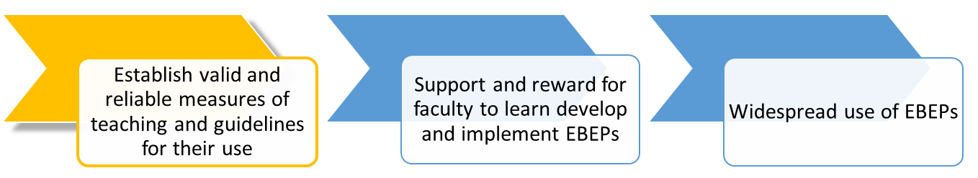
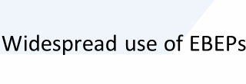
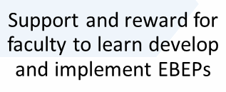
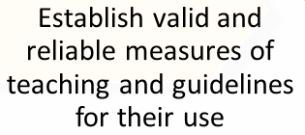
Changing Campus Incentives, Rewards, and Culture Work Group #3
Focus on Teaching Evaluation
Working Group Leads:
Noah Finkelstein, Mark Lee, Emily Miller, Barbara Schaal, Toby Smith
Notes:
Noah 4:20-4:25 Teaching Evaluation

Slide 13
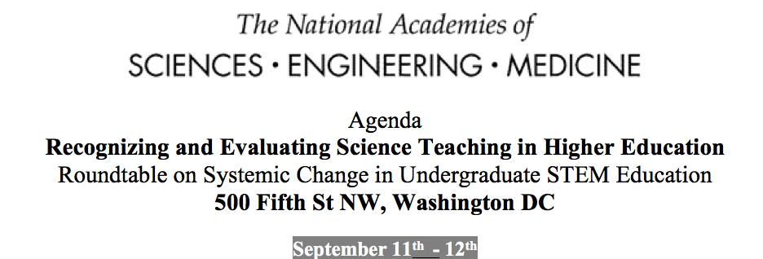
40 participants representing :
Breadth of higher ed, prof. societies & orgs.
Researchers on institutional change,
Scholars of faculty evaluation
Administrators, NASEM

Slide 14
Transforming Teaching Evaluation - Focus Workshop Goals:
Identify the breadth of approaches/practices/strategies
Identify shared goals across these efforts and explore strategies for addressing the common barriers to implement methods to use multiple sources of information to evaluate teaching.
Build a community among the early adopters that provides credibility and continued incentives for this work at the institutional level as well as a forum for the needed individual emotional support
Foundation for 1) public dissemination convocation (2020); and 2) the launch of a consensus study on Professional Standards for Teaching STEM in Higher Education that examines the existing evidence base
Notes:
Noah 4:20-4:25 Teaching Evaluation

Slide 15
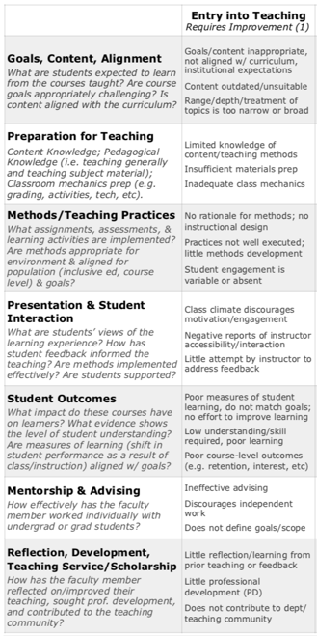

Use rubric for summative assessments
7 components of effective teaching
teaching narrative
Self-Study
Formative Assessment
self-reflection protocol
Tenure, Reappointment, Promotion Processes
teaching development sems
student evaluations
Student
Voice
solicited comments
Merit Process
classroom observations
Peer Review
Summative
Assessment
solicited outside review
Align multiple measures from
3 voices of assessment to rubric
.net

Slide 16
Significant Growth and Attention…
AAU, ASCN (Miller, Broussard)

Slide 17



Significant Growth and Attention…
Outcomes: Growing Network / Coordinating Taxonomy / Language
2020 National Convening (100+ institutions)
NSEC Jun Meeting, St. Louis

Slide 18
Meeting students where they are
Work Group #1
Ann Gates, Mary Heiss, John Lee, Patty Lopez, and Kyle Swanson
Consider variations in students’
Backgrounds
Pathways
Goals
Panel in September 2018 on Changes in the Learners:
Increased Variety of Students and Student Goals
Ryan Kelsey, Achieving the Dream
John Michael Lee, Elizabeth City State University
Lindsey Malcom-Piqueux, California Institute of Technology
Pablo Sacasa, Miami Dade College
Mica Estrada, University of California, San Francisco
Notes:
Kerry 4:25-4:30 Workforce

Slide 19
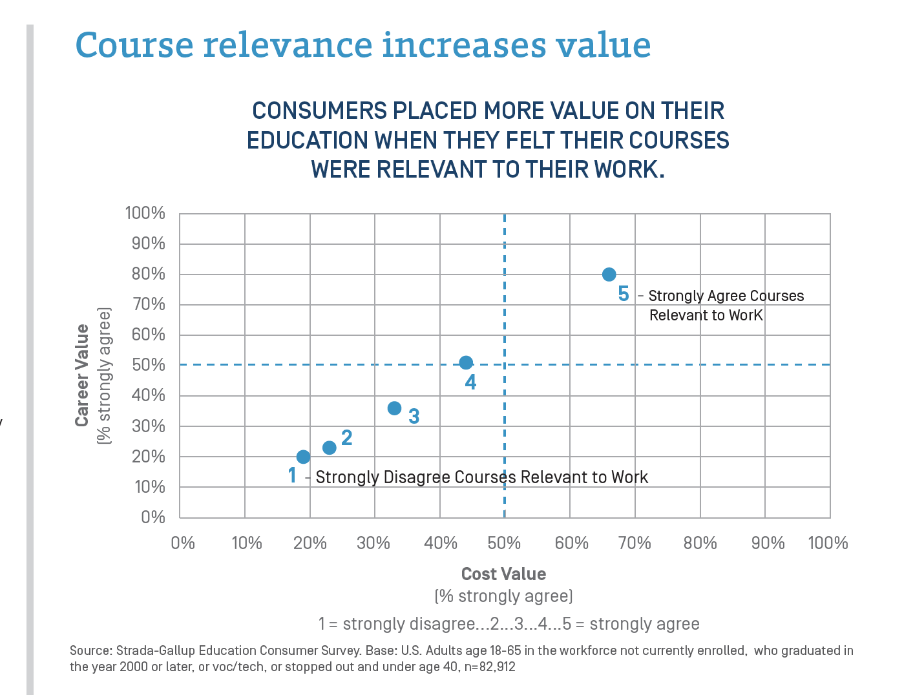
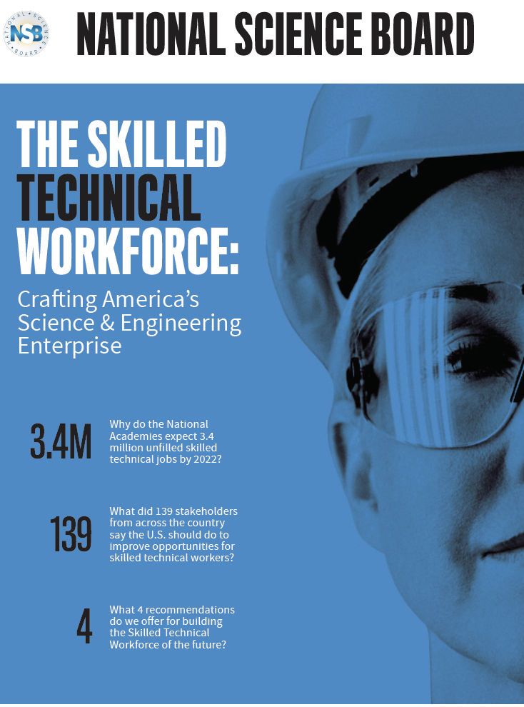
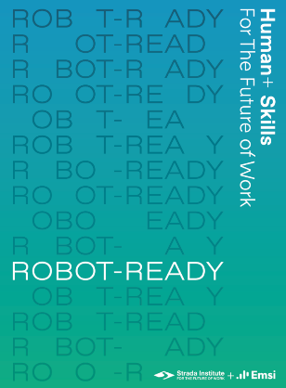
Workforce and STEM Education: Work Group #5
Susan Singer, Grace Suh, Levon Esters, and Collins Jones
Problem Statement: STEM related industries advance rapidly resulting in misalignment between educational preparation and workforce needs
Technical workforce
Often overlooked
Robust examples of
industry-academe partnerships
Humans + Skills
Deep disciplinary knowledge and skills
Work across disciplinary domains
Strong intrapersonal and interpersonal skills
Relevance
Enhances valuing of education (Strada, Education Value Equation)
Enhances student success (NASEM, Supporting Students’ College Success)

Slide 20
Roundtable Potential
Encourage synergistic partnerships through convening power
Bring together stakeholders who otherwise do not connect
Enhance academic and industry understanding of needs
Aligning both technical and interpersonal/intrapersonal skills development
Profile and share highly effective practices
Exchange of promising practices between 2-year and 4-year institutions
Enhance visibility and efficacy of multiple pathways into STEM careers
Role of credentialing and certificates
Increasing diversity and inclusion

Slide 21
Roundtable Contributions
Work to date: Panel with federal and industry stakeholders,
How are workforce needs changing?
What role can the roundtable play in helping higher ed navigate these changes and helping them to provide appropriate undergraduate STEM education to all students?
Allyson Knox, Senior Director of Education and Policy Programs, Microsoft
Cindy Hasselbring, Senior Policy Advisor, OSTP
Erik Noble, Senior Policy Advisor, OSTP
Dorn Carranza, Innovation & Industrial Partnerships, VentureWell
Moderator: Susan Singer, Rollins College
Next: Workshop with industry, academic, federal, and foundation stakeholders focused on innovative strategies for workplace-based education and upskilling, building upon NASEM consensus studies

Slide 22
Please ask questions in the chat about the Roundtable work on
Evidence-based instruction
Teaching Evaluation
Preparing the workforce of the future
Notes:
Noah 4:30-4:40 moderates a discussion across the three themes.

Slide 23
What will the Roundtable catalyze next?
Examining issues related to students, workforce, technology, changes in the academy
Priority areas
Impact of Technology
Access and Equity
Notes:
Ann- Big Picture Goals and Actions. Next Steps 4:40-4:45
Where the RT is going conceptually.

Slide 24
Upcoming Roundtable Activities
Teaching Evaluation
Summary of September working meeting-release this winter
Presentation at AAC&U Annual Meeting-January 2020
Webinar for ASCN on teaching evaluation work-March 24, 2020
Convocation planned for later in 2020
Planning for a Distributed Workshop on Inclusive Evidence-Based Instruction-Summer/Fall 2020
Other Upcoming NASEM Activities
Symposium on Imagining the Future of Undergraduate STEM Education-September 2020
Notes:
Ann- Big Picture Goals and Actions. Next Steps 4:40-4:45
In addition to continued effort by the work groups we have some specific presentations and events coming up.
Priority areas
Technology
Access and Equity

Slide 25
Your Thoughts
How do you envision undergraduate STEM education will look in 20 years?
Notes:
Input from participants 4:45-4:55
Have questions in reserve in case audience needs prompting:
1 What are your thoughts about how workplace needs will impact undergraduate STEM education?
2 Where will learning take place?
3 How will technology change education?

Slide 26
Information about BOSE & BOSE projects including the Roundtable: http://nas.edu/BOSE Ideas or suggestions kbrenner@nas.edu
Notes:
4:55
Webinar evaluation from ASCN last few minutes

